Slide 1
Joint Mathematics Meetings 2017
Teaching and Learning of Undergraduate Ordinary Differential Equations, I
10:20 AM Friday, 6 January 2017
Marriott Marquis, A702 Atrium Level
Stay Tuned
Modeling in Differential Equations Courses
Brian Winkel, PROF Emeritus,
United States Military Academy
West Point NY USA
Director SIMIODE
Brian@simiode.org www.simiode.org

Slide 2
Invitation to Publish Your Ideas and Practices
Presenters and YOU are encouraged to submit your article for consideration in special issue of PRIMUS .
“A Modeling First Approach to Teaching Differential Equations”
Edited by
Chris McCarthy, Borough of Manhattan Community College,
New York NY
Brian Winkel, SIMIODE, Cornwall NY
Ellen Swanson, Centre College, Danville KY
Contact: BrianWinkel@SIMIODE.com

Slide 3
All materials mentioned in this talk are available here.

Slide 4
Modeling motivates learning differential equations
(1) Audio Output
(2) Tuned Mass Dampers to keep structures from
destructive displacements in the presence of
earthquakes, tremors, and wind forces
(3) Radio Tuning of an electrical circuit

Slide 8
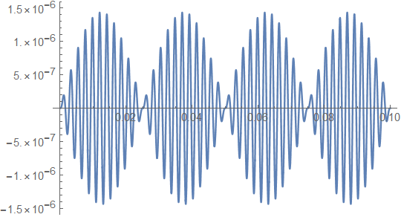

Slide 9
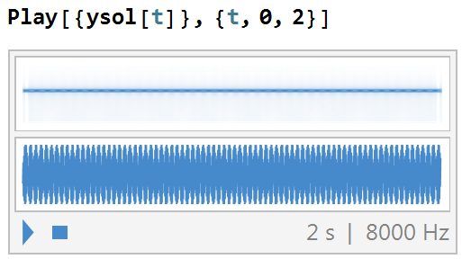

Slide 10
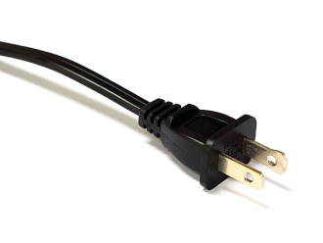
Shameless
For Talk from Civil Engineer on Tuned Mass Dampers
Saturday January 7, 2017 AMS Special Session on The Modeling First Approach to
Teaching Differential Equations A601, Atrium Level, Marriott Marquis
10:30 a.m. Modeling in an Engineering Mathematics Class
Tuned Mass Dampers Keith A Landry, Georgia Southern University

Slide 11
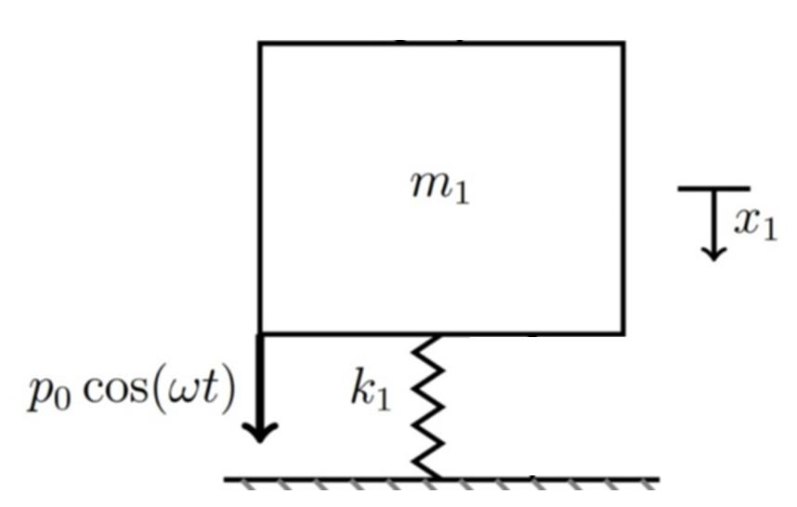
Single Degree of Freedom (SDOF)
Pure Oscillator
with driver function

Slide 12
Single Degree of Freedom (SDOF)
Pure Oscillator
with driver function
Free Body Diagram

Slide 13
Single Degree of Freedom (SDOF)
Pure Oscillator
with driver function
Free Body Diagram

Slide 14
Single Degree of Freedom (SDOF)
Pure Oscillator
with driver function
Free Body Diagram
Denominator could spell T-R-O-U-B-L-E. Indeed . . . .

Slide 15
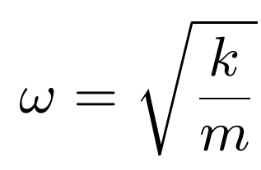
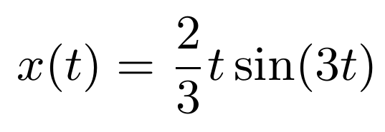
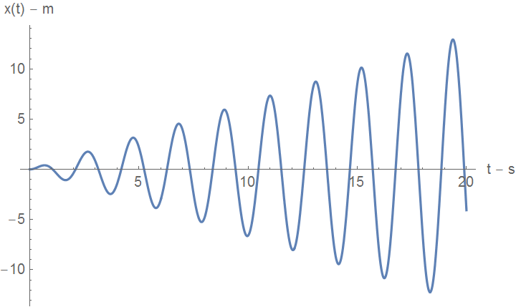
If
we have resonance.
m = 1 kg, k = 9 N/m, p₀ = 4 N,
with
= 3
“t” is how you spell T-R-O-U-B-L-E.
This is what
T-R-O-U-B-L-E
looks like!

Slide 16
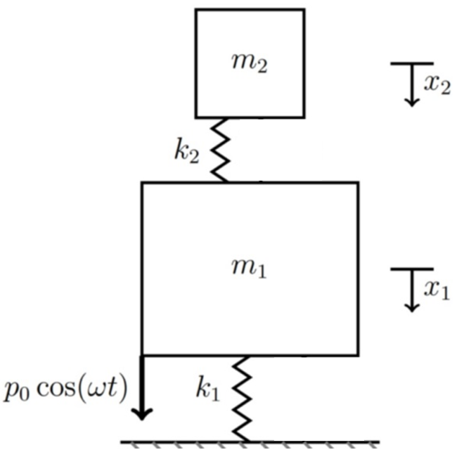
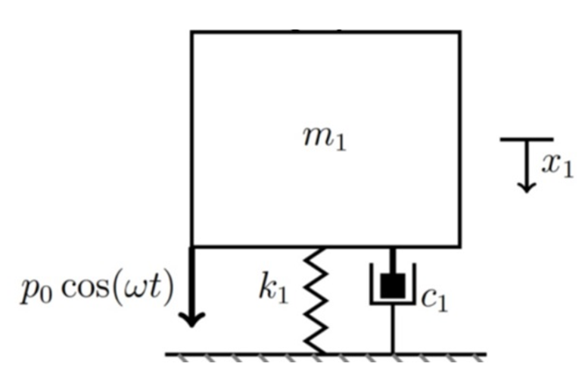
Options to mitigate resonance
Put damper in the spring mass system
Add another spring mass.

Slide 17
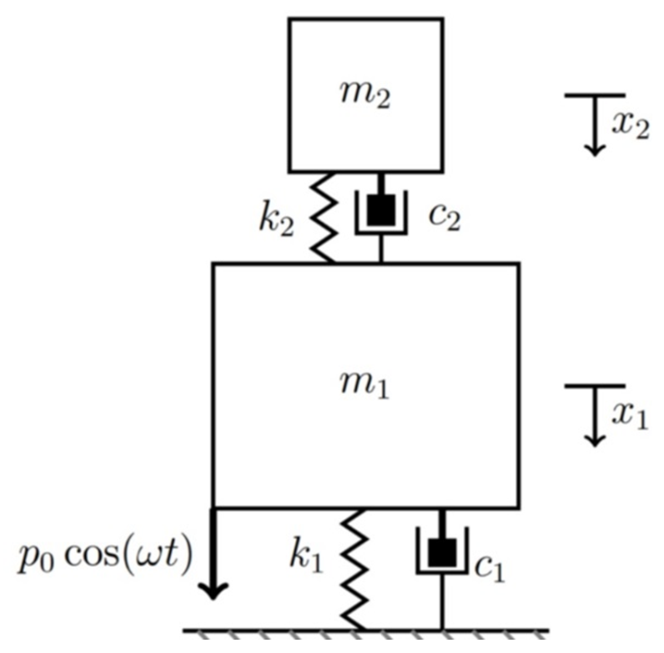
Put damper in the spring mass system
leads to damped mass. Realistic.
Add another spring mass leads to
system of spring masses.
We could do both, i.e.
add damper
AND
add second spring mass.
But not yet.

Slide 18
Add another spring mass.
Free Body Diagram
At rest. . .

Slide 19
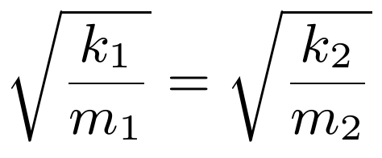
Tuned Mass Damper
Add another spring mass – but tune it to same frequency.
Free Body Diagram
At rest. . .

Slide 20
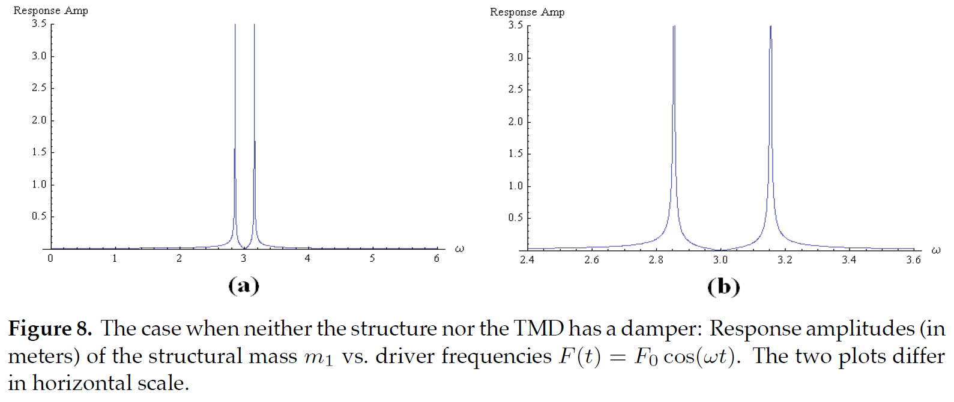
We can obtain the amplitude of the steady state solution
as a function of input frequency ω.
Large mass TMD
Small mass TMD

Slide 21
Return to just damper solution

Slide 22
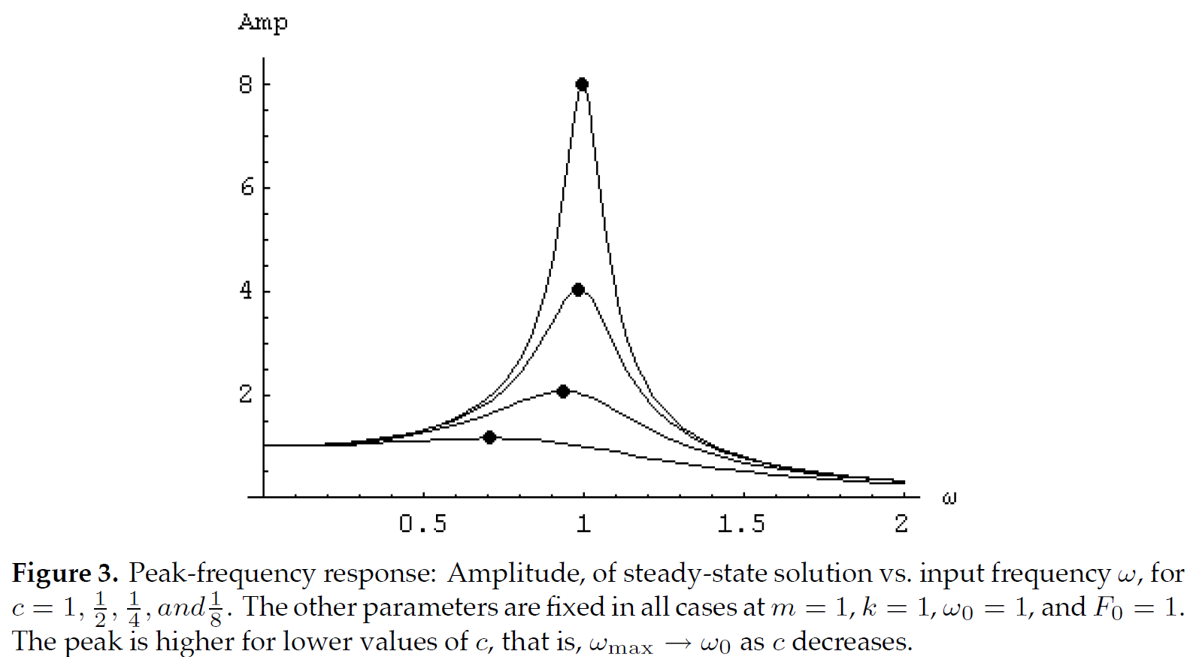

Slide 23
What if only the tuned mass has damping,
i.e. if c₁ is 0, but c₂ is not 0?

Slide 24
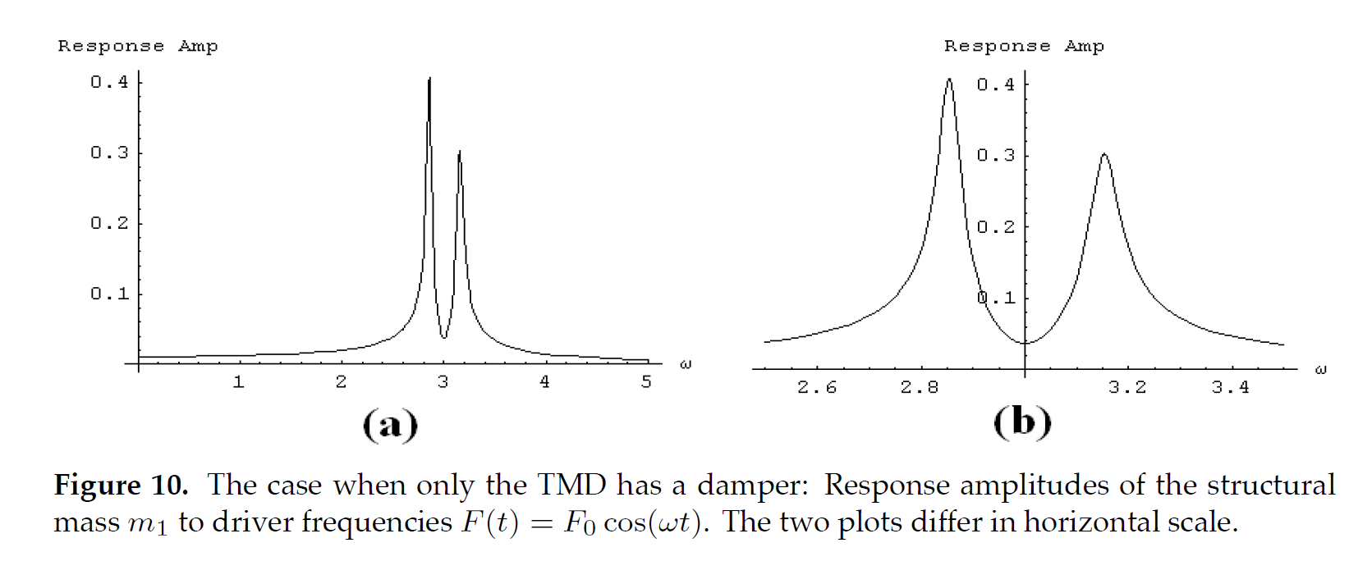

Slide 25
Give this a try. What might you expect?

Slide 26
An aside MAA MiniCourse #13
Teaching Modeling-First Differential Equations
Technology and Complete End Game Efforts
Second Session
1:00 – 3:00 PM 7 Jan 2017
Marriott Marquis L506-507 Lobby Level
Walk in . . . join us.

Slide 27
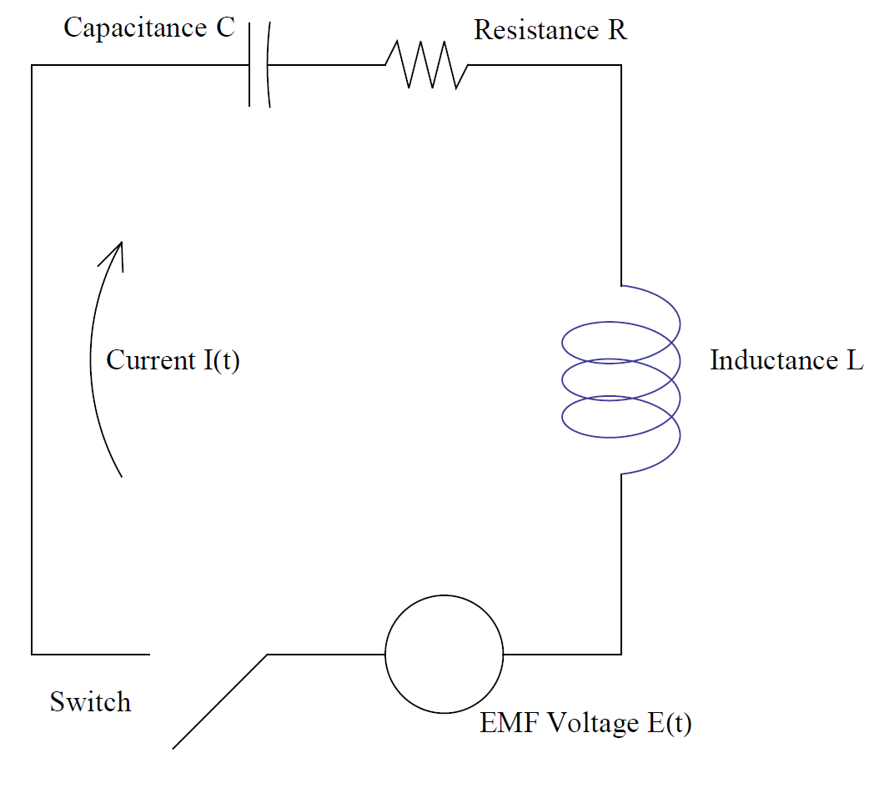
Staying tuned

Slide 28
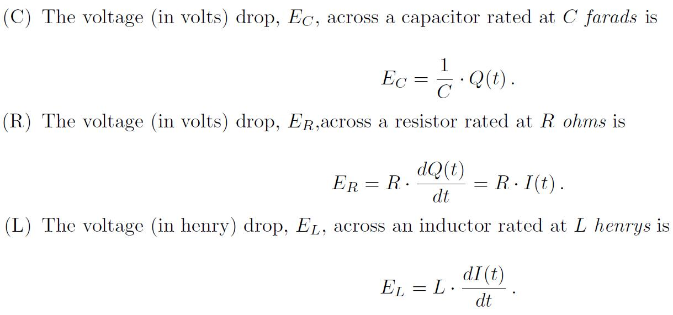
Kirchhoff’s Voltage Law says that the sum of the voltages
in a circuit is equal to that of the induced voltage, Emf(t).
Here Q(t) is charge and I(t) = Q’(t) is current.

Slide 29
Differentiate both sides. . .
. . . and rearrange.

Slide 30
Input voltage Emf(t) yields
circuit differential equation
with y(t) = I(t).
As with spring mass systems we can study amplitude
response of current to frequency of input voltage.
Further one can then compute Gain, i.e., ratio of the
amplitude of the steady state output voltage to the
amplitude of the input voltage.

Slide 31
We note amplitude of input voltage Emf(t) = sin(ω t) is 1.
Thus gain IS the amplitude of the steady state solution.
Suppose L and R are fixed and we can vary capacitance C.
Then for given input frequency (presumably from the
“ether” as a radio broadcast signal) we can find C which
maximizes gain.

Slide 32
That is exactly what we do in radio tuner.
We tune by finding C which maximizes gain.

Slide 33
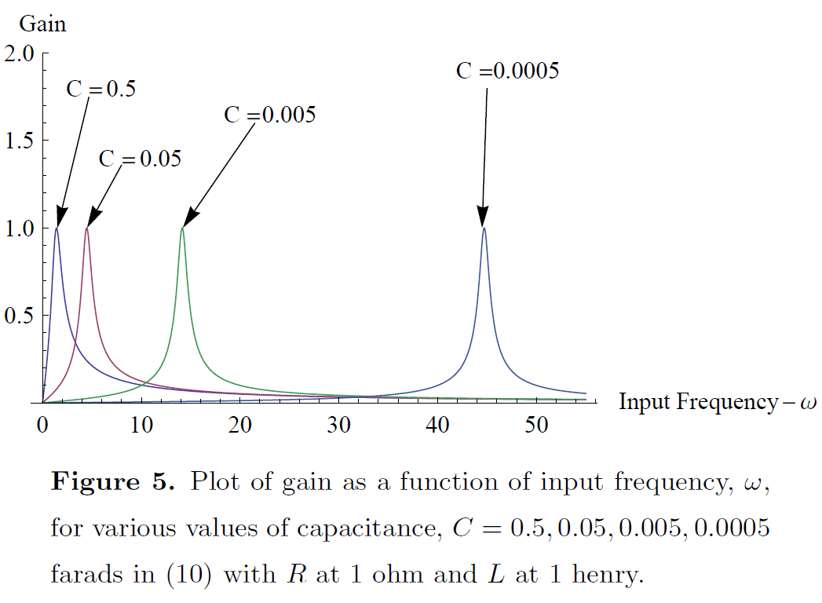

Slide 34
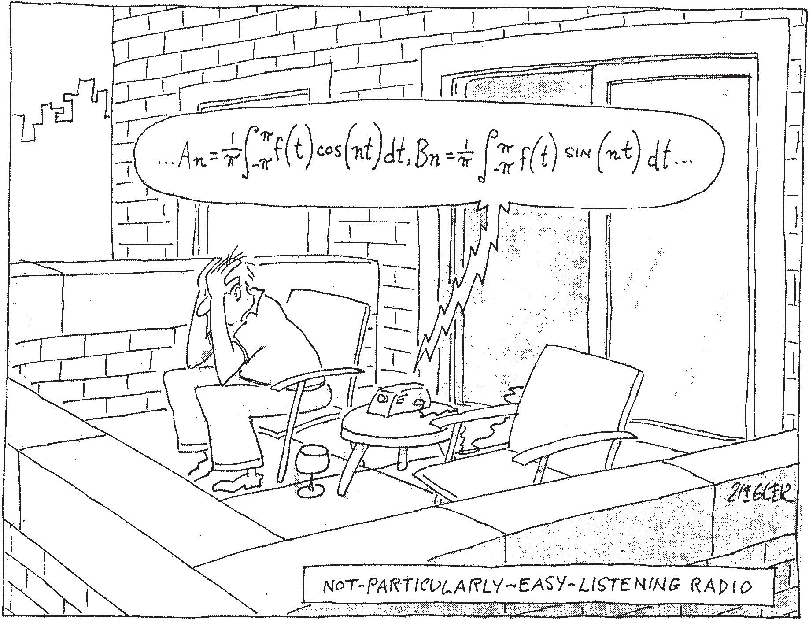
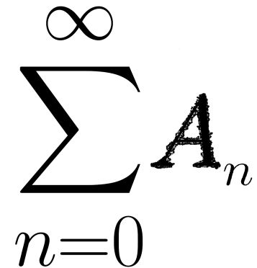
Not all work. . . not all fun. . . building for modeling-first differential equations
These images
are related!

Slide 36
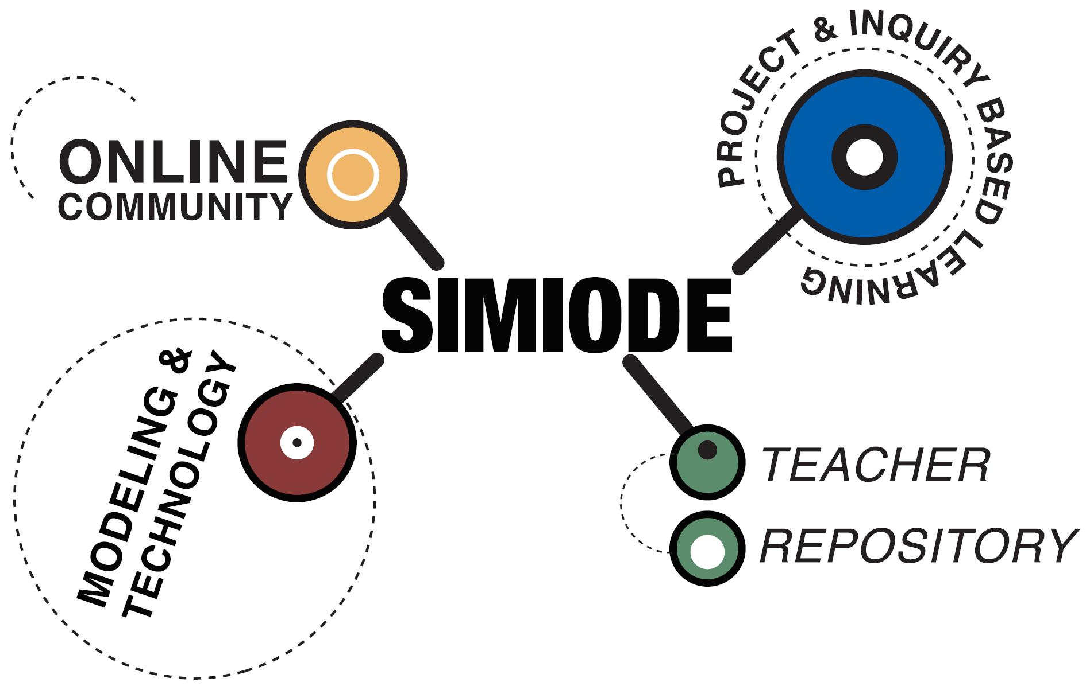

Slide 37
Come join us at SIMIODE
and bring your students.

Slide 39
Thank you for engaging.

