Slide 1
Bringing the Differential Equations Course into the 21st Century With a Computer Algebra System and a Modeling First Approach.
JMM 2017
Patrice Geary Tiffany
Rosemary Carroll Farley
patrice.tiffany@manhattan.edu
rosemary.farley@manhattan.edu

Slide 2
The 3 elements of a perfect storm at our institution:
Modeling first approach and material available through
SIMIODE.
Our experience using technology in the calculus classroom. It was natural to continue its use in DE.
The CUPM Guidelines that say that with technology, modeling problems that were previously inaccessible become accessible.

Slide 3
What we decided to do:
Adopt and adapt a modeling first approach in our
differential equations classes.
Hold one of three 50 minute classes each week
in a computer lab where we do modeling first.

Slide 4
What we do:
Break the class into groups.
Give students time to think and make mistakes.
Ask questions when appropriate.
Answer a question with question.
Encourage the students to speak mathematically.
Give them code when they need it—If you tell me
what you want to do, I will give you the code to do it.

Slide 5
The use of technology enhances this modeling first approach
Students are no longer limited to exploring modeling problems that are solved by hand.
The appropriate technological tool can encourage students to hypothesize and experiment.
A computer algebra system allows students to analyze their solutions, and easily readjust their hypothesis if a particular graph or solution makes no sense.
As a multipart problem gets more complicated, a simple copy and paste allows students to recognize both differences and commonalities. This is a powerful mathematical idea.

Slide 6
The Boarding School Problem
A student carrying a flu virus returns to an isolated
college campus of 1000 students.
After 4 days, 50 students are infected.
How many students are infected after 6 days?
Find a function describing the number of infected students.
Plot the function and analyze the plot.

Slide 7
FROM DISEASE SPREAD--SIMIODE:
If in a population of size 1000 we have x(t) members
who have a communicable disease and can spread it upon
contact with susceptible members of which there are
(1000 −x(t)) then a possible model for the rate of the spread
of the disease could be the logistic equation:
x'(t) = k x(t) (1000 - x(t))
where the product x(t) ∗ (1000 − x(t)) represents the
number of interactions that could take place per unit time
and k is a constant which reflects just how many interactions
take place AND how many result in the spread of the disease.

Slide 9
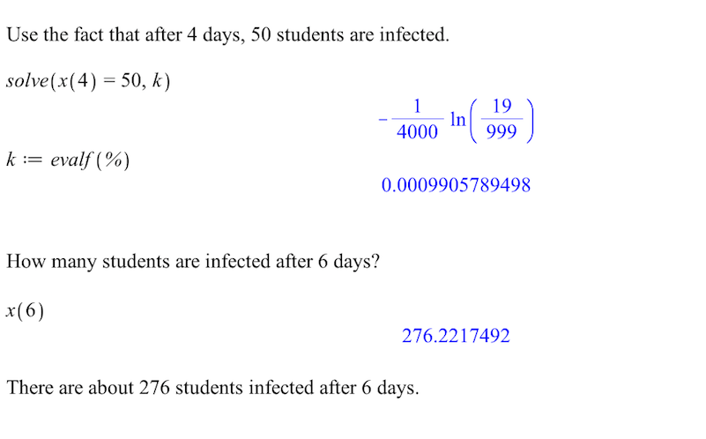

Slide 10
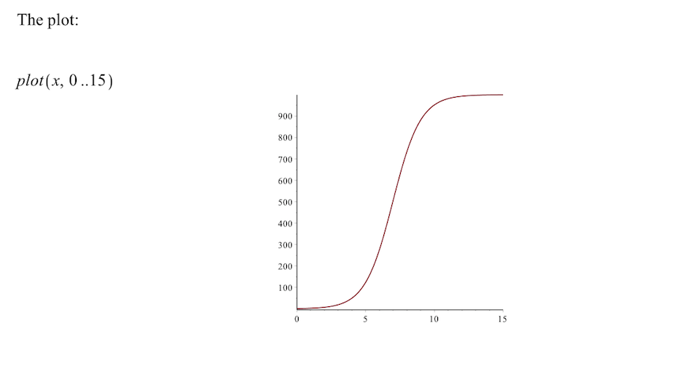
Certainly all 1000 students will eventually get sick with this model. Students
talk about the speed with which people get sick.

Slide 11
Predator-Prey: Blue Whales and Krill:
Abstract:
Students will use Excel to observe qualitative behavior in a simulation of a predator-prey model, with blue whales and krill as the predator and prey populations, respectively.
Students are asked to explain terms in the system of differential equations, compute population values using
iteration without a spreadsheet. Then they will implement the simulation in Excel and create charts to observe qualitative behavior.
Lydia Kennedy (2016), "6-25-T-WhalesAndKrill,”
https://www.simiode.org/resources/1498.

Slide 12
“One of the favorite foods of the blue whale is krill. Blue whales are baleen whales and feed almost exclusively on krill. These tiny shrimp-like creatures are devoured in massive amounts to provide the principal food source for the huge whales. In the absence of predators, in uncrowded conditions, the krill population density grows at a rate of 25% per year. The presence of 500 tons/acre of krill increases the blue whale population growth rate by 2% per year, and the presence of 150,000 blue whales decreases krill growth rate by 10% per year. The population of blue whales decreases at a rate of 5% per year in the absence of krill. “

Slide 13
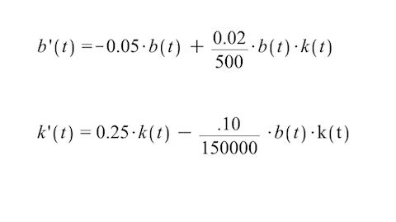
These assumptions yield a pair of differential equations
(a Lotka-Volterra model) that describe the population of the
blue whales (b) and the krill population density (k)
over time given by:

Slide 14
Time in years | Blue Whale Population | Krill population in tons per acre
0 | 75000 | 150.0000000
1 | 71700 | 180.0000000
2 | 68631.24 | 216.3960000
3 | 65793.73903 | 260.5939828
4 | 63189.87018 | 314.3121768
5 | 60824.8305 | 379.6493239
6 | 58707.2732 | 459.1669177
7 | 56850.16705 | 555.9876887
8 | 55271.97842 | 673.9126156
9 | 53998.31884 | 817.5584471
10 | 53064.27416 | 992.5168711

Slide 15
Blue Whale Population | Krill population in tons per acre
75000 | 150
=B2-0.05*B2+(0.02/500)*B2*C2 | =C2+0.25*C2-(0.1/150000)*B2*C2
=B3-0.05*B3+(0.02/500)*B3*C3 | =C3+0.25*C3-(0.1/150000)*B3*C3
=B4-0.05*B4+(0.02/500)*B4*C4 | =C4+0.25*C4-(0.1/150000)*B4*C4
=B5-0.05*B5+(0.02/500)*B5*C5 | =C5+0.25*C5-(0.1/150000)*B5*C5
=B6-0.05*B6+(0.02/500)*B6*C6 | =C6+0.25*C6-(0.1/150000)*B6*C6

Slide 16
Time in years | Blue Whale Population | Krill population in tons per acre
29 | 1460198.315 | 3878.7851122
30 | 1613740.218 | 1072.6177342
31 | 1602290.263 | 186.8212500
32 | 1534149.424 | 33.9653160
33 | 1459526.268 | 7.7180650
34 | 1387000.543 | 2.1377689
35 | 1317769.119 | 0.6954867
36 | 1251917.323 | 0.2583644
37 | 1189334.395 | 0.1073216
38 | 1129872.781 | 0.0490578

Slide 17
Time in years | Blue Whale Population | Krill population in tons per acre
91 | 74538.94581 | 0.0060056
92 | 70812.01642 | 0.0072085
93 | 67271.43602 | 0.0086703
94 | 63907.88755 | 0.0104491
95 | 60712.51988 | 0.0126162
96 | 57676.92453 | 0.0152596
97 | 54793.1135 | 0.0184877
98 | 52053.49835 | 0.0224343
99 | 49450.87014 | 0.0272643
100 | 46978.38057 | 0.0331816

Slide 18
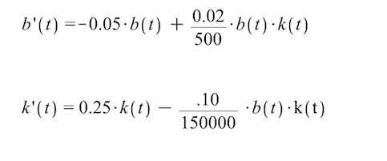
We will not ask Maple to solve this system of differential equations.
Rather, we will let Maple plot the direction field and a particular
solution for certain initial conditions.
Let's again assume that the initial amount blue whale population
is 75,000 and the krill population (in tons per acre) is 150.

Slide 19
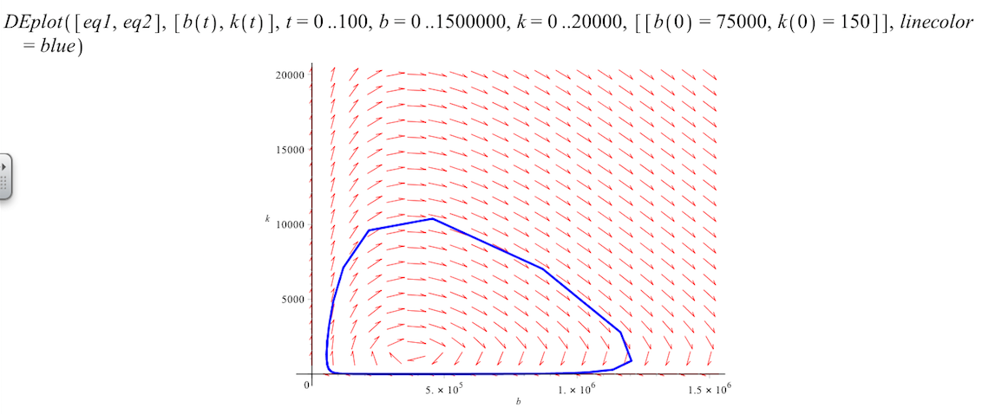

Slide 20
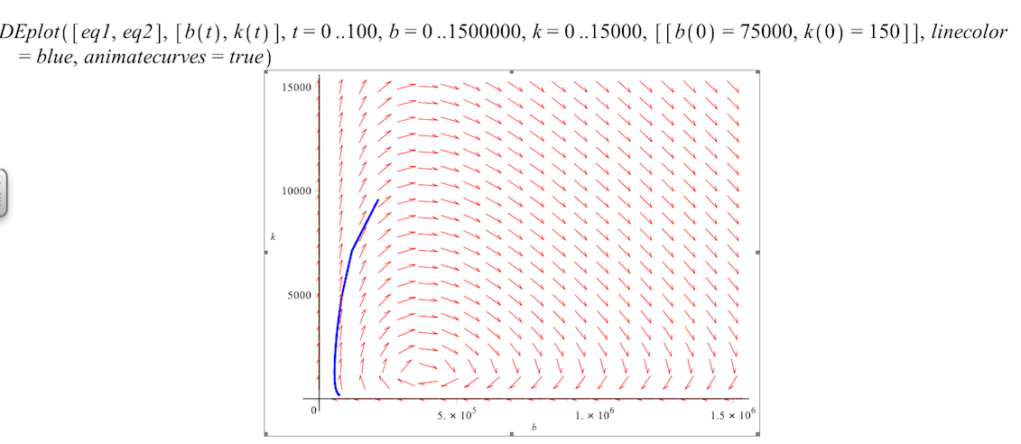

Slide 21
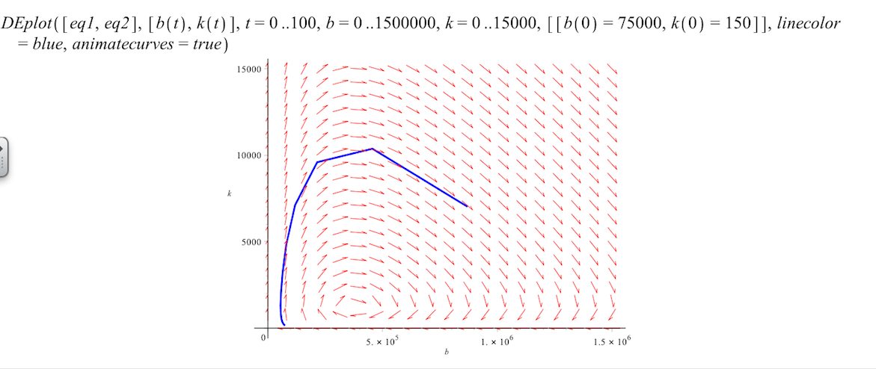

Slide 22
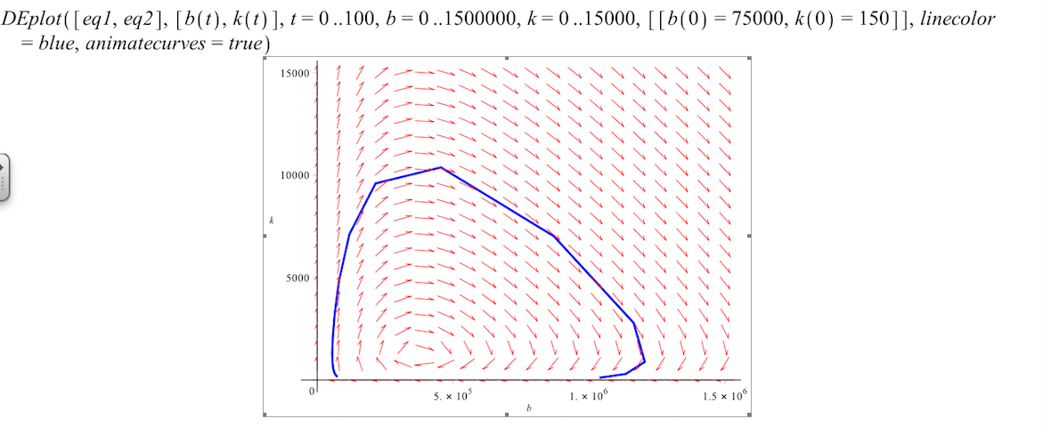

Slide 24
Parting Words:
Getting started with the modeling first approach is much easier with the support of the SIMIODE community.
The use of technology encourages students to hypothesize, experiment, analyze their solutions, and if necessary readjust their hypothesis and try again--without frustration! And students really like answers.
Csas
Sss

Slide 25
Thanks!
Feel free to contact us at:
patrice.tiffany@manhattan.edu
rosemary.farley@manhattan.edu

