Slide 1
MATH
BOWL
∑
±
∂
∫
÷
∞
At SCUDEM

Slide 2
Rounds for Today’s Competition
An Ode to ODE in Math
Bad Movie Math
Punny Math
Mathematical Team Names

Slide 3

Round 1:
An Ode to ODE in Math
ODE
The answer to each question is a math term which contains “ode” in its spelling.

Slide 4
SAMPLE QUESTION:
The “M” in SCUDEM stands for this.
ANSWER: modeling
ODE

Slide 5
Round 1, Question 1
A fixed point on a phase portrait could be a stable, unstable or saddle this.
ODE

Slide 6
Round 1, Question 2
One of the three measures of central tendency is this.
ODE

Slide 7
Round 1, Question 3
The enigma machine could do this to a message.
ODE

Slide 8
Round 1, Question 4
In geometry, this is the shortest path between two points.
ODE

Slide 9
Round 1, Question 5
A regular polyhedron with twelve faces is called this.
ODE

Slide 10

Round 2:
Bad Movie Math
Each question will be a quote from a movie that is mathematically inaccurate, either intentionally or by accident. You must identify the movie the quote is from.

Slide 11
SAMPLE QUESTION:
James Bond: “How far is that rig from the terminal? And how fast is it travelling?”
Technician: “It’s 106 miles from the terminal going 70 miles and hour.”
James Bond: “We’ve got 78 minutes.”
ANSWER: The World Is Not Enough

Slide 12
Round 2, Question 1
Scarecrow: “The sum of the square roots of any two sides of an isosceles triangle is equal to the square root of the remaining side.”

Slide 13
Round 2, Question 2
Pongo: “Everybody here? All fifteen?”
Patch: “Twice that many, Dad. Now there’s 99 of us!”

Slide 14
Round 2, Question 3
Hazel Grace Lancaster: “There are infinite numbers between 0 and 1. There's .1 and .12 and .112 and an infinite collection of others. Of course, there is a bigger infinite set of numbers between 0 and 2, or between 0 and a million.”

Slide 15
Round 2, Question 4
Einstein Bobblehead: “Don’t you get it, kid? You’re looking for the secret number at the heart of the pyramids!”
Amelia Earhart: “Well, whistle me Dixie, the answer’s pi!”
Larry Daley: “Pi?”
Einstein Bobblehead: “Three point one four one five nine two six five to be exact!”

Slide 16
Round 2, Question 5
Aaron Samuels: “It’s a factorial, so you multiply each one by n.”
Cady Heron: (thinking) Wrong.
“Is that the summation?”
Aaron Samuels: “Yeah, they’re the same thing.”
Cady Heron: (thinking) Wrong, he was so wrong.
“Thanks, I, uh, I get it now.”

Slide 17
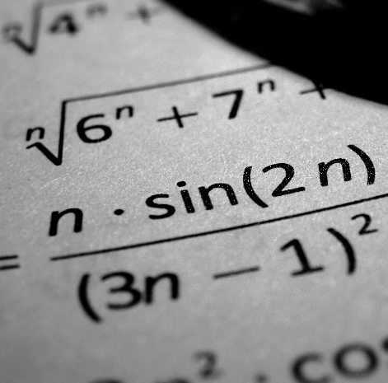
Round 3:
Punny Math
Math Puns are the first sine of madness
The answer to each question is a math pun!

Slide 18
SAMPLE QUESTION:
What comment did the geometer make when asked about the four angles formed at the intersection of two perpendicular lines that a student had drawn?
ANSWER: They looked “all right” to her.
Math Puns are the first sine of madness

Slide 19

Round 3, Question 1
Why is the function $y=e^{x}$ never grumpy, upset, or pessimistic?
Math Puns are the first sine of madness

Slide 20
Round 3, Question 2
How would a real mathematician describe her relationship with her imaginary friend?
Math Puns are the first sine of madness

Slide 21
Round 3, Question 3
Why could the atheist solve linear equations but didn’t understand quadratic ones?
Math Puns are the first sine of madness

Slide 22
Round 3, Question 4
If you are playing Tic-Tac-Toe and switch which letters you are playing, who does your opponent become?
Math Puns are the first sine of madness

Slide 23

Round 3, Question 5
For the student who was so bad at math, the expression $2n+3n$ was this to him.
Math Puns are the first sine of madness

Slide 24
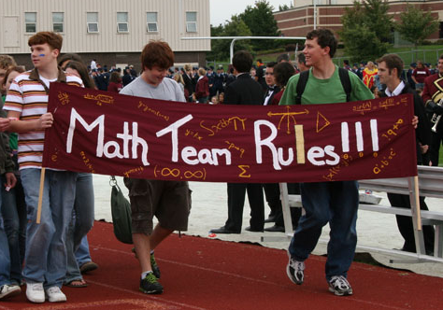
Round 4:
Mathematical Team Names
Each hint is both about the name of a professional sports team AND a mathematical concept. Use the hint to find the name of the mathematical concept.

Slide 25
SAMPLE QUESTION:
An attempt to determine from a mixed group of people who are athletes from the US Military Academy and who are imposters would be this type of puzzle.
ANSWER: (Black) Knights and Knaves

Slide 26

Round 4, Question 1
“Lebron James plus Dwanye Wade plus Chris Bosh equal the Big Three” could be an example of this.

Slide 27
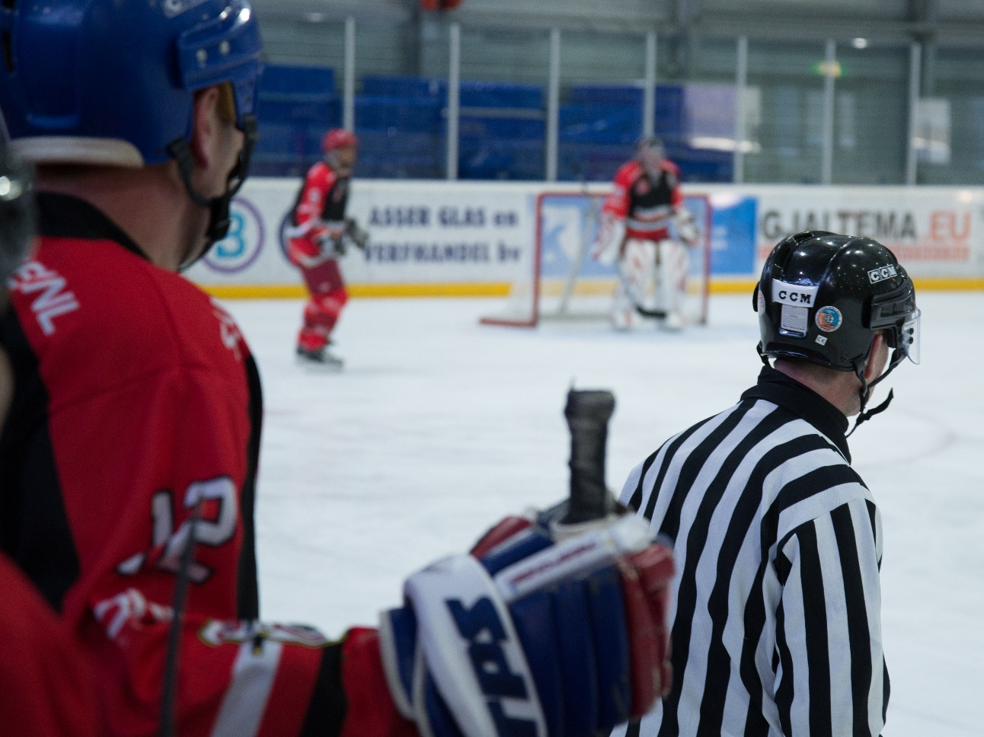
Round 4, Question 2
A question asking you to compare the goal scoring efficiency of Nashville’s hockey team to their frequency of appealing to a higher deity would be this.

Slide 28
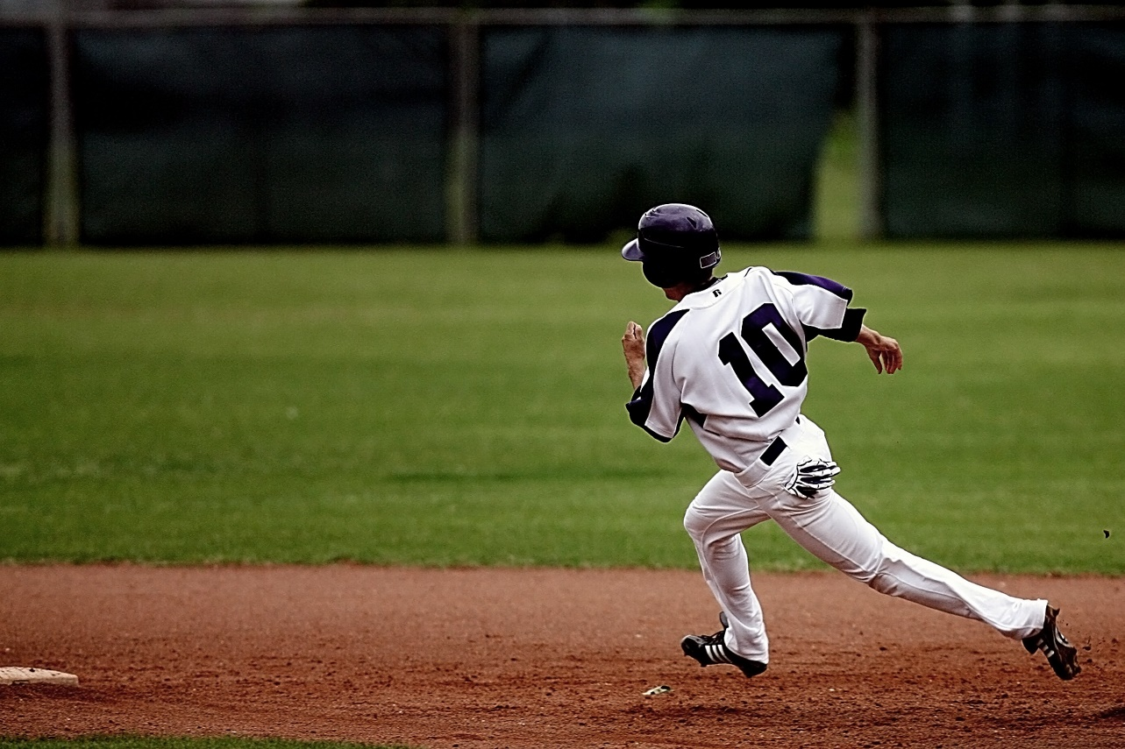
Round 4, Question 3
Your best guess as to which numbers are both worn by Minnesota professional major league baseball players and are non-factorable would be this.

Slide 29
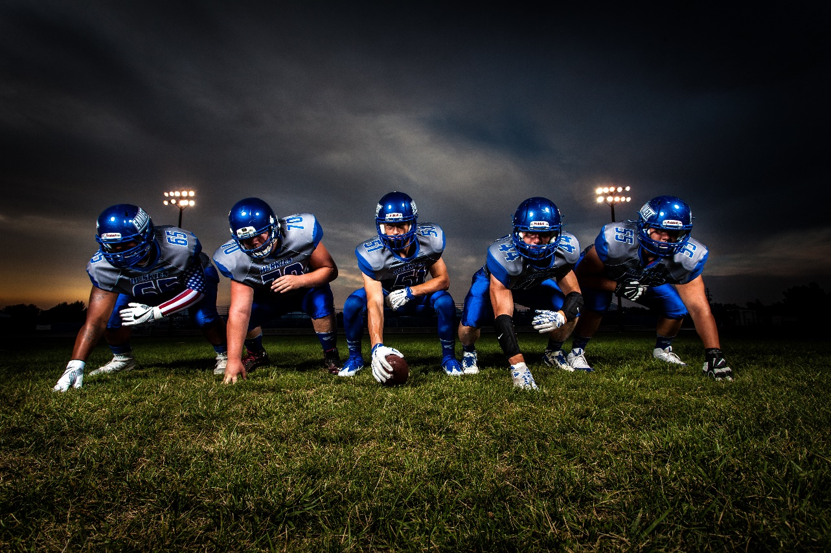
Round 4, Question 4
The journey undertaken by the former NFL Houston team as they moved to Tennessee before they became the Titans would be this.

Slide 30
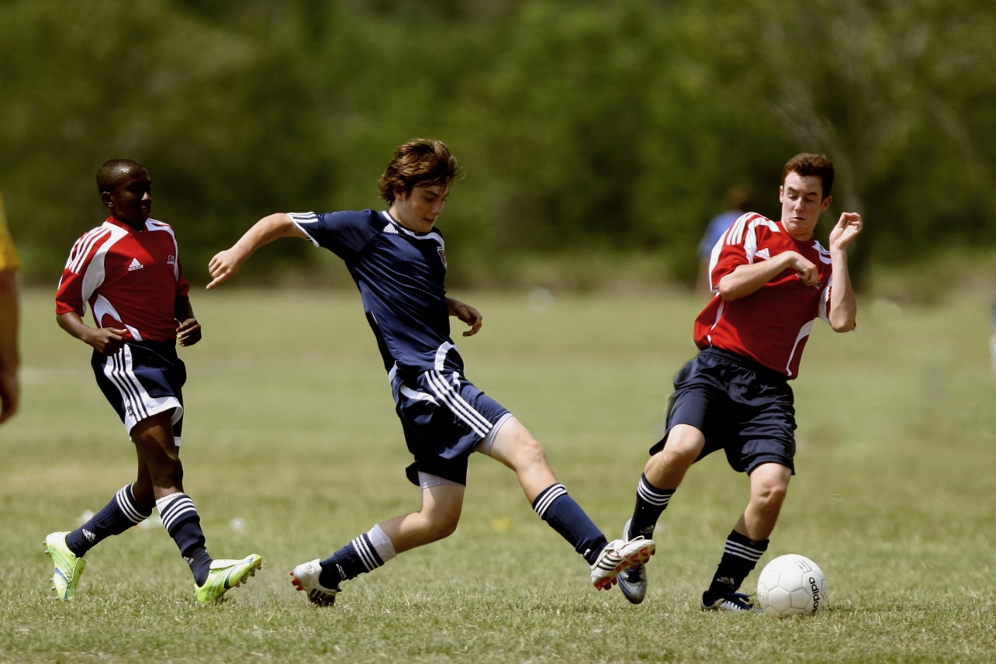
Round 4, Question 5
An in-depth examination of Salt Lake’s Major League Soccer team could be described as this.

Slide 31
TIEBREAKER
As of August 2017, the largest known prime is how many digits long?

Slide 32
Thanks For Playing!!!
±
∑
∂
∞
∫
÷
MATH
BOWL
At SCUDEM
Math Puns are the first sine of madness
ODE

Slide 33
Pictures All Used Under Creative Commons License
https://www.pexels.com/photo/addition-board-chalk-close-up-374916/
https://www.pexels.com/photo/action-backboard-ball-basketball-358042/
https://www.pexels.com/photo/hockey-players-on-rink-63897/
https://www.pexels.com/photo/baseball-player-running-on-court-209864/
https://www.pexels.com/photo/football-players-in-blue-jersey-lined-under-grey-white-cloudy-sky-during-sunset-186076/
https://www.pexels.com/photo/action-athletes-ball-blur-274422/
https://www.pexels.com/photo/mathematical-formula-74228/
https://en.wikipedia.org/wiki/File:Lths_Math_team_06-07.jpg

