Slide 1
SIMIODE Sponsored
SCUDEM 2017
Student Competition Using Differential Equation Modeling
14 October 2017
Mount Saint Mary College Newburgh NY USA

Slide 2
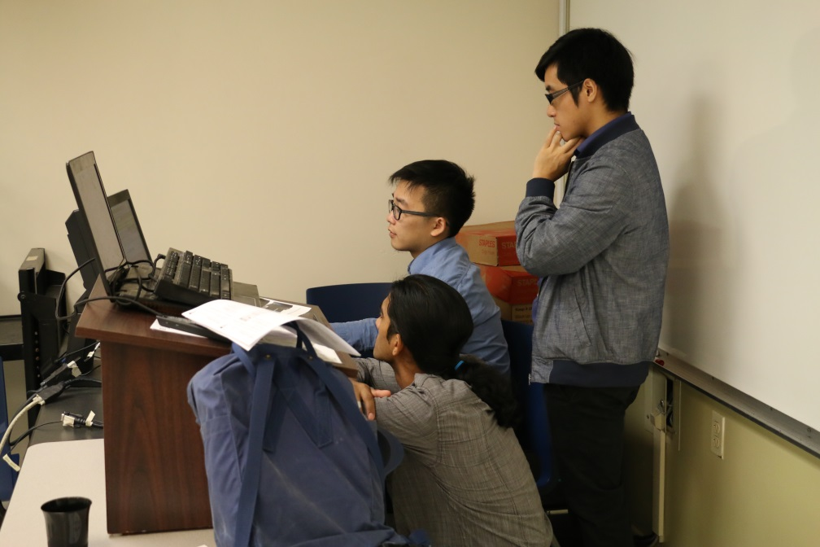
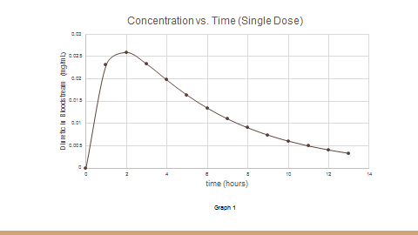
On Monday morning, 9 October 2017, at their home institutions
student teams selected one of three problems on which to work:
Problem A Going Viral
Problem B Drug Interactions
Problem C Game Play

Slide 3
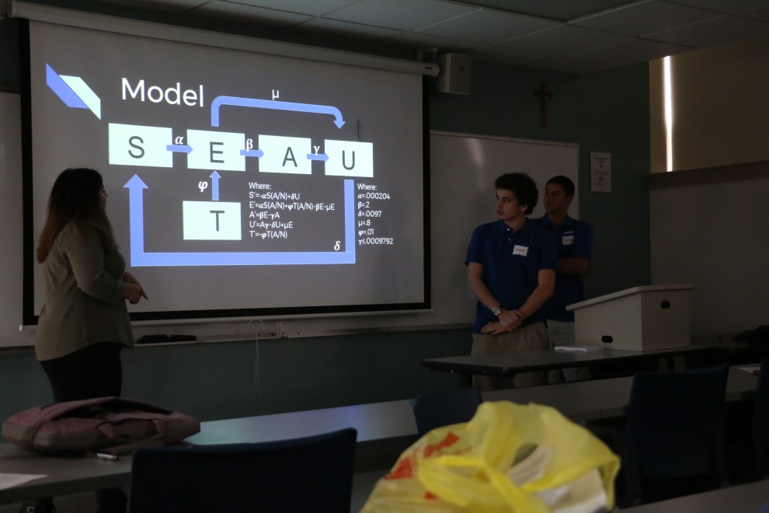
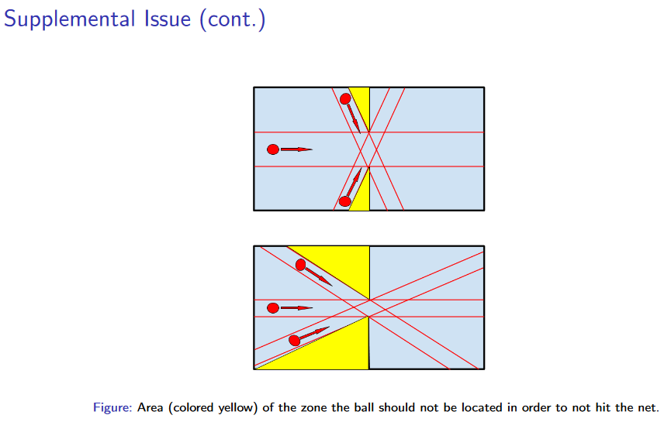
Competition Saturday was
14 October 2017 at local site, Mount Saint Mary College, Newburgh NY USA.
Students incorporated an additional issue into their
model and presented results.

Slide 4
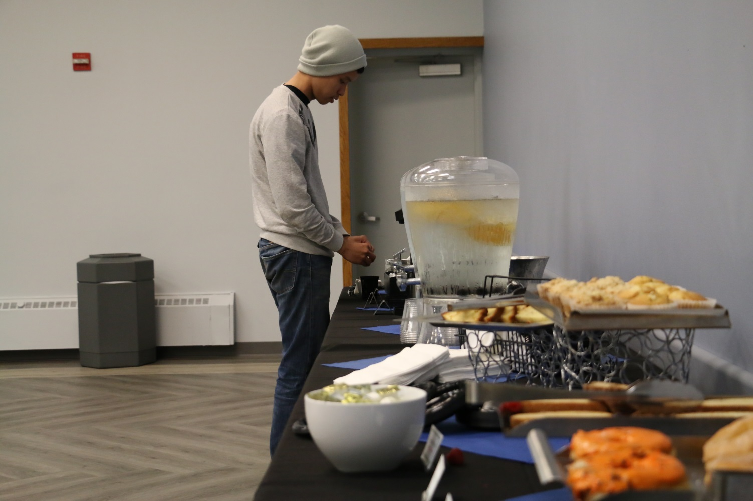
Welcome refreshments after early morning journey
from home school to host site school
Mount Saint Mary College, Newburgh NY USA

Slide 5
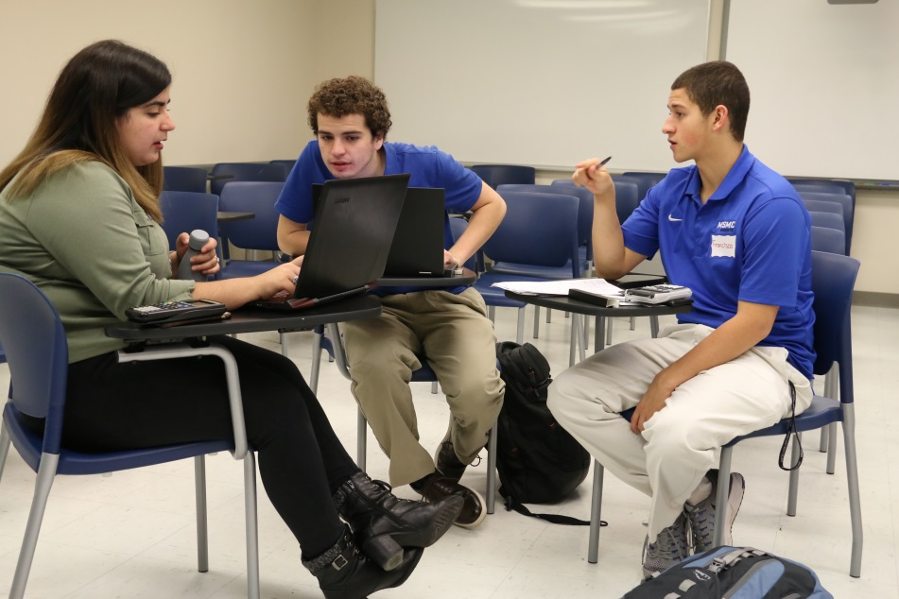
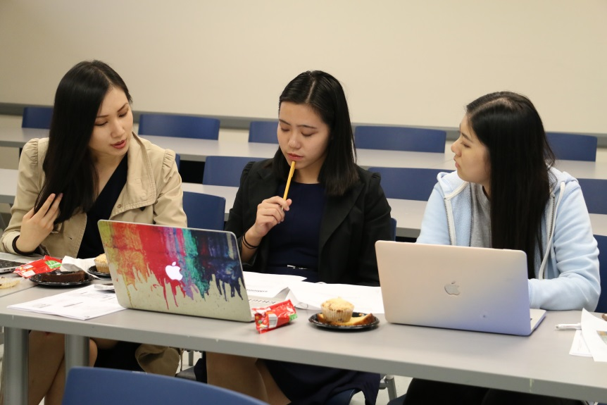
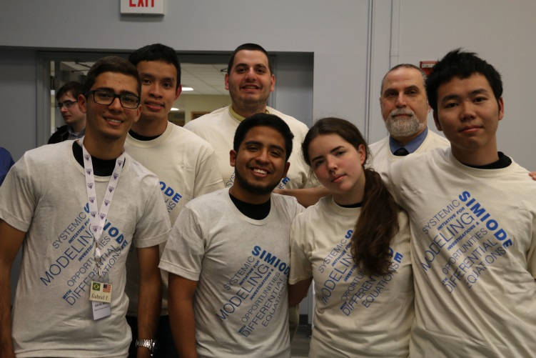
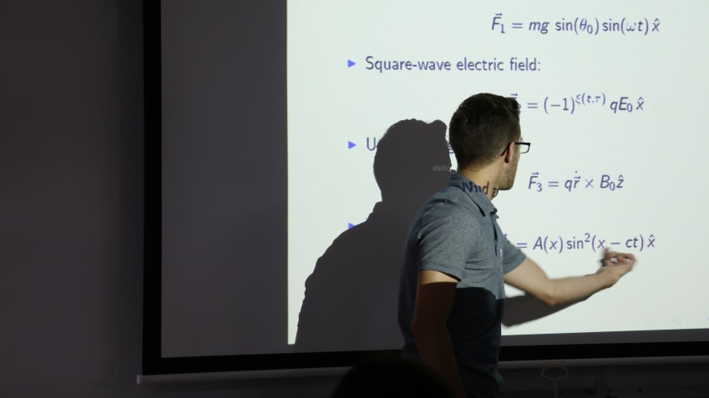
Students had a great time doing,
talking about, and presenting
mathematical modeling with
differential equations.

Slide 6
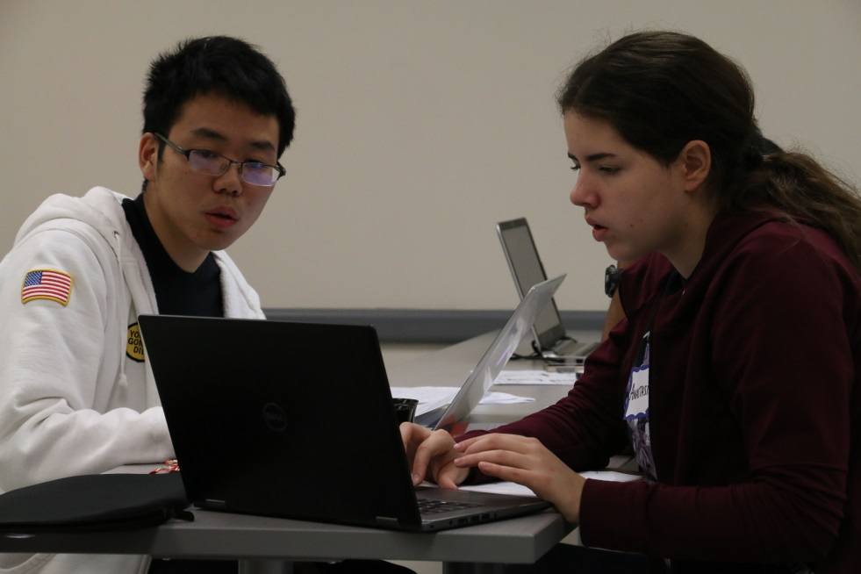
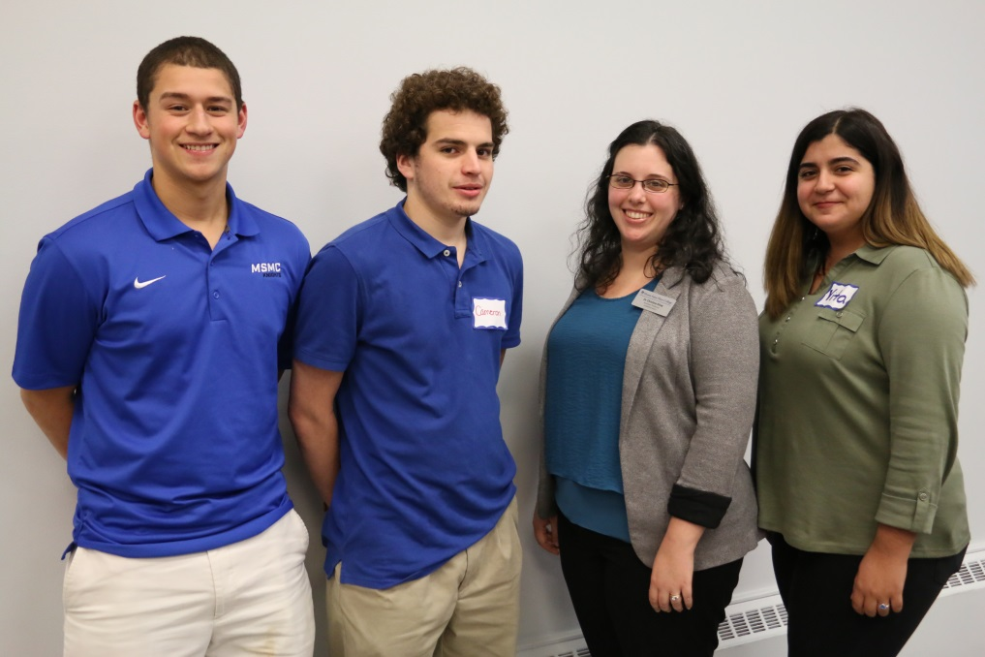
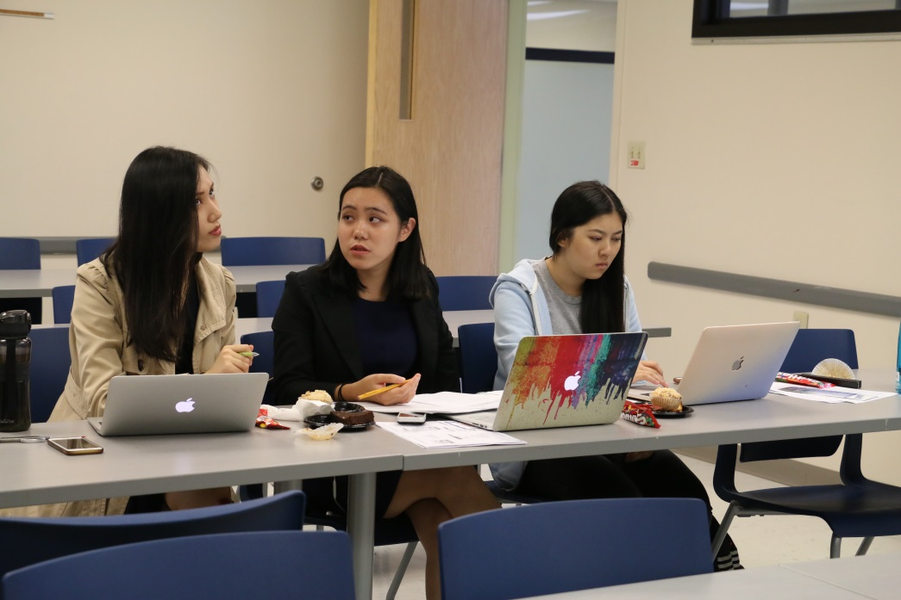
Student teams in action with
“home” team and coach from
Mount Saint Mary College.

Slide 7
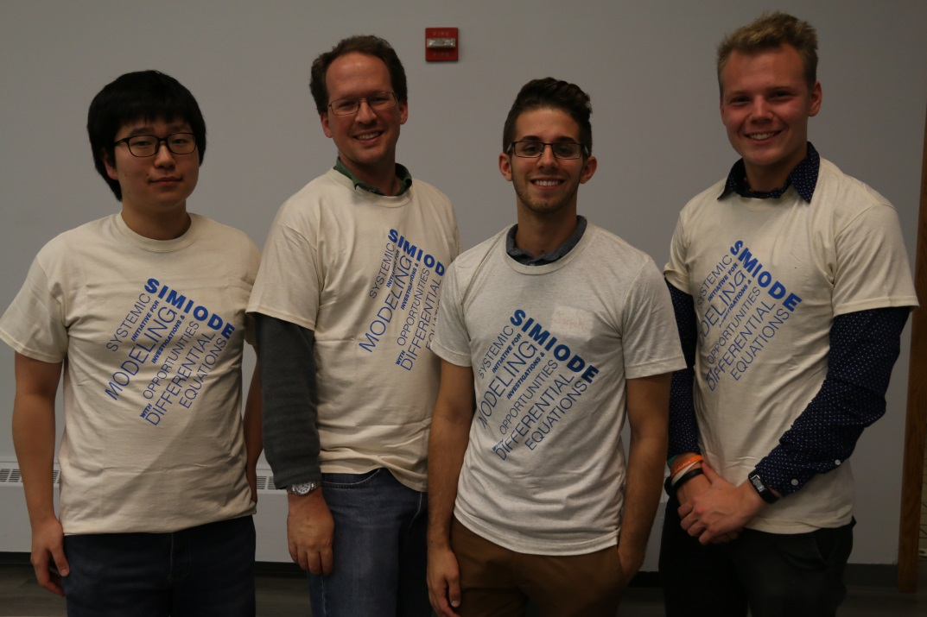
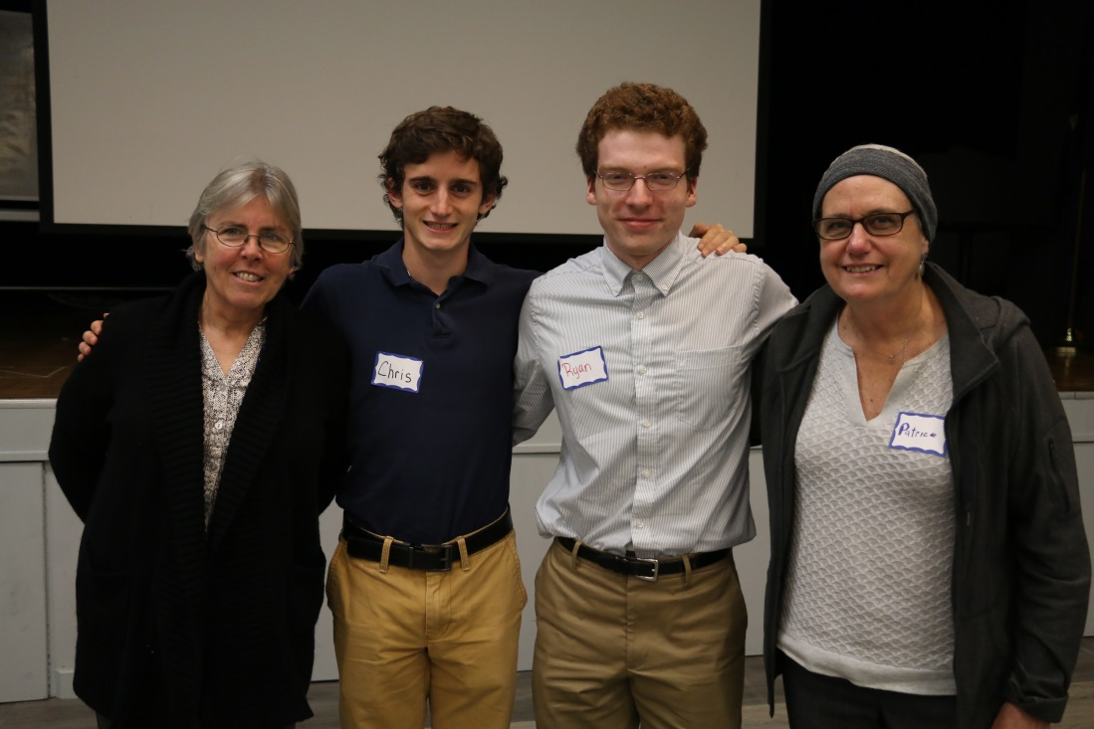
Outstanding Award Teams
with their coaches.
University of Massachusetts
at Amherst
Manhattan College

Slide 8
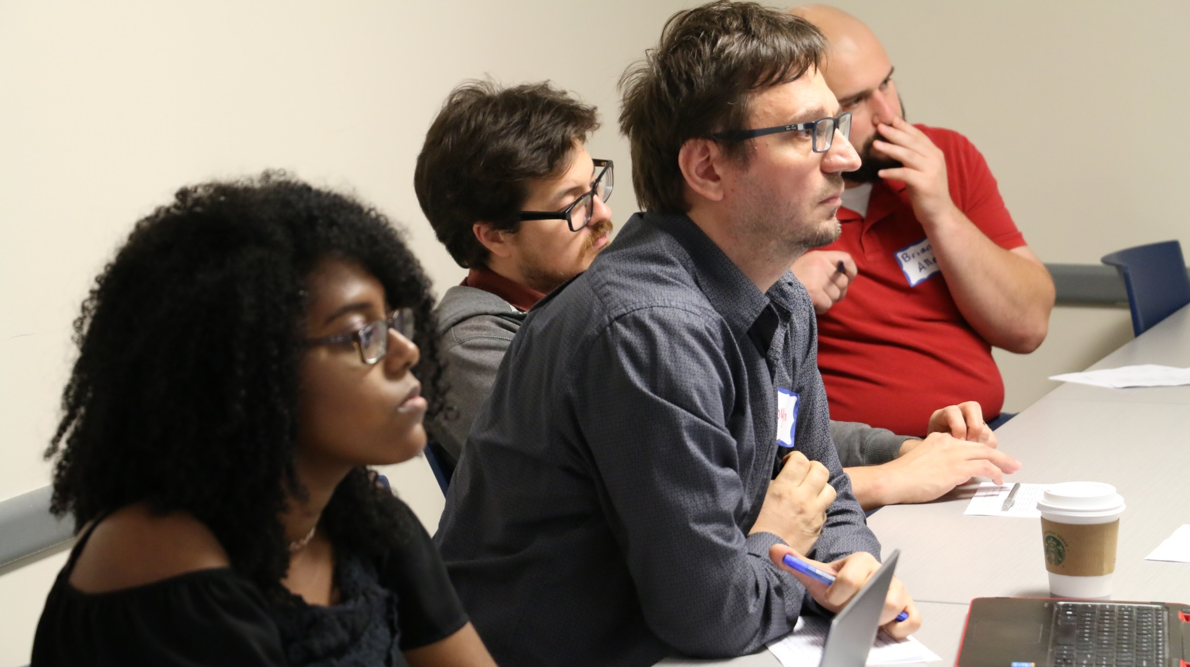
Student and Faculty judges
listening to student presentation.

Slide 9
SCUDEM is sponsored by SIMIODE

Slide 10
We had a MathBowl for Students with fun mathematics
questions in four categories:
An Ode to ODE in Math
Bad Movie Math
Punny Math
Mathematical Team Names

Slide 11
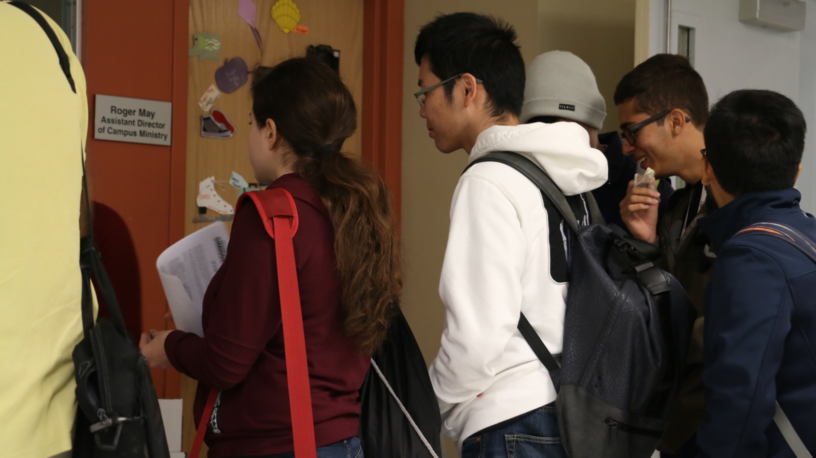
Time to head home after
rewarding day of modeling with differential equations
and meeting new friends

Slide 12
Plan ahead
SCUDEM 2018
International Competition
Over 100 sites
Registration opens 1 February 2018
Form a team! Be there! Move ahead!

