Slide 1
Sneaking in LaTeX while Teaching by Modeling
Dina Yagodich, Frederick Community College
Joint Mathematics Meeting
San Diego, CA
12 January 2018

Slide 2
Background
Teach at a two-year community college
For past 4 years, modeling projects have been used in instruction for Differential Equations
Half of our math faculty use LaTeX
Great skill for students
Student programming skills are limited

Slide 3
Shameless plug for SIMIODE
https://www.simiode.org/

Slide 4
SIMIODE projects
Quick Start
First Day Activities
Ant Tunnel Building, a simple approach to create differential equation model
Modeling Spread of Oil Slick, poor data for a differential equation model
Modeling Scenarios for Early Topics
Falling Column of Water illustrates Torricelli's Law
Chemical Kinetics based on students' chemistry texts
Spread of the word JUMBO in literature exploring exponential growth
Dissipation of retinal gas bubbles following surgery using clinical data
Adsorption simulation on a wall with first-order differential equation
Others scenario samples include Potato cooling; Finance of savings and loans; student simulation of spread of common cold.

Slide 5
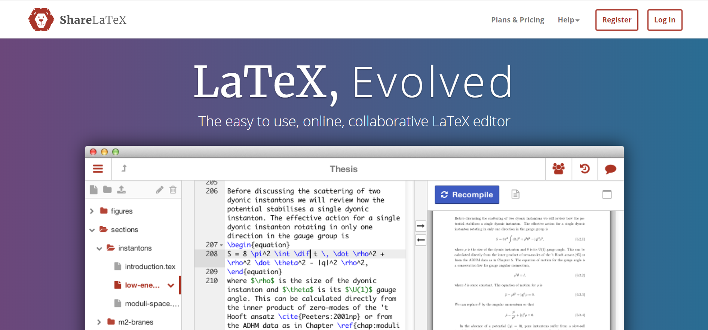
https://www.sharelatex.com/

Slide 6
https://www.sharelatex.com

Slide 7
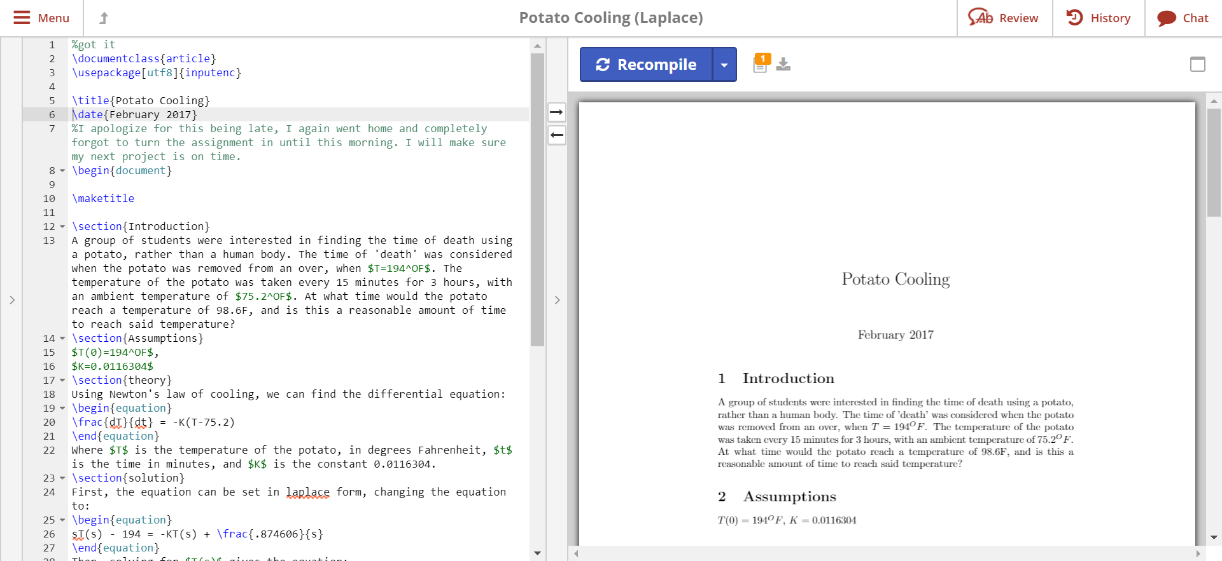
https://www.sharelatex.com

Slide 8
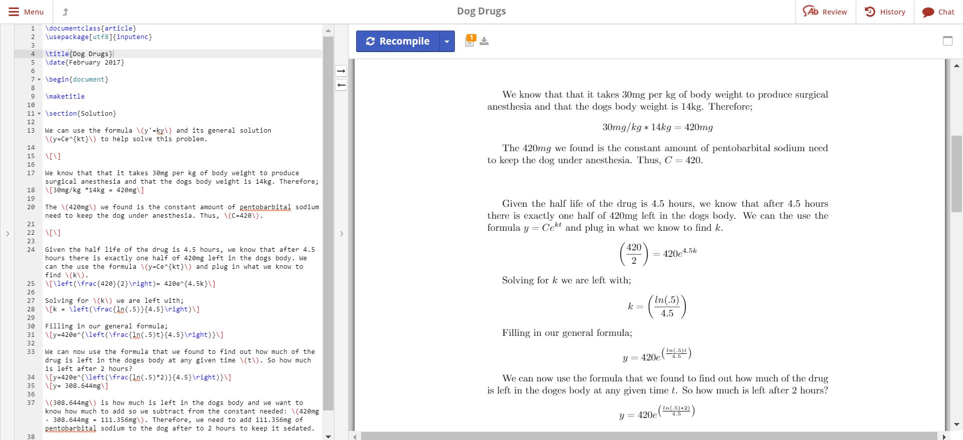
https://www.sharelatex.com

Slide 9
Recommendations
Keep it simple
Start small
Give examples
Modeling assignments
Formula sheets like LaPlace Transforms
Feedback
Bonus points for homework turned in via LaTeX
Not just for Differential Equations modeling

