Slide 1
Faculty Professional Development
Saturday, October 27, 2018
Organized BY: Catherine Bonan-Hamada,
Lisa Driskell & Tracii Friedman Colorado Mesa University
Facilitated By: Local Host Site
Notes:
After judging the team executive summaries and brief break, begin the workshop.
The workshop should begin by 10:30am.
If workshop facilitator (is not Host Site coordinator and) has not been introduced:
Hello faculty and students. Welcome to [Host Site]. I am [name] and I will be facilitating our first session of the SCUDEM Fall 2018 Faculty Development Workshop.
For faculty, your Participant Handout contains much of the same information found on the slides so you can follow along and take notes there if you wish.
NEXT SLIDE
Dear Workshop Leader,
The notes with the following slides contain suggestions and comments (in black) and an optional script in orange. The faculty participant handouts have the same material that’s in the slides (except the “Common Cold Spread” slides) so that faculty participants have the information to take home with them. Screenshots of portions of the participant handout corresponding to the slides are included with the facilitator notes.
*Students will get the Common Cold Spread scenario handout but not the Faculty Development participant handout.

Slide 2
SESSION I
10:30-11:30am
Notes:
Session I: 10:30-11:30.
Session 1 will run until approximately 11:30am at which time we will take a break for lunch before starting again at 1pm for Session 2. At that time, students will participate in a fun MathBowl.
NEXT SLIDE

Slide 3
SIMIODE
Host and Sponsor of
SCUDEM:
Nonprofit organization founded by :
Dr. Brian Winkel, Emeritus Professor of Mathematics, United States Military Academy
Notes:
A. Introduction to SIMIODE, 2 slides, Slides 3-4. Total Time 2 min
_______________________________________________________________________
State the information on this slide. ( < 1 min )
SIMIODE is the nonprofit organization that has organized the SCUDEM competition.
See graphic:
SIMIODE stands for: Systemic Initiative for Modeling Investigations & Opportunities with Differential Equations.
NEXT SLIDE
Participant Handout, Page 2

Slide 4
SIMIODE
Host and Sponsor of
SCUDEM:
SIMIODE offers materials and support for faculty who want to use modeling to motivate and teach differential equations.
Resources are also available for students.
Everything in SIMIODE is FREE and all materials are offered according to a Creative Commons license.
Nonprofit organization founded by :
Dr. Brian Winkel, Emeritus Professor of Mathematics, United States Military Academy
Notes:
A. Introduction to SIMIODE, 2 slides, Slides 3-4. Total Time 2 min
_______________________________________________________________________
State the information on this slide. ( < 1 min )
SIMIODE offers materials and support for faculty who want to use modeling to motivate and teach differential equations.
Resources are also available for students and we will mention of few of those resources at the end of this session.
Everything in SIMIODE
is FREE and all materials are
offered according to a
Creative Commons
license.
NEXT SLIDE
Participant Handout, Page 2

Slide 5
Overview
Session I: 10:30-11:30
Session II: 1-1:50 pm
Modeling in Differential Equations Courses
Introduction to SIMIODE
Sample a Scenario
Discussion I
SIMIODE Resources
Modeling Throughout the Curriculum
Overview of SIMIODE.org
Featured Scenarios
Sample Course Activities
Discussion II
Opportunities to Get Involved
Notes:
This slide does not need to be discussed in detail.
Note that this Session of the workshop will run until 11:30 when we break for lunch. For the bulk of this section, you will be working through a scenario as if you are student then a Discussion will follow.
After lunch, during Session 2, the faculty will have a quick tour of SIMIODE.org and the offerings available there and then briefly review featured modeling scenarios. Sample Course Activities will be provided to promote and inspire modeling throughout the curriculum. We will conclude our time with a lengthy discussion of sharing ideas and classroom experiences.
NEXT SLIDE

Slide 6
Modeling in Differential Equations
Sample a Scenario
We will work through a modified version of a scenario available at SIMIODE.org to experience the activity with and as students:
Common Cold Spread (Scenario 1-37-S)
by Corban Harwood, George Fox University
Appropriate for a first day or early semester project.
Notes:
B. Sample a Scenario: Experience the Common Cold Spread Scenario, Total Time 40-45 min
______________________________________________________________________
This Slide: ( < 1 min )
The scenario activity we will sample today is a modification of the Common Cold Scenario by Corban Harwood. The scenario would be appropriate for a first day or early semester activity. Today’s workshop version is adapted from a multi-week project.
-- -- -- -- -- -- -- -- -- -- -- -- -- -- -- -- -- -- -- -- -- -- -- -- -- -- -- -- --
The Facilitator comments for this section are notes only without a script. The participants will be working together to run the simulation and work through the scenario handout. Notes provided on the following slides will help you guide the participants and move them along, if needed, to stay within the time allowance. But we expect the participants to work in groups on the scenario independently of the slides.
The main goal of the “Sample a Scenario” section of the workshop is to provide participants with an opportunity to experience one of the SIMIODE scenarios along with their students, thus getting a feel for the perspective of the student while also interacting directly with the students.
There should be enough time for them to think about the problem, work through the “hands-on” simulation, plot the data, and choose the model. In order to allow enough time for the analysis and possible variations discussions, you may wish to provide the solution to the differential equation rather than having participants solve. There is a slide with the solution if you wish to use it.
Please see next slide for outline and section time limits.

Slide 7
Modeling Activity Outline
Simulating the Spread of the Common Cold
Statement and Set-Up (4 min)
Simulation (8 min)
Data Visualization (6 min)
Model Development (10 min)
Analysis (12 min)
Possible Variations (5 min)
*Note: if you finish an activity section early, you are encouraged to go on to the next section.
Notes:
B. Sample a Scenario: Experience the Common Cold Spread Scenario, Total Time 40-45min
______________________________________________________________________
The entire length of this activity should be 40-45 minutes, ending by 11:18 to leave time for Discussion I among the faculty and students. A couple minutes are needed at the end for the SIMIODE resources for students slide.
At the end of the allotted time for each section, participants should be guided to move on to the next section. Giving a one-minute warning may be helpful. Of course, if individual groups complete a section early, they should go ahead and proceed to the next section.
There is a slide with Sample data and one with the solution to the differential equation. These are included for your reference. You may choose whether to display them or not based on the progress and questions of the participants. In particular, to save time, you may wish to show the solution rather than having participants do the solving.
-- -- -- -- -- -- -- -- -- -- -- -- -- -- -- -- -- -- -- -- -- -- -- -- -- -- -- -- --
This Slide: ( 1 min)
Alert participants that you will be guiding them to move on to the next section when the time for the current section is running low (1 minute warning) but that they should proceed to the next section if they finish a section early.

Slide 8
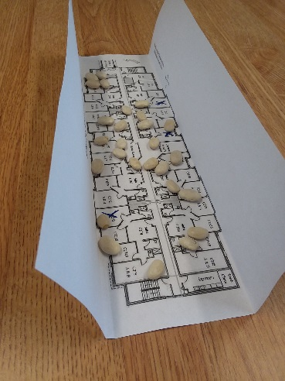
Common Cold Spread
Statement and Set-Up (4 min)
Three students in the North Ave Residence Hall have a cold. They have infected rooms in the hall and susceptible students who come in contact with the infected rooms will become ill as well.
Break into groups
Retrieve supplies
workshop version of the scenario (note: floor plan is on last page)
30 beans and a cup
Remove the floor plan (one per group) from the packet and fold the sides up to create walls.
Notes:
B. Sample a Scenario: Experience the Common Cold Spread Scenario, Total Time 40-45 min
______________________________________________________________________
Statement and Set-Up (4 min)
Inform participants that they should get into groups (student teams with their faculty member)
Distribute beans and a cup (optional) to each group.
Distribute the scenario handout to all students and faculty.
Participants read the STATEMENT on page 1 of the Workshop Version scenario handout.
The residence hall floor plan is the last page of the packet.
Each group uses one floor plan. They should fold the paper as pictured to create walls to contain the beans as they re dropped.

Slide 9
Common Cold Spread
Simulation (8 min)
N = 30 residents (beans)
Initially y₀ = 3 residents are infected with the common cold.
After each round, remove the beans that become infected.
Continue the simulation until no beans remain.
Notes:
B. Sample a Scenario: Experience the Common Cold Spread Scenario, Total Time 40-45 min
______________________________________________________________________
Simulation (8 min)
Note, we will be using N = 30 residents (beans) and y₀ = 3 for our simulation.
Initially 3 beans should be set aside (since y₀ = 3) and only 27 beans tossed at round 1.
Suggest participants read the simulation steps before beginning the simulation.

Slide 10
Common Cold Spread
Data Visualization (6 min)
Complete the Simulation table
Round n Change in Infected: y(n+1) – y(n)
Round n Infected Derivative: average of Change in Infected
Sketch the graphs
Notes:
B. Sample a Scenario: Experience Common Cold Spread Scenario, Total Time 40-45 min
______________________________________________________________________
Data Visualization (6 min)
The small groups could compare their graphs with other groups before moving on to the second modeling part, if that seems appropriate for your participants. You could gather the attention of all groups for this or identify groups whose graph of Infected looks logistic to show to those that do not look logistic (some simulations could end up looking more linear).
(Note, if not done now, in the Analysis section groups are asked to compare their graphs)

Slide 11
Common Cold Spread
Model Development (10 min)
Choose the most appropriate model
$\frac{dy}{dt}=a\sin\left(bt\right) \frac{dy}{dt}=a\left(t−b\right)\left(t−c\right)$
$\frac{dy}{dt}=a\left(30−y\right) \frac{dy}{dt}=ay\left(30−y\right)$
Solve the differential equation
Notes:
B. Sample a Scenario: Experience the Common Cold Spread Scenario, Total Time 40-45 min
______________________________________________________________________
Model Development (10 min)
Suggestions for helping to determine the most appropriate model are given on the scenario handout (graph, initial condition, end behavior, etc.)
While some simulations may result in a linear-looking Infected (y) graph, there will likely be at least one time (round) where the slope is steeper than the rest resulting in an inflection point.
The correct model is the logistic growth model: dy/dt = ay(30-y)
The next slide (slide 12) gives sample data that can be pointed to for reference if there are questions. This sample simulation and data are from the Teacher Version of the published data.
The slide after that (slide 13) has the solution to the differential equation.
The differential equation is separable and requires partial fractions to solve. The initial condition y₀=3 can be used to determine the constant of integration and another data point can be used to solve for the parameter a. (Other methods to determine can also be used.)
In order to allow enough time for the analysis and possible variations discussions, you may wish to provide the solution to the differential equation rather than having participants solve.

Slide 12
Common Cold Spread —Sample Data
Simulation Table with $y_{0}=3$ and $N=30$
Time ($t$) (rounds) | 0 | 1 | 2 | 3 | 4 | 5 | 6 | 7
Susceptible Count | 27 | 25 | 21 | 14 | 5 | 2 | 1 | 0
Infected Count ($y(t)$) | 3 | 5 | 9 | 16 | 25 | 28 | 29 | 30
Change in Infected | 2 | 4 | 7 | 9 | 3 | 1 | 1 | 0
Infected Derivative (${dy}/{dt}$) | 1 | 3 | 5.5 | 8 | 6 | 2 | 1 | 0.5
Infected Count (given by model) | 3.00 | 5.84 | 10.34 | 16.00 | 21.39 | 25.32 | 27.65 | 28.87
Notes:
B. Sample a Scenario: Experience the Common Cold Spread Scenario, Total Time 40-45 min
______________________________________________________________________
Sample Data
This slide contains data from a simulation included in the Teacher Version of the published scenario.
This slide is optional and may used to move groups along to the next section or it may needed if some participants are having trouble with the simulation.

Slide 13
Common Cold Spread — Model Solution
Model: Logistic Growth Model
$\frac{dy}{dt}=ay\left(30−y\right); y\left(0\right)=3.$
Separable, can be solved using partial fractions.
$$y=\frac{30}{1+9e^{−30at}}$$
Using a data point such as y(3), we can determine the parameter a. (e.g. if y(3) = 16, a = 0.0259)
Notes:
B. Sample a Scenario: Experience the Common Cold Spread Scenario, Total Time 40-45 min
______________________________________________________________________
Model Solution
This slide gives the solution to the logistic growth model.
This slide is optional and may used to move groups along to the next section or it may needed if some participants have not taught or had experience with differential equations for some time.

Slide 14
Common Cold Spread
Analysis (12 min)
Discuss the following with your group.
Compare your model with the Infected Count data from your simulation. How well does your model fit?
How could your model be improved?
Compare your data and models with another group. Are your results similar?
How could the simulation of the spread of a cold be improved?
Notes:
B. Sample a Scenario: Experience the Common Cold Spread Scenario, Total Time 40-45 min
______________________________________________________________________
Analysis (12 min)
Groups may need a calculator app to evaluate the model for different values of t in order to compare with the data.
After comparing the model to the data, groups discuss the other analysis questions in the handout.
You may wish to gather the attention of the groups and have them share their comments with the large group.

Slide 15
Common Cold Spread
Possible Variations (5 min)
How would the model and solution be affected by
Different values of y₀?
Different floor plans or different sized beans?
Infected common areas such as the laundry room, study room?
New rules for the common suite locations?
Notes:
B. Sample a Scenario: Experience the Common Cold Spread Scenario, Total Time 40-45 min
______________________________________________________________________
Possible Variations (5 min)
Participants address possible variations to the simulation.
If groups finish the previous sections early, that is great because they will have more time for this discussion.
You can decide to have this discussion take place in the small groups and then shared to the large group or they could take place entirely in the large group.

Slide 16
Discussion I (5-10 min)
Topic: Using the Common Cold Spread scenario in your class
See next slide and faculty handout for question prompts.
Notes:
B. Sample a Scenario: Discussion I, Total Time 5-10 min
_______________________________________________________________________
Small Group Discussion: 5-7 min
Share with Large Group: 3 min
End by 11:28 so that there are 2 minutes left to complete the “SIMIODE Resources for Students)
Discussing the Common Cold Spread Activity
Now that we’ve worked through the Common Cold Spread scenario with our students, let’s discuss the experience and using the scenario in our classes.
The question prompts are on the next slide as well as in the Faculty Participant Handout. Faculty can refer to Page 3 of the faculty handout to take notes.
Begin by sharing with your group members and in 5 or so minutes, we’ll share our ideas with the entire group.

Slide 17
Discussion I
What did you like about the scenario?
As a student, how would you feel about doing an activity similar to this in class or as a project? Do you feel you would learn and benefit from such an activity?
As an instructor, how well might this approach work in your class?
What other scenarios or differential equations topics could be simulated in a similar manner using beans or candies?
Notes:
B. Sample a Scenario: Discussion I, Total Time 5-10 min
_______________________________________________________________________
Small Group Discussion: 5-7 min
Share with Large Group: 3 min
End by 11:28 so that there are 2 minutes left to complete the “SIMIODE Resources for Students)
Discussing the Common Cold Spread Activity
The goal is to get students and faculty sharing about what was effective and what would work for them in the classroom.
Encourage a lot of interaction with the students here. This is a great opportunity for the faculty to get feedback from their students.

Slide 18
SIMIODE
Online Community
Project & Inquiry Based Learning
Modeling and Technology
Instructional Resources
The SIMIODE HUBzero Community is for Students AND Faculty!
Notes:
C. SIMIODE Resources, 3 slides, Slides 18-20. Total Time 2min
_______________________________________________________________________
State the information on this slide. ( < 1 min )
There are several facets to SIMIODE. It is an Online Community of Educators. SIMIODE promotes Project and Inquiry Based Learning in Differential Equations Courses through use of Modeling and Technology by providing Instructional Resources to the Community of educators and students.
NEXT SLIDE
Participant Handout, Page 3

Slide 19
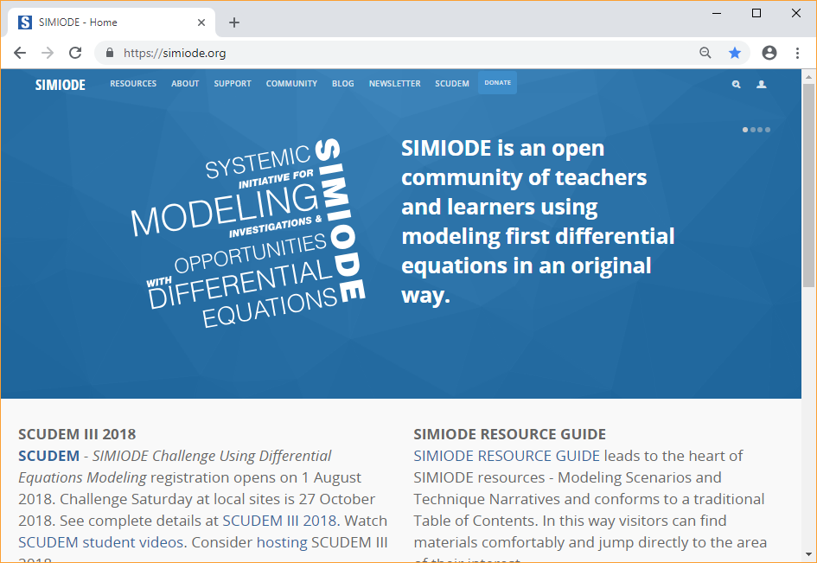
SIMIODE Resources
Easy access to resources for Students and Faculty
Notes:
C. SIMIODE Resources, 3 slides, Slides 18-20. Total Time 2min
_______________________________________________________________________
Locate the Resources tab.. ( < 1 min )
Students can go to SIMIODE.org and click on the Resources Tab in the upper left.

Slide 20
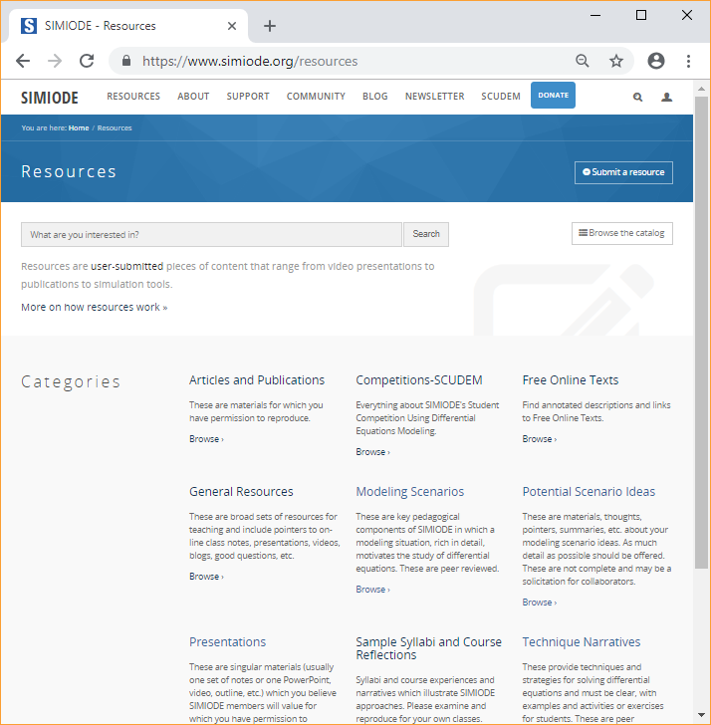
Resources
Free Online Text Materials
Technique Narratives
Modeling Scenarios
Potential Modeling Scenario Ideas
And more!
Notes:
C. SIMIODE Resources, 3 slides, Slides 18-20. Total Time 2min
_______________________________________________________________________
Locate the Resources tab.. ( < 1 min )
Students and faculty can access
Free online text materials,
Technique Narratives,
Modeling Scenarios,
Potential Scenario Ideas, And more!
NEXT SLIDE
Participant Handout, Page 3

Slide 21
11:30-1:00 Break for Lunch
Notes:
You will want to start Session 2 promptly at 1pm, so you may want to recommend that the participants plan to return 5-10 minutes before 1pm.

Slide 22
SESSION II
Welcome back
Notes:
Session 2 should begin by 1pm because student presentations begin at 2pm.
Welcome back!

Slide 23
SESSION II Outline
Brief Overview of SIMIODE.org
Featured Modeling Scenarios
Scenario Attributes
Selected Scenarios of Various Formats
Modeling Throughout the Curriculum
Course Activity Samples
Discussion II: Sharing experiences
Opportunities to Get Involved
Notes:
A brief reminder of the plan for this session.
As mentioned in the morning, we will spend the afternoon session
on a quick slide tour of SIMIODE.org and the offerings available there followed by briefly reviewing featured modeling scenarios before focusing on Modeling Throughout the Curriculum through sample course activities and a discussion session.
NEXT SLIDE

Slide 24
SIMIODE
Online Community
Project & Inquiry Based Learning
Modeling and Technology
Instructional Resources
Notes:
A. Brief Overview of SIMIODE.org, 7 slides, Slides 24-30. Total Time 5 min
_______________________________________________________________________
State the information on this slide.
You can follow along in your participant handout, beginning on page 4.
NEXT SLIDE

Slide 25
Brief Overview of SIMIODE
Accessing Modeling Scenarios
Supporting Documents
SIMIODE Community
Resources on SIMIODE
Notes:
A. Brief Overview of SIMIODE.org, 7 slides, Slides 24-30. Total Time 5 min
_______________________________________________________________________
This slide: < 1 min
The SIMIODE website is full of resources and faculty with accounts have access to many features of the community. We will spend a few minutes highlighting just a few of these features.
We’ve experienced the Common Cold Spread modeling scenario available on SIMIODE and now we will start our overview of SIMIODE.org with how to access the modeling scenarios on the website. To save time, rather than live-clicking through the website, we will proceed with slides.
NEXT SLIDE

Slide 26
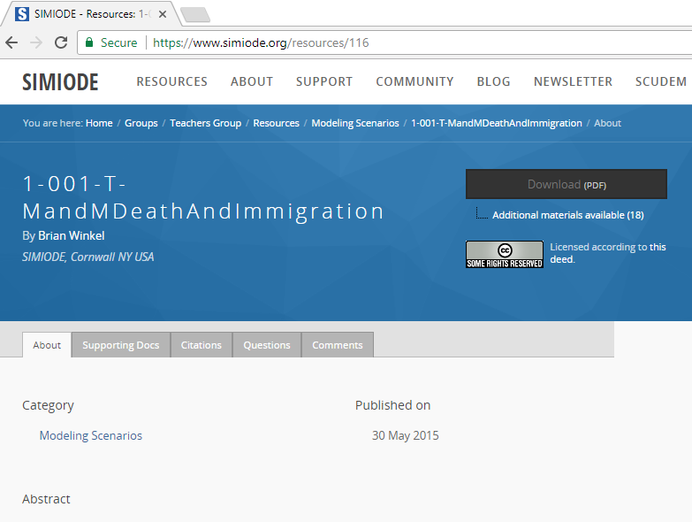
Accessing Modeling Scenarios
Create an account
Note: Your account and teacher status must be approved by an administrator before gaining access to Teacher Versions and Supporting Docs.
Choose a Modeling Scenario
Resources -> Modeling Scenarios
Select the Teacher Version of chosen scenario
Click Supporting Docs tab
Notes:
A. Brief Overview of SIMIODE.org, 7 slides, Slides 24-30. Total Time 5 min
_______________________________________________________________________
This slide: 1 min
Be sure to highlight the NOTE about approval needed before access to Teacher Materials is granted.
The screenshot on the slide points out the “Supporting Docs” tab available on the page dedicated to the modeling scenario.
To access the Teacher Versions of the modeling scenarios and the supporting documents, you will need to create an account so that your teacher status can be verified – this may take a day or so, so plan ahead.
Click-through instructions
to get you to the modeling
scenarios that are in your
packet for future reference
so we will not go through
those. But, note that
each scenario has a
dedicated page with
access to Supporting
Docs, Comments, etc.
NEXT SLIDE
Participant Handout, Page 4

Slide 27
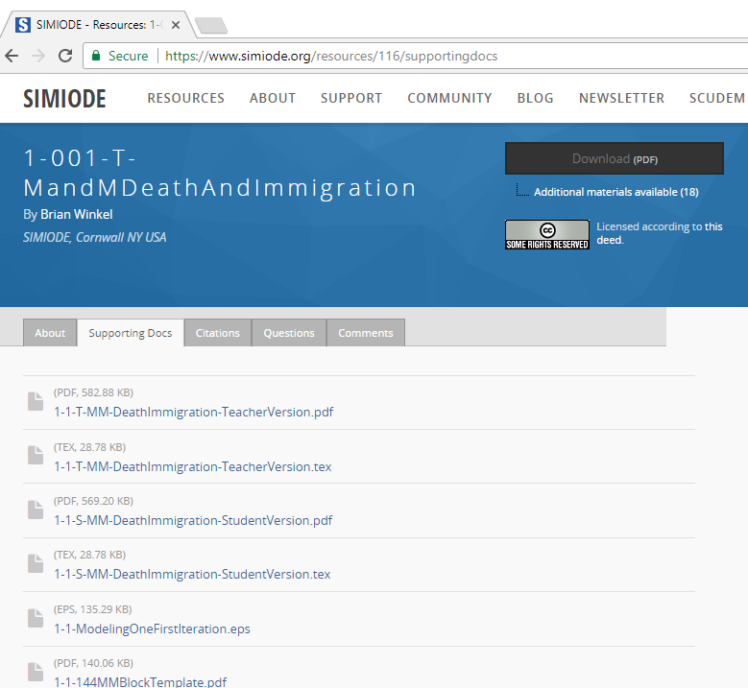
Supporting Documents
Included:
Student and Teacher Versions
.tex files that may be edited and customized
May include:
Excel files
Data files
CAS files
PowerPoint slides
Videos
Notes:
A. Brief Overview of SIMIODE.org, 7 slides, Slides 24-30. Total Time 5 min
___________________________________________________________________________
This slide: 1 min
The screenshot on the slide shows the “Supporting Docs” for one particular modeling scenario: 1-001-T M & M Death and Immigration. The number and type of supporting documents available will vary with each scenario.
There is a Supporting Docs tab for each modeling scenario. The supporting docs will ALWAYS include the pdf and LaTeX files for the student and teacher versions of the scenario. Access to the LaTeX files allows you to customize the scenarios for your class.
The supporting documents
for the M & M Death and
Immigration scenario are
shown. Not all scenarios
will have this many
resources, but you can see
that here there are
Power Point files, videos,
and Mathematica files.
NEXT SLIDE
Participant Handout, Page 4

Slide 28
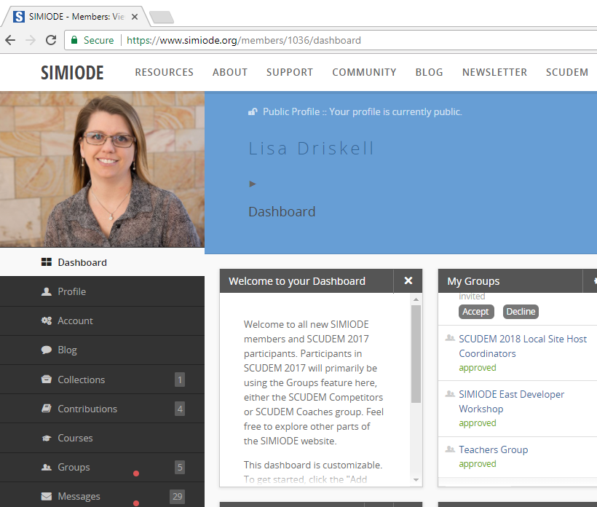
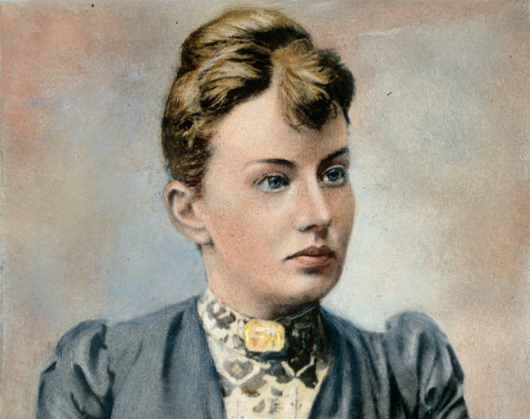
SIMIODE Community
Dashboard
Personalized dashboard to access community features
Groups
Join the Teachers Group for access to resources
Sonia Kovalevsky
Notes:
A. Brief Overview of SIMIODE.org, 7 slides, Slides 24-30. Total Time 5 min
_______________________________________________________________________
This slide: 1 min
The screenshot on the slide shows the “Dashboard” for a member with an account. Highlight the availability of creating and joining Groups and the access to messages and Group Forums.
SIMIODE is more than a website. SIMIODE provides an online platform for its community members to actively engage with others. With a SIMIODE account, members have access to their personal and customizable dashboard. There, members can create and join Groups and participate in group forums and blogs.
When you have a chance,
take some time to
explore the different
features of the
Dashboard and Group
memberships.
NEXT SLIDE
Participant Handout, Page 4

Slide 29
Resources on SIMIODE
Starter Kit for teaching Differential Equations with modeling
https://www.simiode.org/starterkit
Notes:
A. Brief Overview of SIMIODE.org, 7 slides, Slides 24-30. Total Time 5 min
_______________________________________________________________________
This slide: < 1 min
The screenshot on the slide shows the Starter Kit ad on the homepage (the images on the homepage cycle and this is one of them). Participants have the link to the Starter Kit in their handout.
In addition to modeling scenarios, SIMIODE provides other valuable resources. A Starter Kit is available for instructors who wish to try a modeling-based differential equations course. To help you find the Starter Kit, the link is provided in your handout.
NEXT SLIDE
Participant Handout, Page 4

Slide 30
Resources on SIMIODE
Starter Kit Features
First day activities
Modeling scenarios selected for specific topics
Sample syllabus
General Resources
48-page document: https://simiode.org/resources/881/supportingdocs
Includes listing of texts, class notes, available software, etc.
Notes:
A. Brief Overview of SIMIODE.org, 7 slides, Slides 24-30. Total Time 5 min
_______________________________________________________________________
This slide: 1 min
This slide lists a few features of the Starter Kit. Be sure to state these. SIMIODE also has a General Resources packet which lists texts etc. Having everything listed in one place is a good resource for a person teaching Differential Equations. Participants have the link to the General Resources in their handout.
The Starter Kit provides a guide for faculty who wish to transition to teaching Differential Equations with a modeling-based approach. The “Kit” includes sample syllabi as well as specific SIMIODE modeling scenarios to be used for the
various
Differential
Equations
topics.
NEXT SLIDE
Participant Handout, Page 4

Slide 31
Featured Modeling Scenarios
Scenario Attributes
Sortable topics: separable equations, logistic growth, pde, parameter estimation, linear, etc.
Sortable themes: physics, biology, disease, energy, etc.
Structures: guided step-by-step, exploration, open-ended
Formats: short exercise, in-class activity, out-of-class project, simulation
Notes:
B. Featured Modeling Scenarios, 5 slides, Slides 31-35. Total Time 7-12 min
_______________________________________________________________________
This slide: 1-2 min
The scenarios accessible on the SIMIODE website range over a wide variety of topics and styles. Several attributes of available modeling scenarios are listed here and in your handout.
The selection of available scenarios span the topics covered in a typical Differential Equations course. The scenarios are peer-reviewed and the diversity of authors brings a welcome variability in style and format.
In the following slides, select scenarios are featured to illustrate
the variety of scenario formats as well as other highlights.
NEXT SLIDE
Participant Handout, Page 5

Slide 32
Featured Modeling Scenarios
Scenarios for short in-class examples or exercises
Notes:
B. Featured Modeling Scenarios, 5 slides, Slides 31-35. Total Time 7-12 min
_______________________________________________________________________
This slide: < 1 min
There is no need to read every point in the tables, so we have selected a
handful of highlights to point out.
In addition to the project-type scenarios available, there are also scenarios that resemble examples or exercises that you may find in a textbook. These can be used to supplement lecture with in-class activities.
NEXT SLIDE

Slide 33
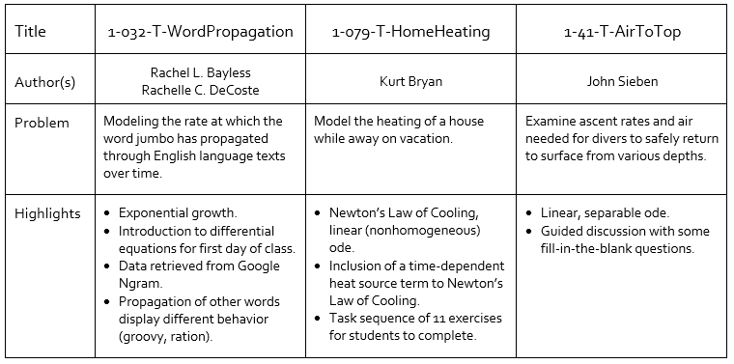
Featured Modeling Scenarios
Scenarios for in-class groups or discussion
Notes:
B. Featured Modeling Scenarios, 5 slides, Slides 31-35. Total Time 7-12 min
_______________________________________________________________________
This slide: 1-2 min
The tables on this and the next three slides are found in the participant handout. There is no need to read every point in the tables, so we have selected a handful of highlights to point out.
The first selection of featured modeling scenarios are scenarios that can be completed in class.
While exponential growth is often introduced by modeling observations in the STEM fields, the Word Propagation scenario brings a new idea. The scenario makes use of Google Books Ngram Viewer which displays a graph showing how frequently a word or phrase has occurred in books over the years. In this scenario that can be used on the first day of class, students model the rate at which the word jumbo has propagated through English language texts over time.
A feature of note in the Home Heating scenario is that students are presented with a task sequence of 11 exercises that can be completed individually, in groups, or part of a class discussion.
NEXT SLIDE

Slide 34
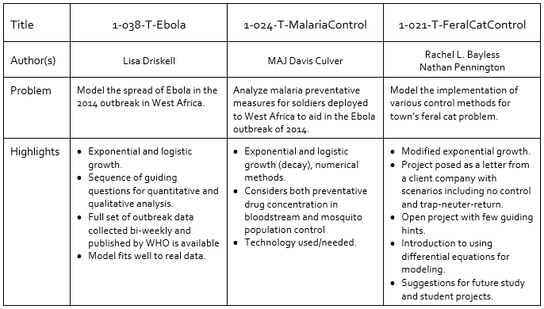
Featured Modeling Scenarios
Scenarios requiring multiple class periods and/or out of class project
Notes:
B. Featured Modeling Scenarios, 5 slides, Slides 31-35. Total Time 7-12 min
_______________________________________________________________________
This slide: 1-2 min
There is no need to read every point in the tables, so we have selected a handful of highlights to point out.
Often times we may wish to introduce modeling through an out of class project or over a sequence of class periods. This next selection of featured modeling scenarios would work well for either situation.
The Ebola scenario uses data published by the World
Heath Organization to model the 2014 Ebola Outbreak
in West Africa with simple exponential and logistic
models. The logistic model fits well to the data which
may come as a surprise to students who haven’t had
experience with modeling (see the plot on the
handout). In a related yet very different modeling
scenario, students consider the threat of Malaria for
soldiers who were deployed to West Africa to aid in
Ebola Outbreak of 2014.
While the Ebola project is very guided for students, the Feral Cat Control scenario is an example of a more open-ended problem.
NEXT SLIDE
Participant Handout, Page 6

Slide 35
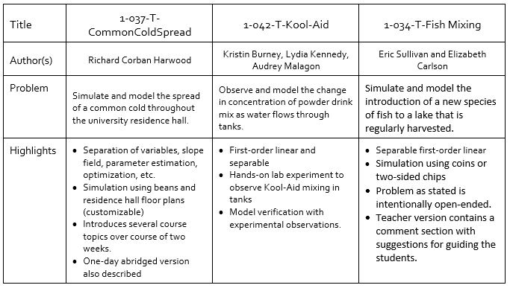
Featured Modeling Scenarios
Scenarios involving a simulation or lab component
Notes:
B. Featured Modeling Scenarios, 5 slides, Slides 31-35. Total Time 7-12 min
_________________________________________________________________
This slide: 1-2 min
There is no need to read every point in the tables, so we have selected a
handful of highlights to point out.
Experiments and simulations that involve data collection are
powerful tools for helping students make connections between
the observations they witness and the models they create and
use.
The Common Cold Spread can be customized by choosing a floor plan from your home college or university. This scenario is clever because it can span over two weeks and be used to introduce
several course topics, or an abridged version can be
completed in one day.
The Kool-Aid Mixing scenario has students observe the
actual mixing of solution as water flows in and out of
tanks (see picture in handout).
Fish Mixing uses pennies to simulate introducing a new
species of fish into a lake.
NEXT SLIDE
Participant Handout, Page 7
Participant Handout, Page 7

Slide 36
Modeling Throughout the Curriculum
Course Activity Samples
Discussion II: Sharing Experiences
Notes:
Transition to the focus on modeling in other courses.
After seeing some of what is available for modeling in Differential Equations, we now want to shift the focus to Modeling Throughout the Curriculum.
Many of the scenarios found at the SIMIODE website can be modified for use in courses other than Differential Equations. For example, the Common Cold Spread scenario from Session 1 may fit nicely into a Calculus II course.
NEXT SLIDE

Slide 37
Adapting Scenarios
Adapting and using SIMIODE scenarios to promote modeling throughout the curriculum.
**Ready-to-use course activities
are included with your workshop materials.**
Notes:
C. Modeling Throughout the Curriculum. Course Activity Samples: Slides 37-39, 5-10 min
______________________________________________________________________
This slide: < 1 min
Course activity samples are provided for participants to take home. These are not in the Participant Handout packet but should be distributed to participants. There are a couple slides that have the same info that is listed in the Participant Handout. You can click through the slides or just give the participants time to look over the Sample Activities.
To promote modeling throughout the curriculum, course activities that have been adapted from SIMIODE modeling scenarios are included in the materials for this workshop. You are encouraged to use these activities in your own courses and to consider how you may
adapt other SIMIODE
scenarios for your
classes.
Retreive your
Ready-to-use course
activities now. (There
should be 3 activities)
NEXT SLIDE
Participant Handout, Page 8

Slide 38
Adapting Scenarios
Ready-to-Use Course Activities for College Algebra+
Exponential Decay Using Data and the TI-83/84 Calculator
Adapted from "1-002-T-Tossing," Brian Winkel (2015).
Simulation performed to collect data
Teacher info page included
Modeling an Epidemic
Adapted from : "1-038-T-Ebola," Lisa Driskell (2016).
Compare exponential and logistic models to real-life data
Notes:
C. Modeling Throughout the Curriculum. Course Activity Samples: Slides 37-39, 5-10 min
_______________________________________________________________________
This slide: 2-4 min
Course activity samples:
You can read the info on this and the next slide but also give the participants a little time to look over the Sample Activities.
The first two course activity samples can be used in a College Algebra course. In the first sample, Exponential Decay Using Data and the TI-83/84 Calculator, students generate data by tossing dice, or using a phone app. The second sample comes from the Ebola scenario discussed earlier. Take a couple minutes to look over the activities.
Participant Handout, Page 8
Sample Activities 1 and 2

Slide 39
Adapting Scenarios
Ready-to-Use Course Activities for Calculus II
Match the Models
Adapted from "1-091-T-Slopefields," Ben Dill; Holly Zullo (2017).
Use handout or cut out characteristics for tactile matching activity.
Many Others (use as-is, not included in participant packet)
Ebola Outbreak in West Africa, scenario "1-038-S-Ebola"
Propagation of the Word Jumbo, scenario “1-032-S-WordPropagation”
Notes:
C. Modeling Throughout the Curriculum. Course Activity Samples: Slides 37-39, 5-10 min
_______________________________________________________________________
This slide: 2-4 min
You can read the info on this slide but also give the participants a little time to look over the Sample Activities.
The third course activity sample is designed for a Calculus 2 course. While the topic of differential equations and direction fields are often included in the course, the relationship to the verbal description of the situation is not always incorporated. Here, students will match the verbal description with the equations and the direction fields. Other scenarios, such as the Word Propagation and the Ebola scenarios that we saw earlier can be used in a Calculus 2 course with little or no modification. Take a couple minutes to look over this activity and to think about how some of the
activities featured earlier could be
adapted for calculus courses.
Participant Handout, Page 9
Sample Activity 3

Slide 40
Discussion II
Topic: Sharing Experiences
Using modeling activities in other mathematics courses
Logistics of facilitating modeling activities
See handout for question prompts
Notes:
B. Modeling Throughout the Curriculum.
Discussion II: TOTAL Time: 20-30 min
_______________________________________________
Small Group Discussion: 15 min
Share with Large Group: 5-15 min
Finish by 1:47 to Leave a couple minutes for the next slide.
Discussion II: Sharing Experiences
This last discussion centers on sharing your experiences with using modeling in courses other than Differential Equations and the logistics involved in facilitating modeling activities. There are likely too many questions for the time allotted. This is intentional so focus on the questions that are most relevant to your group based on your interests and experiences.
Please refer to Page 9 of your handout and use the given prompts and questions to guide your Discussion. Begin by exchanging ideas within your small group and in 15 minutes, we’ll share our ideas with the entire group.
Discussion Prompts in the Handout:
Using Modeling Activities in Other Mathematics Courses
​Do you use modeling in courses other than Differential Equations and if so, what is one of your favorite activities?
Which topics from other courses lend themselves well to modeling activities?
For which courses or topics do you wish you had more modeling activity ideas?
Do you have favorite resources for ideas for modeling projects and activities?
Logistics of Facilitating Modeling Activities
How do you assign groups? Do the students self-select? Do you pre-assign (randomly or intentionally)? What are the pros and cons of the different methods of group assignment?
How large is your ideal group size? Why?
What modeling activity formats have you used in your classes (in-class activity, out-of-class project, simulation, short exercise, other)?
How do you assess group activities?
How does class size and room arrangement (tables, moveable seating, immoveable seating, computer classroom, etc.) impact each of the previous discussion points (group assignment method, group size, activity format, assessment)?

Slide 41
Opportunities to Get Involved
Become a SIMIODE contributor - author a peer-reviewed modeling scenario!
Attend a workshop
Joint Mathematics Meetings (2019) and MathFest (2019)
Practitioner Workshop (MINDE) for Instructors
July 21 – 27, 2019 at George Fox University, Newberg, OR
NSF funded
Developer Workshop (DEMARC) for creating scenarios
July 17 – 22, 2019 at George Fox University, Newberg, OR
NSF funded
Notes:
D. Opportunities to Get Involved, 1 slide, 2 min
_______________________________________________________________________
This slide: 2 min
Opportunities to Get Involved
If you would like to get more involved with the movement to incorporate modeling across the curriculum, there are several great ways to do so. First, consider becoming a contributor by turning some of your favorite differential equations modeling projects into scenarios to be published on SIMIODE. All scenarios are double-blind peer-reviewed.
SIMIODE has successfully run Minicourses at MathFest and Joint Mathematics Meetings as well as summer Developer Workshops and an MAA PREP workshop in the past. The good news is that these opportunities will be offered again this year!
With new funding from the NSF, SIMIODE will be offering two summer workshops in Oregon in July 2019. The first is a Developer Workshop for creating scenarios and the second is a Practitioner Workshop for instructors interested in teaching a modeling-based differential equations course. The dates are in your handout.
Finally, join SIMIODE at MathFest in San Antonio for the Joint Meetings or Cincinnati for MathFest 2019. Consider attending a minicourse and
Participating in the contributed paper sessions!
NEXT SLIDE
Participant Handout, Page 10

Slide 42
Please join us again next year!
Check out SIMIODE.org in the future for
SCUDEM 2019 Host Sites

