Slide 1
MAA Contributed Paper Session
Introducing Mathematical Modeling Through Competitions, II
11:00 - 11:15 AM Room 304, BCC
Student Competition Using Differential Equation Modeling
SCUDEM for Students and Faculty
Brian Winkel, SIMIODE Director, Cornwall NY USA
Welcome!

Slide 2
MAA Contributed Paper Session
Introducing Mathematical Modeling Through Competitions, II
11:00 - 11:15 AM Room 304, BCC
SIMIODE Challenge Using Differential Equation Modeling
SCUDEM for Students and Faculty
Brian Winkel, SIMIODE Director, Cornwall NY USA
Welcome!
Source: https://www.simiode.org/scudem or Search SCUDEM in Google!

Slide 3
Background
Using modeling in course work at every opportunity
from abstract algebra – cryptology and campanology (bell changing),
operations research – resource allocation,
calculus – optimization and visualization,
differential equations - pharmacokinetic, motion, parameter estimation
Coaching COMAP MCM and ICM for years
Founding SIMIODE (in retirement) in 2013
Conversations with Chris Mccarthy, Borough of Manhattan Community College
Computer competitions. . . . . why not differential equation modeling competition

Slide 4
Strong motivator
Coaching COMAP MCM and ICM for years
Students say, universally,
“It was the best undergrad math experience I ever had!”

Slide 5
Strong motivator
Coaching COMAP MCM and ICM for years
Students say, universally,
“It was the best undergrad math experience I ever had!”

Slide 6
Strong motivator
Coaching COMAP MCM and ICM for years
Students say, universally,
“It was the best undergrad math experience I ever had!”
Aside: What does
this say about our
course offerings?

Slide 7
Strong motivator
Coaching COMAP MCM and ICM for years
Students say, universally,
“It was the best undergrad math experience I ever had!”
FRONT AND CENTER:
What does this say about our course offerings?

Slide 8
MCM
Course Modeling
SIMIODE
Mccarthy

Slide 9
MCM
Course Modeling
SIMIODE
Mccarthy
Spring 2017

Slide 10
Plan for proof of concept and first SCUDEM 14 October 2017
Mount Saint Mary College, Newberg NY USA
Gracious First Host: DR Christina Alvey
Supportive Chair: DR Lee Fothergill
Key Helpful Student Assistants: Heather Polgren
Problem Poser: DR Kelly Black, University of Georgia
Videographer: Dan Torelli, Mount Saint Mary College
MathBowl: DR Paul Fonstad, Franklin College, Franklin IN
SIMIODE Staff HUBZero Platform Managers:
DR Leigh Noble and Mark Tourtellott
Assessment: DR Jennifer Czocher, Texas State University,
San Marcos TX

Slide 11
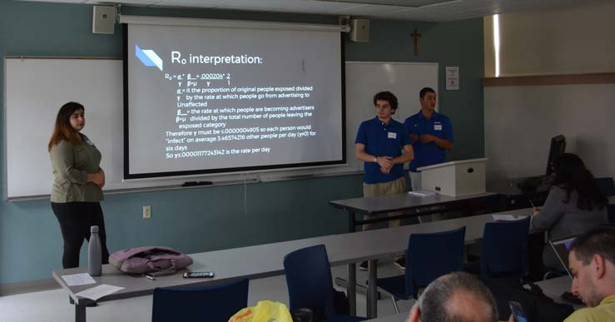
SCUDEM I 2017 Participation
7 teams, 20 students, 8 faculty coaches
Mount Saint Mary College, Newburgh NY
New York City College of Technology, CUNY, Brooklyn NY
United States Military Academy, West Point NY
University of Bridgeport, Bridgeport CT
University of Massachusetts, Amherst MA

Slide 12
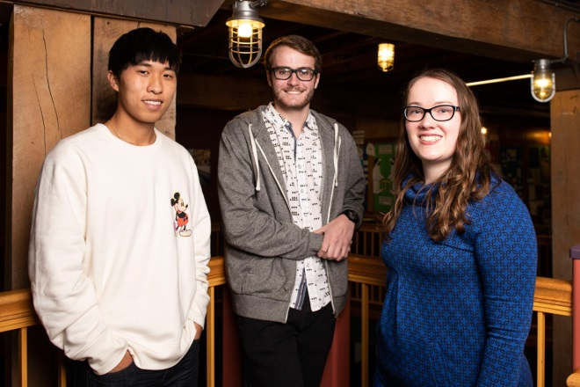
SCUDEM - The Basics
This challenge is for three member teams of students and a faculty coach/mentor.
SCUDEM takes place over a week-long period that begins on a Friday with release of problems at each team’s individual home campus
SCUDEM culminates on Challenge Saturday at the end of the next week at a nearby regional host site in the United States and beyond.

Slide 13
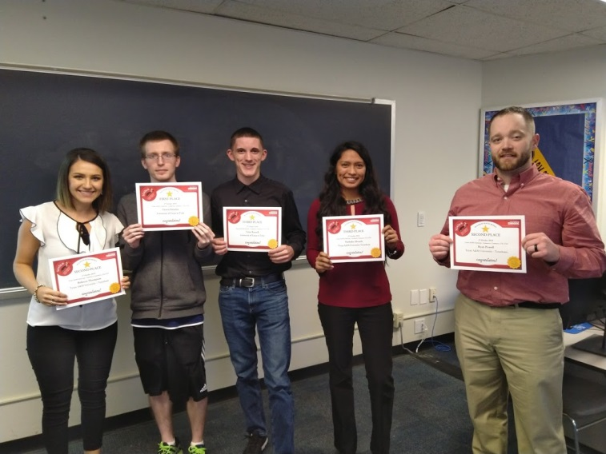
Teams work at home institution for a week on a modeling problem of their choice and preparing an Executive Summary and 10 minute Presentation.
Problems are drawn from the physical, social, and life sciences.
The problems are designed so that every team may experience success in modeling, enhance their model building skills, and increase their confidence in modeling with differential equations.
All teams get an award
Outstanding, Meritorious
or Successful. All win!
It is about the challenge!

Slide 14
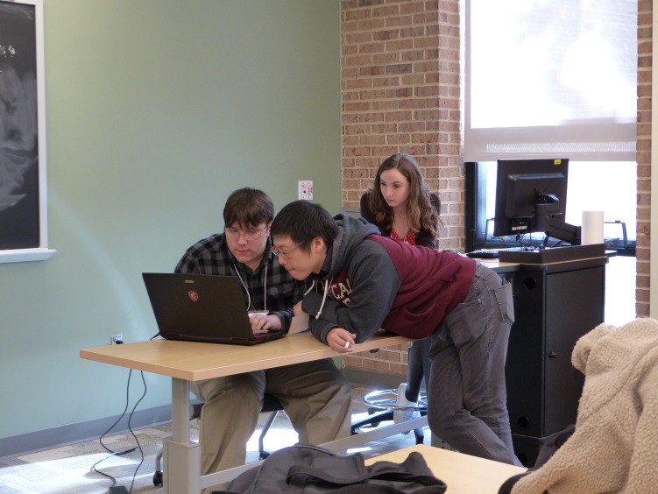
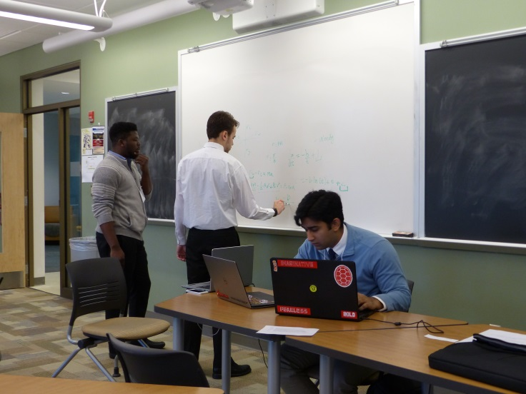
Problem A - Sorting Recyclables - When recycling began in the United States many places required that people separate the different kinds of materials they recycled, and the different materials were collected separately.
Problem B – Alarm Bells - Prey animals have to strike a balance when deciding whether or not to flee a potential predator.
Problem C - Modeling the Cool Kids - One common stereotype about interactions of students at high school and college is that students self-organize into different social groups or cliques.

Slide 15
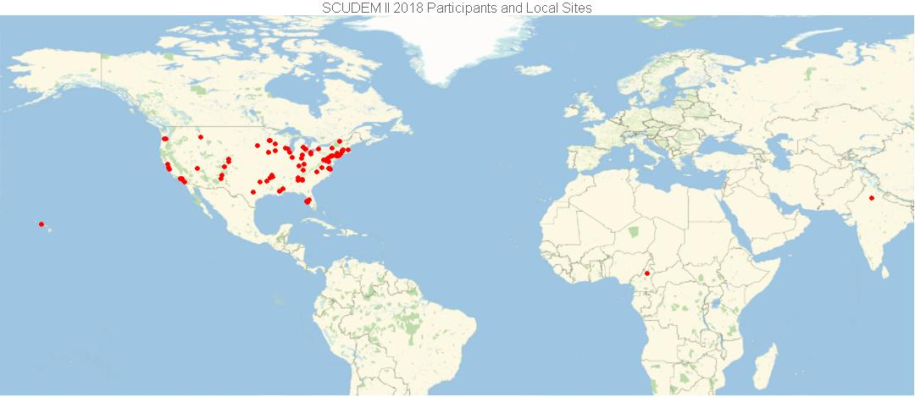
On Challenge Saturday, teams travel with
faculty coach to a nearby regional host sites.
We are looking for local site hosts for SCUDEM IV 2019, 9 November 2019.

Slide 16
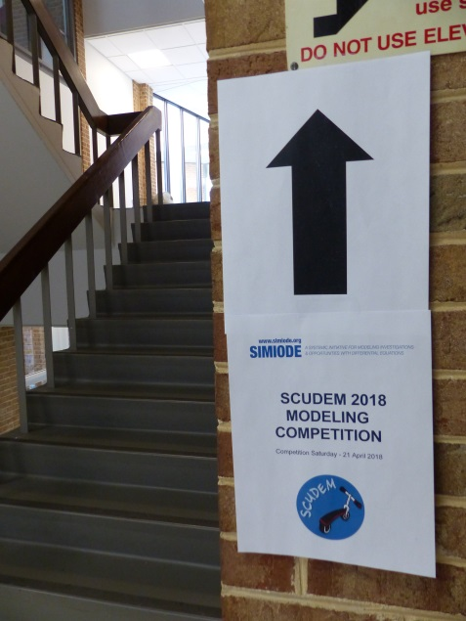
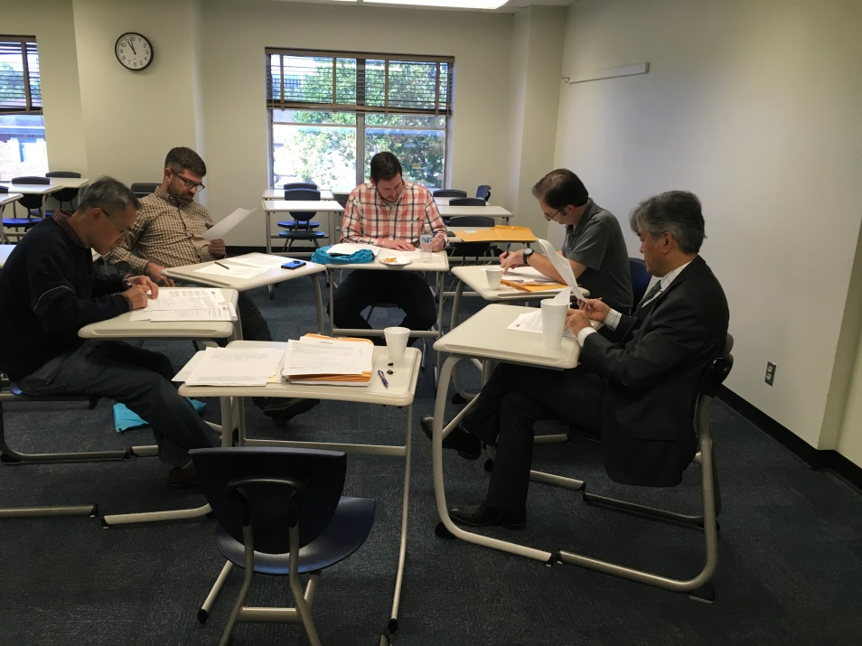
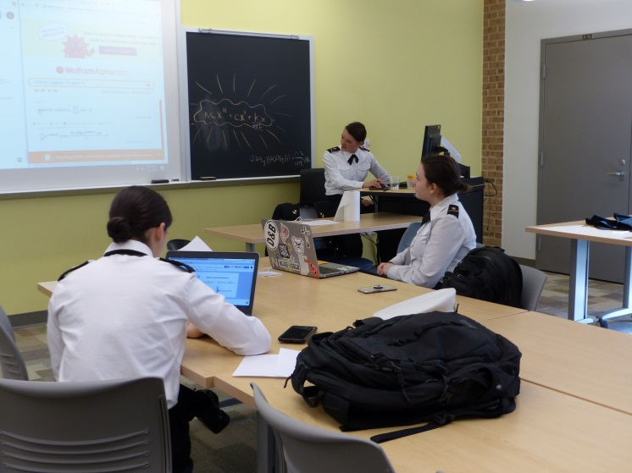
At check-in student teams turn in their Executive Summary for judging by coaches present as students.
Teams then work on a small supplement (NOT a redo) to their modeling problem for inclusion in their final Presentation.

Slide 17
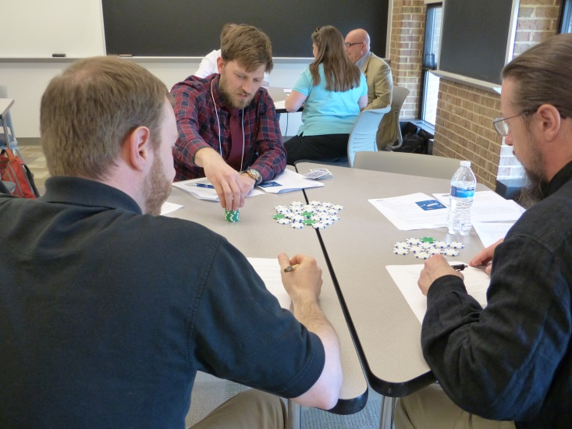
Faculty participate in workshops to help them incorporate more differential equations modeling in their coursework.
The first part of the Faculty Development program engages students and faculty in live modeling scenarios to experience the joy of modeling and form the basis of discussions about the value of modeling in learning and teaching differential equations. Second part devoted to more pedagogical and technical issues for faculty.
Workshop developed by DRs Lisa Driskell, Catherine Bonan-Hamada, and Tracii Friedman, Colorado Mesa University, Grand Junction CO.

Slide 18
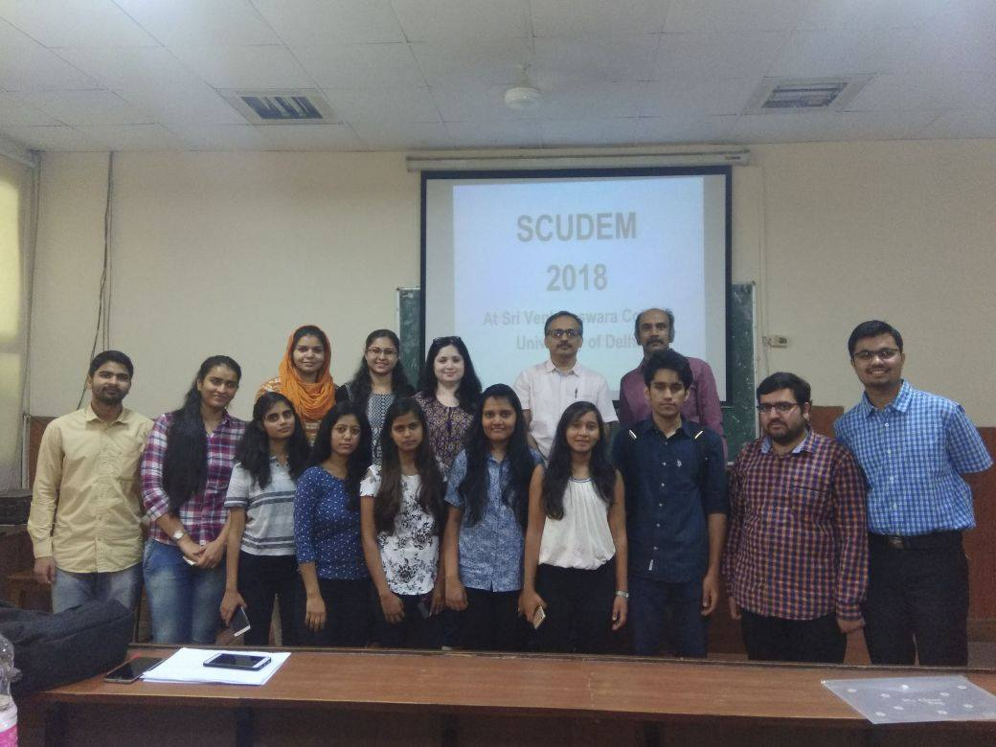
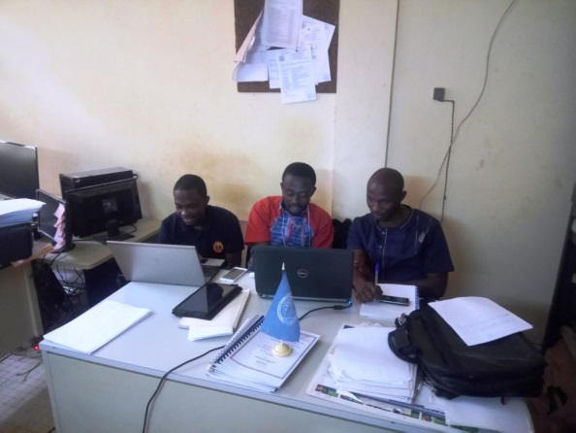
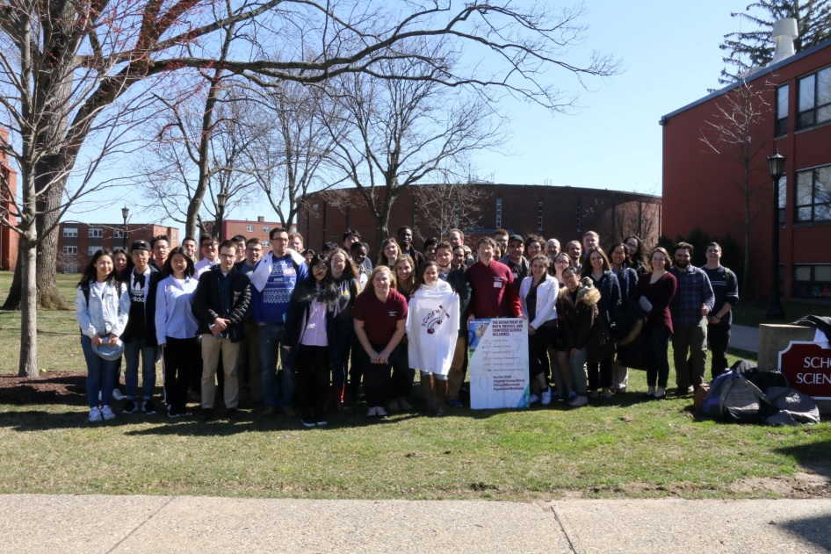
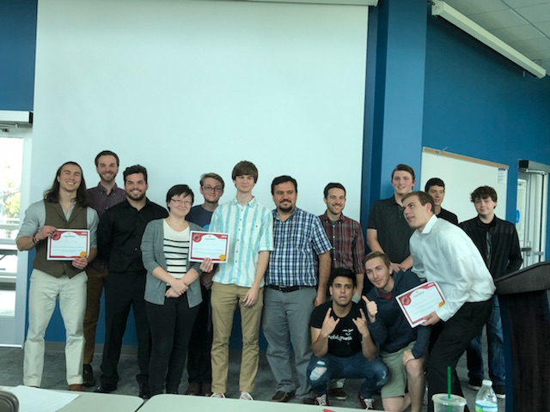
University of Ngaoundere, CAMEROON
University of Delhi, INDIA
St. Petersburg College, Florida
Springfield College, Massachusetts

Slide 19
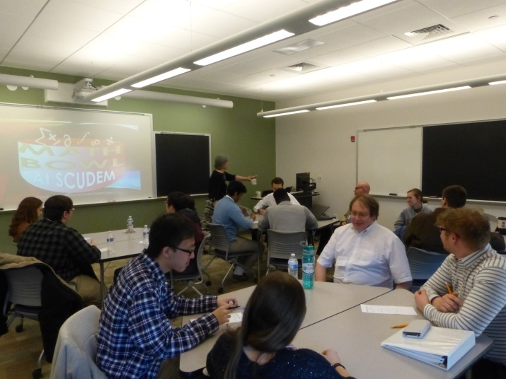
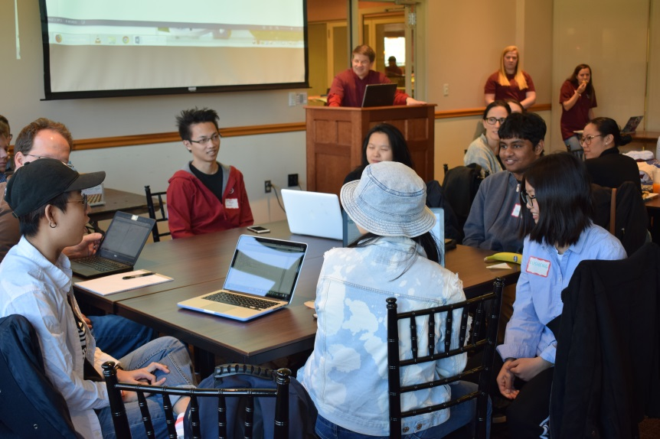
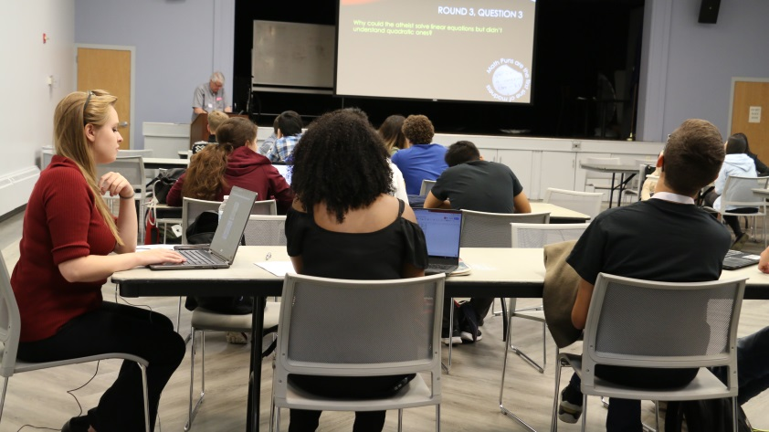
After lunch faculty discuss issues in teaching modeling.
Students engage in a fun team MathBowl.

Slide 20
After lunch faculty discuss issues in teaching modeling while students engage in a fun team MathBowl.

Slide 21
After lunch faculty discuss issues in teaching modeling while students engage in a fun team MathBowl.

Slide 22
Another groaner from MathBowl!

Slide 23
Another groaner from MathBowl!

Slide 24
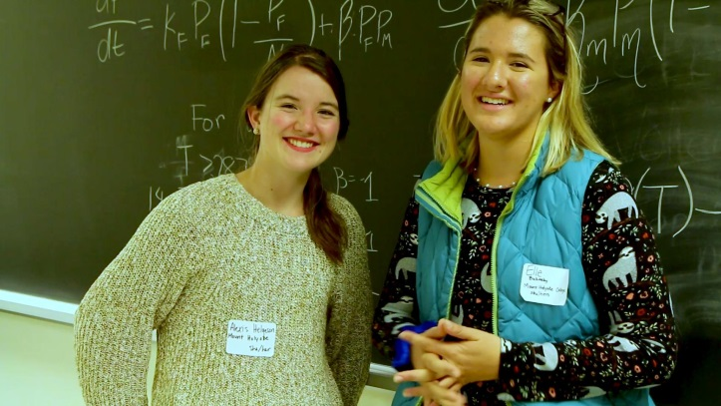
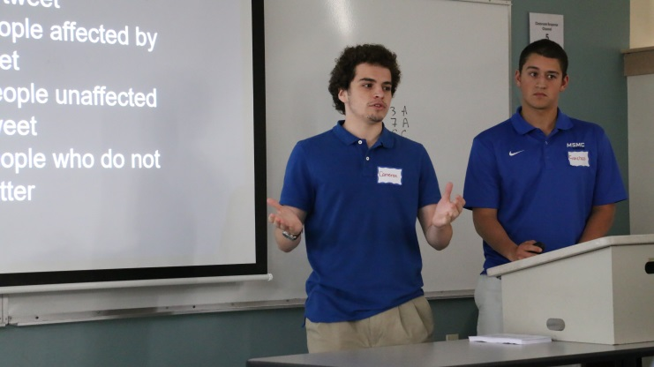
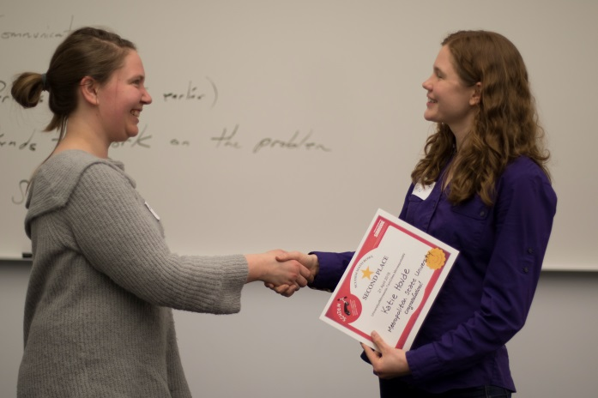
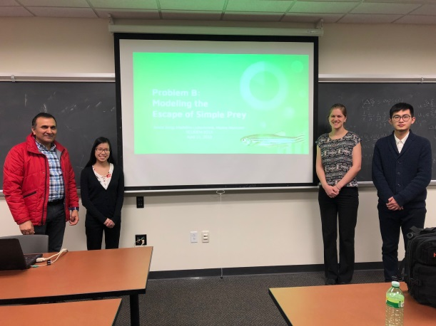
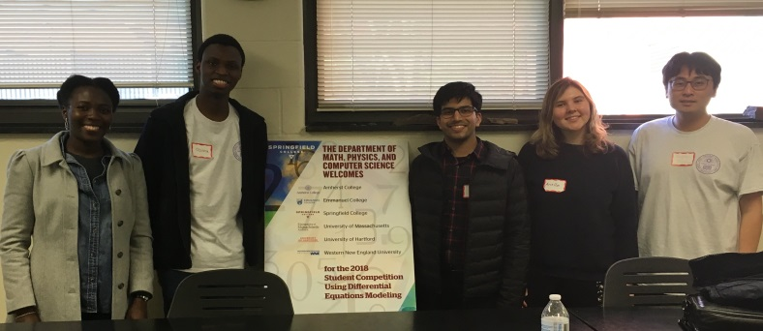
Finally, each team presents its 10 minute Presentation, judged by an audience of coaches and visiting faculty.
The challenge culminates with an awards ceremony rounding out the day by 4:30 PM to allow time to travel home.

Slide 25
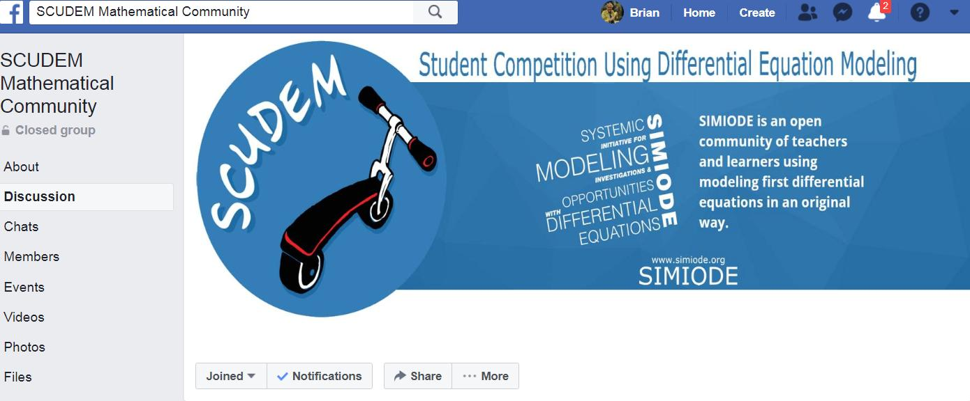
Facebook SCUDEM Page
Source: https://www.simiode.org/scudem
or Search SCUDEM in Google!

Slide 26
Not so small print . . . .
Team and faculty registration fee for SCUDEM and
Faculty Development Workshop is $100 total.
Host school gets their registration fee refunded and
receives one half visiting teams’ registration fees.
All (that means ALL!) materials provided by SIMIODE.

Slide 27
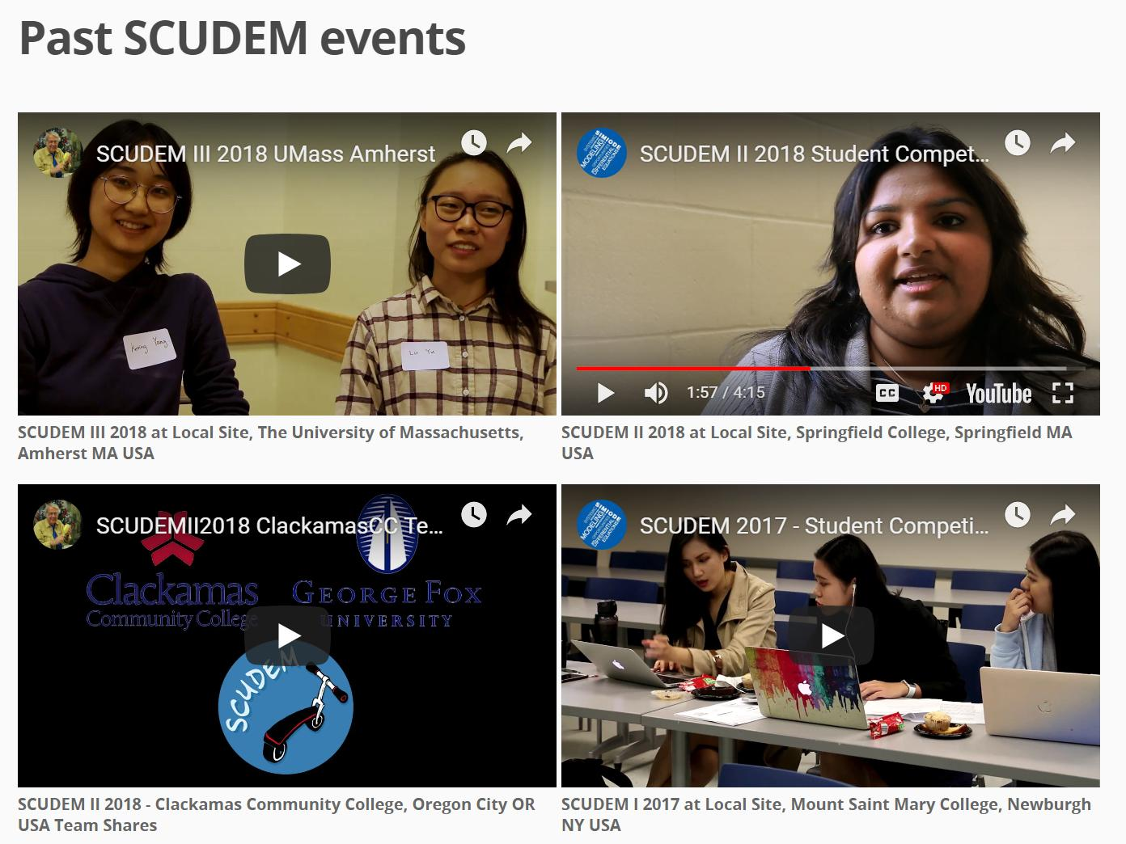
Students tell the story of SCUDEM.

Slide 28
SCUDEM is growing. . . .
SCUDEM III 2018, 27 October 2018 had
40 local sites in United States and beyond
400 students in three member teams
110 coaches
85 schools
Consider hosting for SCUDEM IV 2019, 9 November 2019
See https://www.simiode.org/scudem/2019/hosting
SCUDEM Gathering Friday, 7 – 8:30 PM Douglas Rm Hilton
See page 248 JMM Program Book

