Slide 1
For the 10th Annual Spuyten Duyvil Undergraduate Mathematics Conference, Manhattan College
Modeling First Teaching of Differential Equations – SIMIODE
0930, 16 April 2015 Miguell Hall 207
Brian Winkel, PROF Emeritus,
Mathematical Sciences,
United States Military Academy
West Point NY 10996 USA
BrianWinkel@simiode.org
Director SIMIODE
www.simiode.org

Slide 2

We present an approach we have used for years and are developing as a web-based community of teachers and learners
www.simiode.org
Modeling first differential equations We discuss examples of activities to enable students to develop mathematical modeling skills using differential equations while using technology throughout their learning and doing mathematics.
Systemic Initiative for Modeling Investigations
and Opportunities with Differential Equations

Slide 3

SIMIODE Team
Leigh Noble, Technical Director and applied mathematician
Mark Tourtellott, Technical Director, Art Designer
Jessica Libertini – VMI - Virginia Military Institute, Associate Director
Karen Bliss – Quinnipiac U and then VMI, Associate Director
Brian Winkel, Director, Emeritus MathSci, USMA
Eric Sullivan, Carroll College
Ted Wendt, Carroll College
Audrey Malagon, VA Wesleyan College
Board of Contributing Advisors

Slide 4


i

Slide 5
Sources of modeling opportunities with data are all about us.
(1) Do the Internet thing,
(2) browse library journals – current and the stacks in fields
not known to you,
(3) talk to colleagues OUTside mathematics,
(4) do your own, e.g., spread of slime or cookie dough!
(5) attend other department seminars and conferences,
(6) see ideas in Teachers Group at www.simiode.org.
Take risks, learn yourself, jump into the modeling process
with your students, and have fun learning with them!
Reference: Winkel, B. J. 2013. Browsing Your Way to Better Teaching.
PRIMUS: Problems, Resources, and Issues in Mathematics Undergraduate Studies.
23(3): 274-290. Original references in this paper.

Slide 6
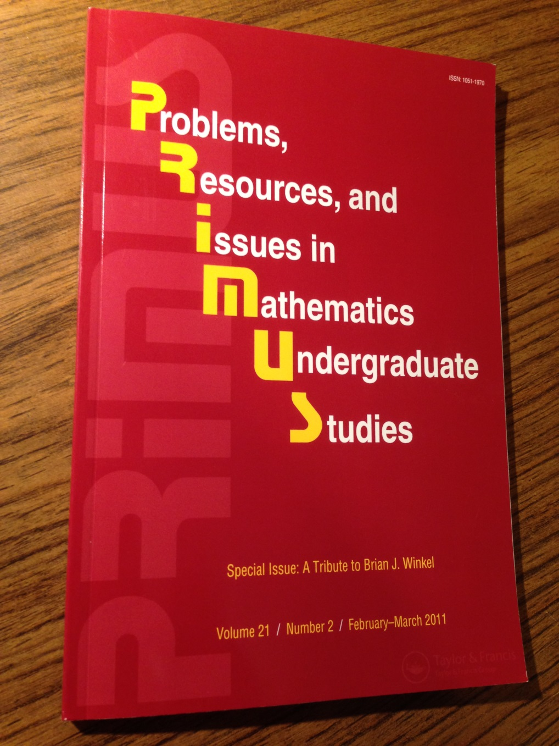
A place find resources for
teaching . . . .
. . . and another place to share
your teaching efforts. . .

Slide 7
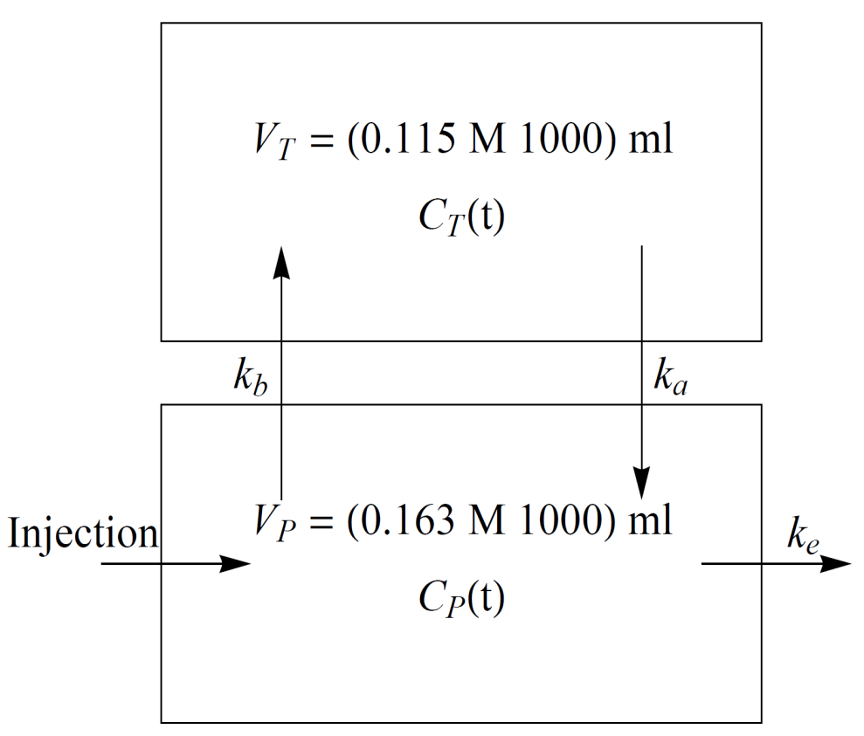
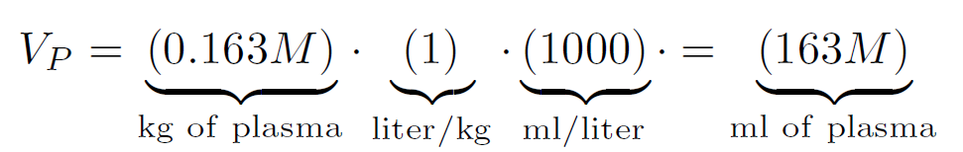
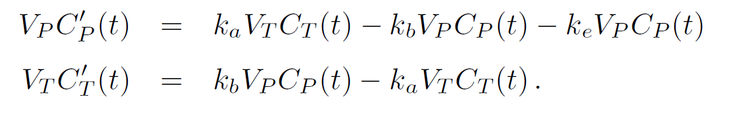
Modeling Lysergic acid diethylamide (LSD) in the human body
C_{P} (0) = 12.2699, for originally LSD was injected at a concentration of 2,000 ng
per kg of body mass for each subject and so we have an initial concentration in the plasma of12.2699 = 2000M/.163M1000 ng of LSD/kg of body mass. C_{T}(0) = 0.
COMPARTMENT MODEL
P = Plasma and T = Tissue
Reference: Winkel, B. J. 2013. Browsing Your Way to Better Teaching. PRIMUS: Problems, Resources, and Issues in Mathematics Undergraduate Studies. 23(3): 274-290. Original references in this paper.

Slide 8
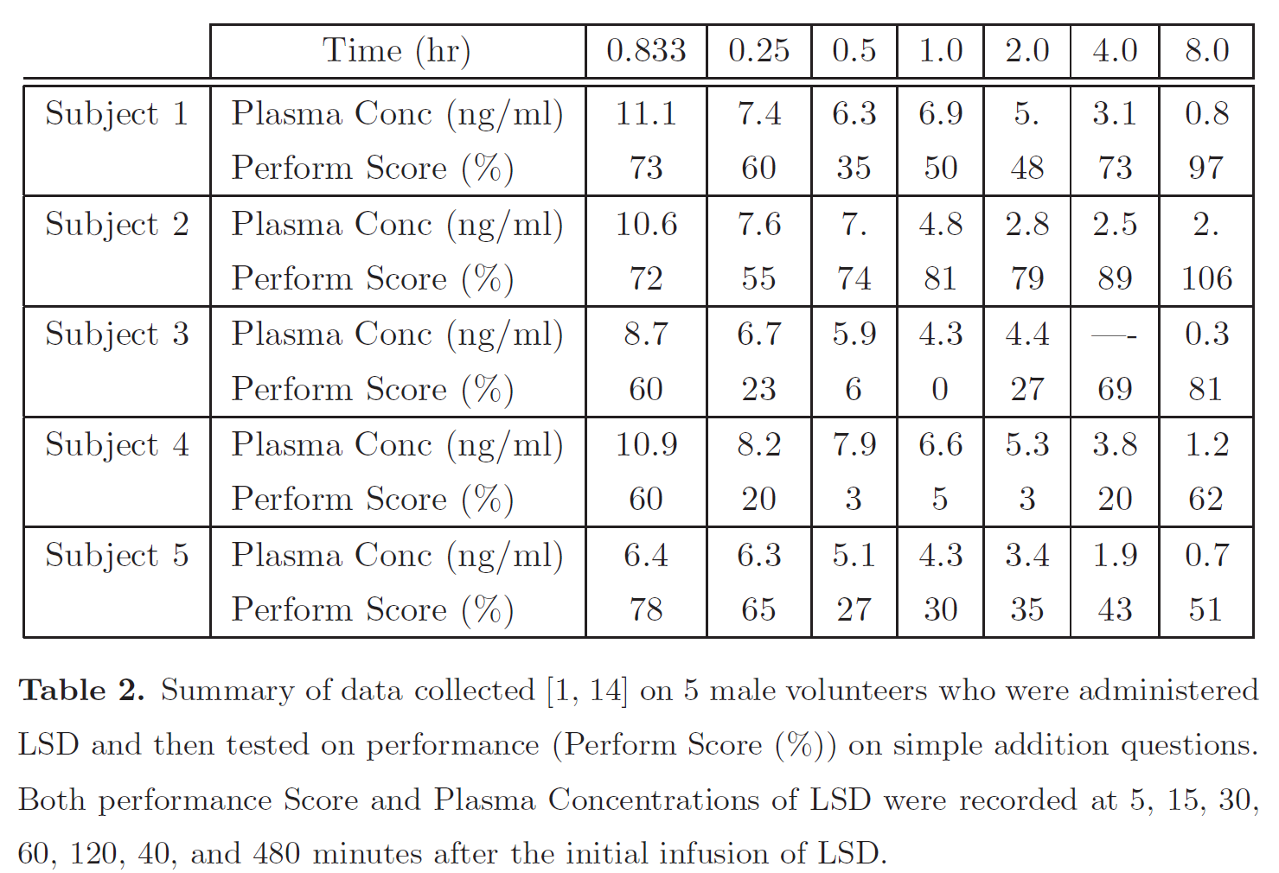

Slide 9
This is the formula for C_{T}(t), the concentration
of LSD in the Tissues as a function of time t.
Solving the system can be done by hand using eigenvalue approaches or with a computer
algebra system (in our case Mathematica) offering a closed form solution.
Take time to notice the forms machines return to us. . . . exponential decay in Tissues.

Slide 10
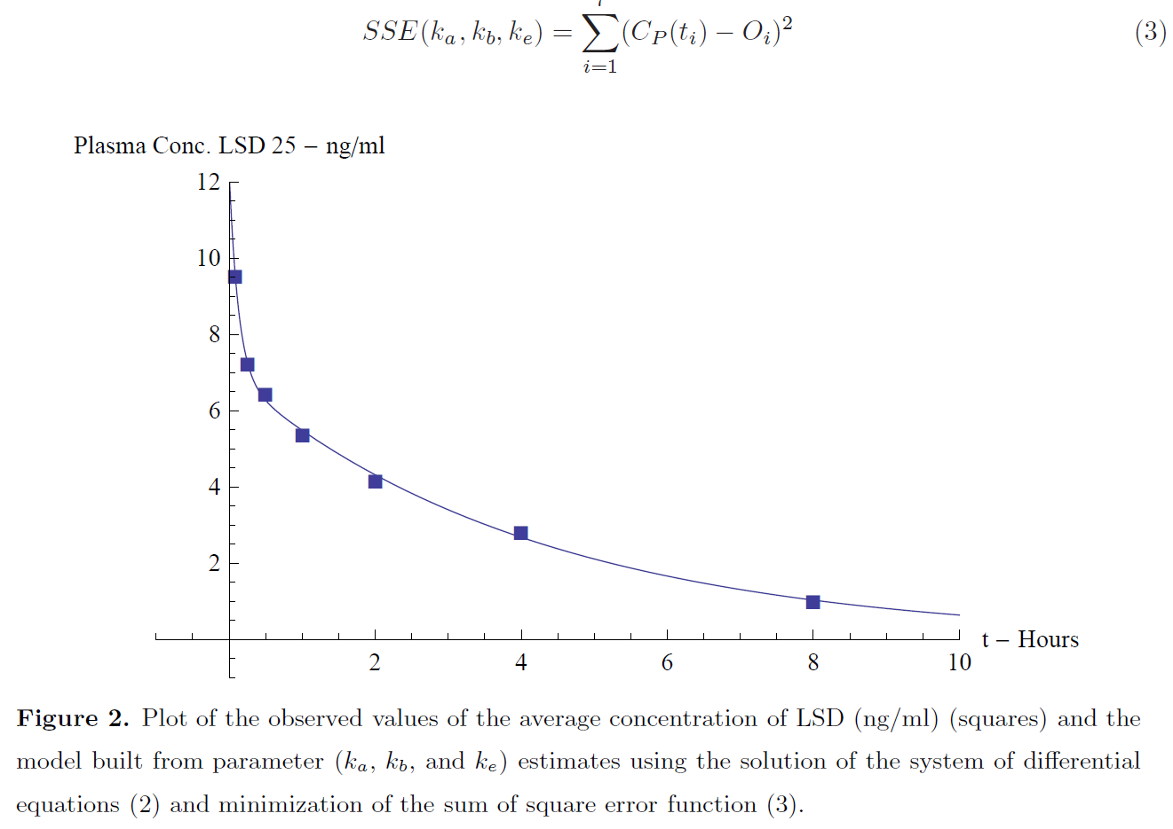

Slide 11
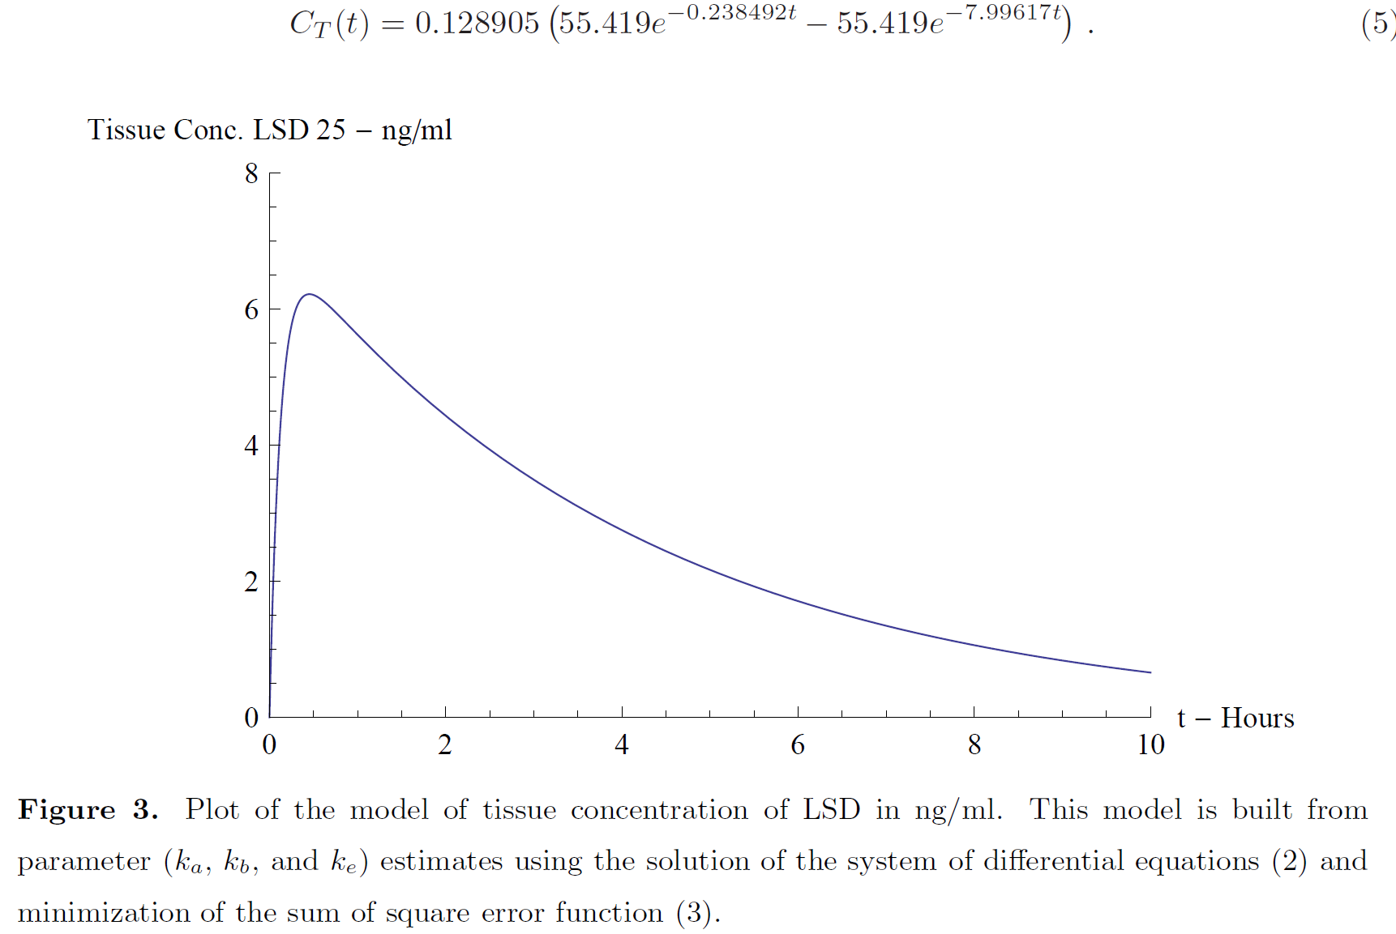

Slide 12
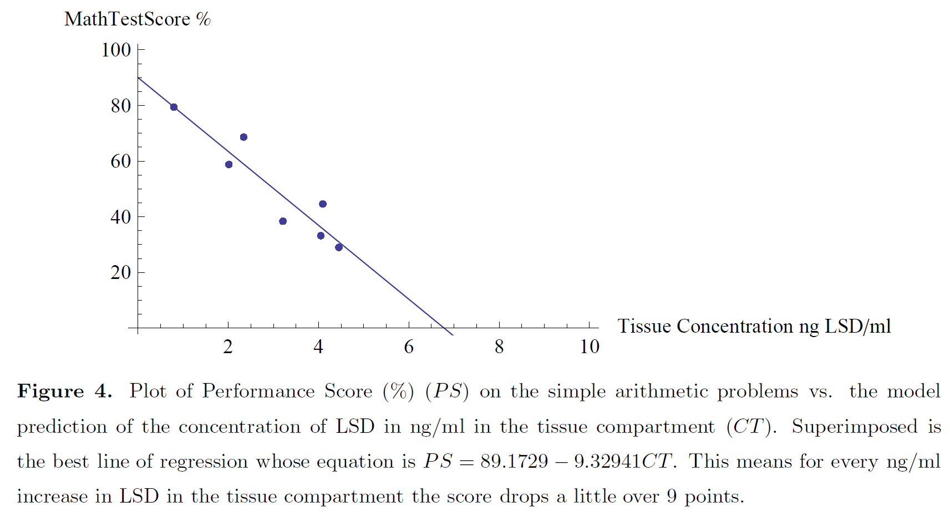

Slide 13
Tuned Mass Dampers
Introduced in MA364 Engineering Mathematics
A Tuned Mass Damper (TMD) is a passive mechanical counterweight for a structure consisting of a moving mass (roughly 1–2% of the structure’s mass) which is usually placed in the upper portion of the structure. The purpose of the TMD is to reduce the effects of motion caused by wind or earthquake.
The first uses of TMDs in the United States for large structures was in the John Hancock Building in Boston in 1977 and City Corp Center in New York in 1978.
TMD’s are used in many, many structures and devices, including buildings and bridges, electric razors, rotating tools, surgery table platforms, etc.
So what is a TMD? Well it is just a system of two second order differential equations
And a physical device to implement the results.
TMD’s can be in the form of sliding slabs (HUGE) of concrete and steel, sloshing tanks of water, pendula, and more.
Winkel, B. J. and K. Landry. 2008. Peak Frequency Responses and Tuned Mass Dampers--Exciting
Applications of Systems of Differential Equations. The UMAP Journal. 29(1): 15-30.

Slide 14
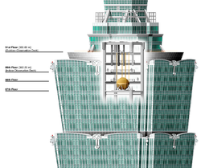
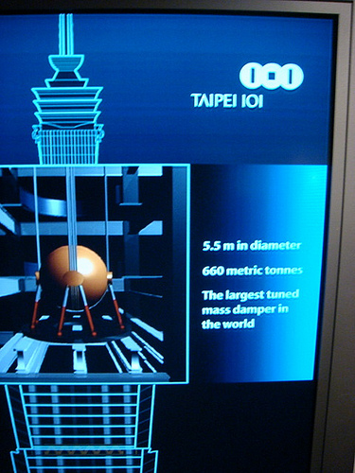

Slide 15
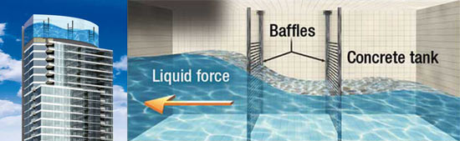
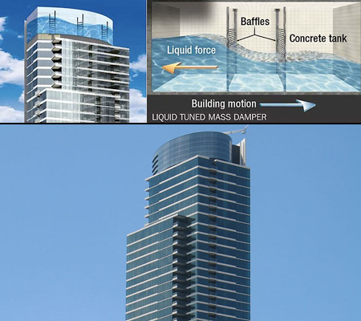

Slide 16
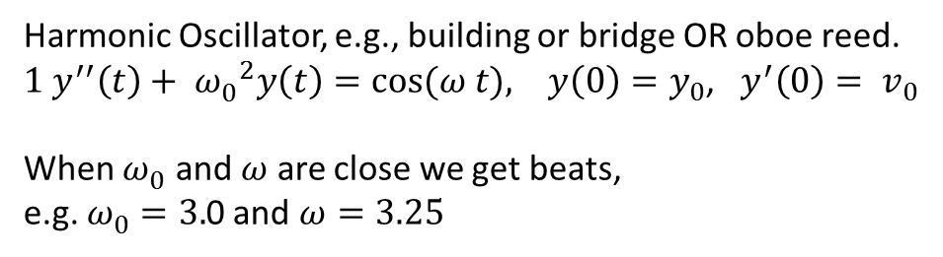
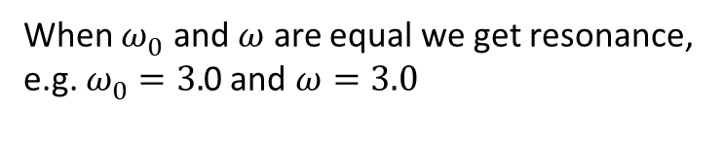
Harmonic Oscillator, e.g., building or bridge OR oboe reed.
$1 y^{′′}\left(t\right)+ {ω_{0}^{}}^{2}y\left(t\right)=cos⁡(ω t), y\left(0\right)=y_{0}$, $y^{′}\left(0\right)= v_{0}$
When $ω_{0}^{}$ and $ω$ are close we get beats,
e.g. $ω_{0}^{}$ $=3.$0 and $ω=3.25$
When $ω_{0}^{}$ and $ω$ are equal we get resonance,
e.g. $ω_{0}^{}$ $=3.$0 and $ω=3.0$

Slide 17
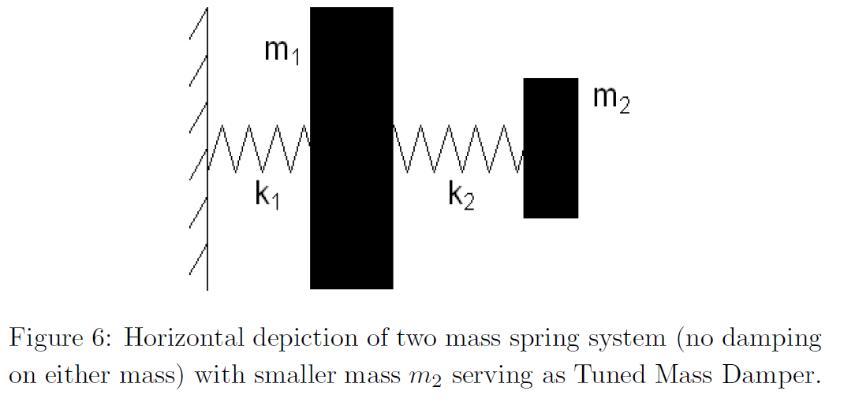
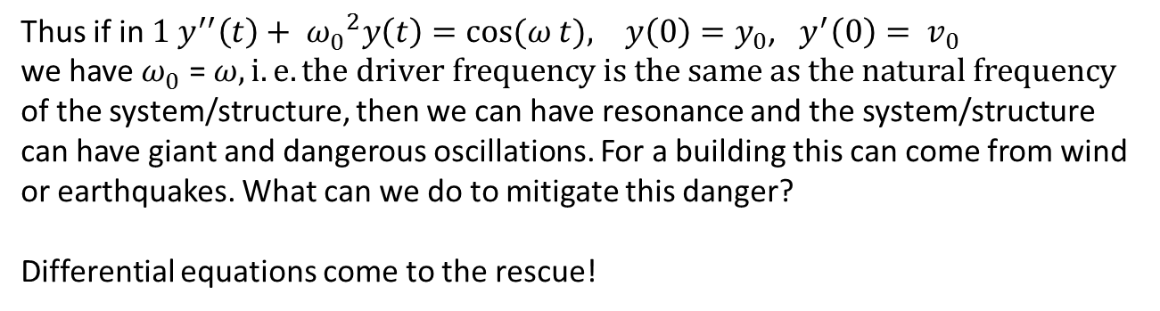
Thus if in $1 y^{′′}\left(t\right)+ {ω_{0}^{}}^{2}y\left(t\right)=cos⁡(ω t), y\left(0\right)=y_{0}$, $y^{′}\left(0\right)= v_{0}$
we have $ω_{0}^{}$ = $ω, i.e. the driver frequency is the same as the natural frequency$
of the system/structure, then we can have resonance and the system/structure
can have giant and dangerous oscillations. For a building this can come from wind
or earthquakes. What can we do to mitigate this danger?
Differential equations come to the rescue!

Slide 18
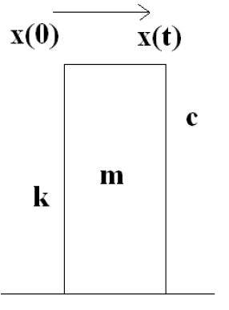
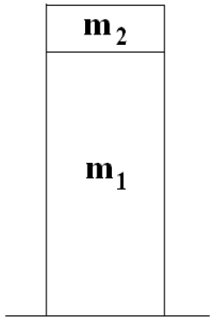
Depiction of two masses for a structure – smaller mass on top.
K (spring constant) is called stiffness and c is still called damping coefficient.

Slide 19
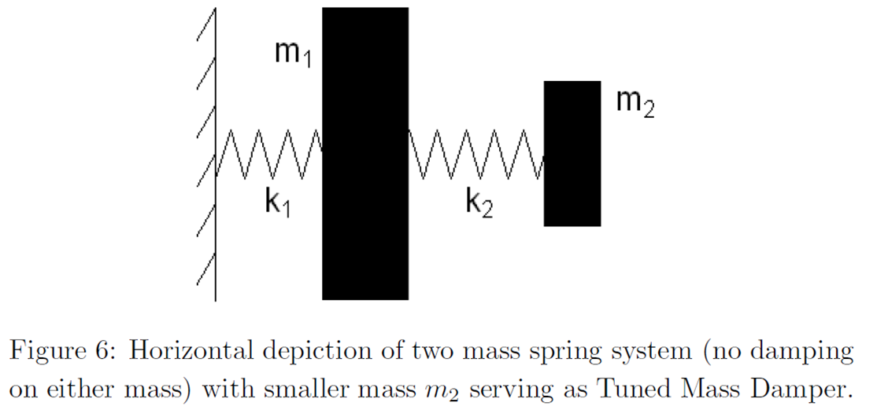
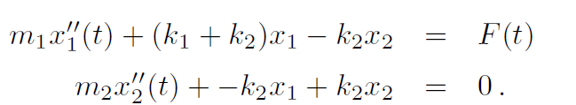
In the simplified case where there is no damping (i.e. c = 0) then we
might seek to control for resonance by adding a second “tuned” mass.

Slide 20
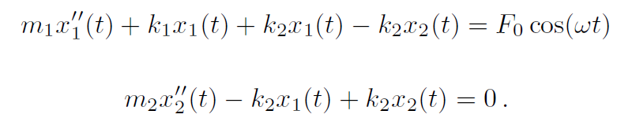
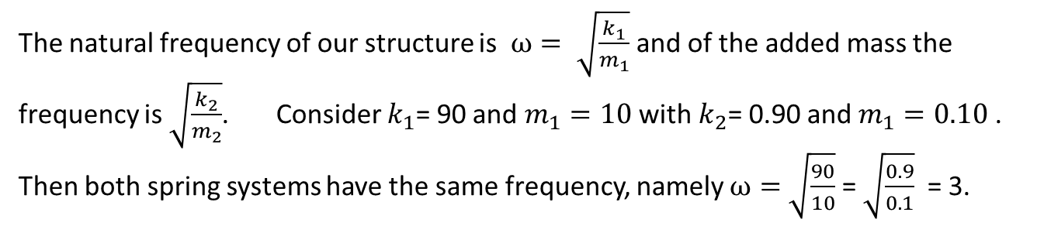
We now “drive” the larger mass with a force. . wind, earthquake
If no second mass then we could have resonance (c=0) or high amplitude.
So we add a second smaller mass and we “tune” it so that its system has the
same frequency as that of the larger mass.
The natural frequency of our structure is $ω= \sqrt{\frac{k_{1}}{m_{1}}}$ and of the added mass the frequency is $\sqrt{\frac{k_{2}}{m_{2}}}$. Consider $k_{1}$= 90 and $m_{1}=10$ with $k_{2}$= 0.90 and $m_{1}=0.10$ . Then both spring systems have the same frequency, namely $ω=$ $\sqrt{\frac{90}{10}}$ = $\sqrt{\frac{0.9}{0.1}}$ = 3.

Slide 21
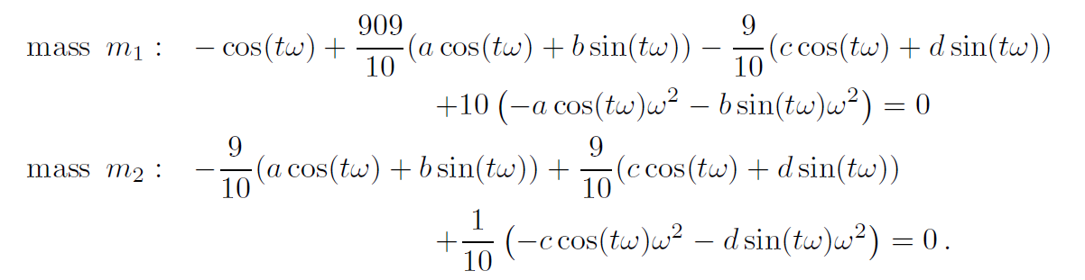
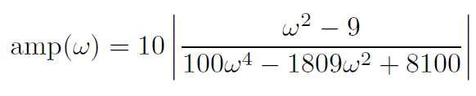
Now, by examining the solution of our system
we can combine terms, simplify, and determine that the amplitude of the resulting
oscillation of mass is
A picture is worth . . . . . How many words . . . . or equations?

Slide 22
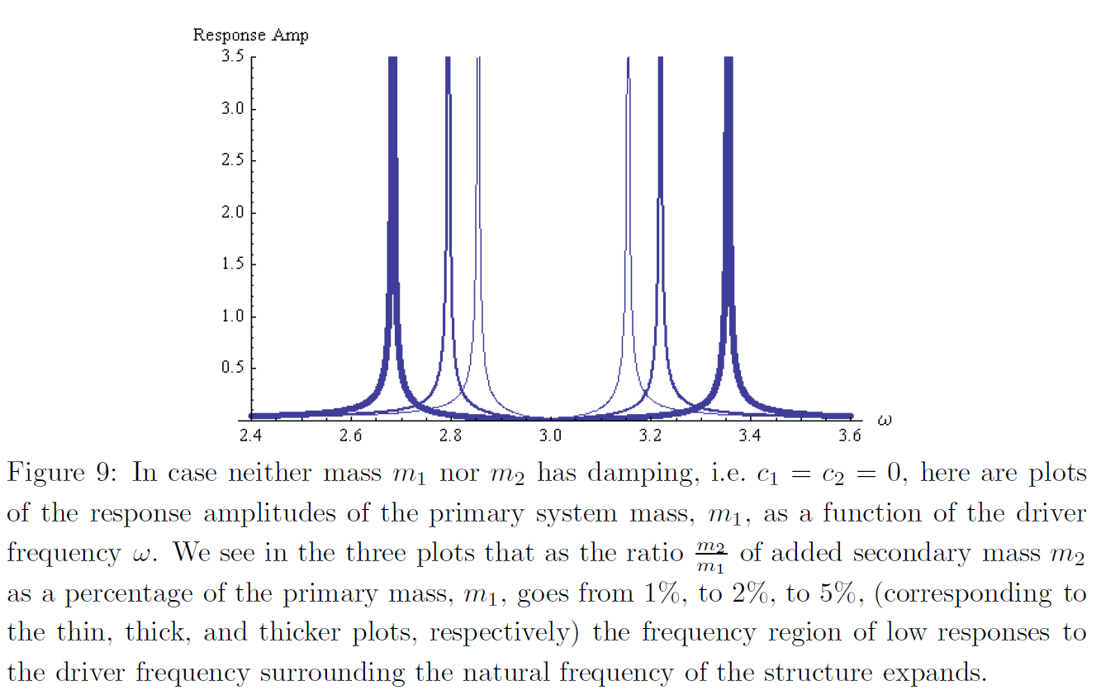
So if we are willing to add more and more mass we get a wider “safe” region.

Slide 23

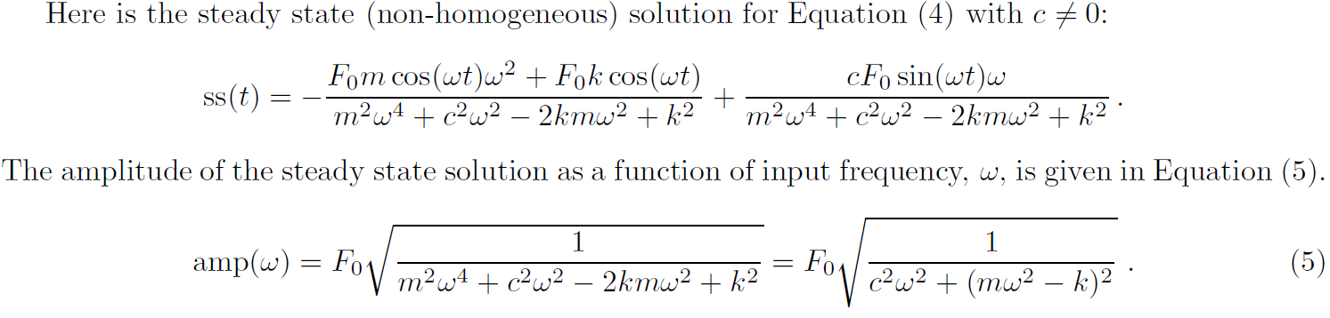
Incidentally, if we go back to just our one mass system
with a driving force
How big can the response, amp(ω), really be?
We seek the maximum frequency response of amp(ω). Again, a picture . . . .

Slide 24
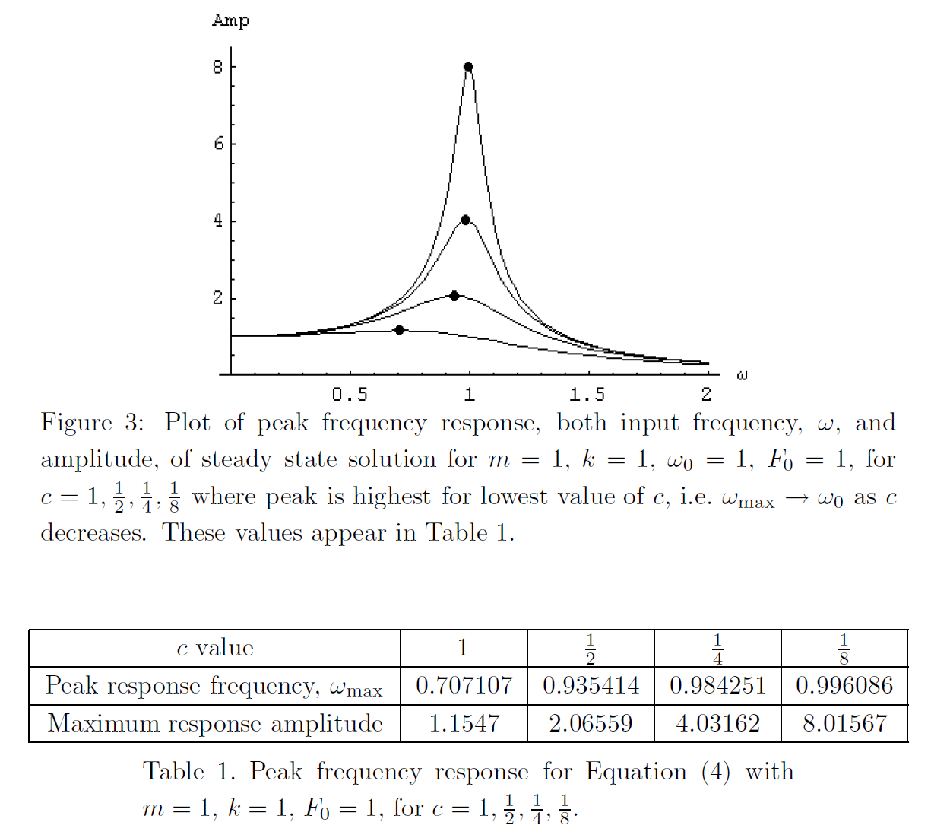

Slide 25
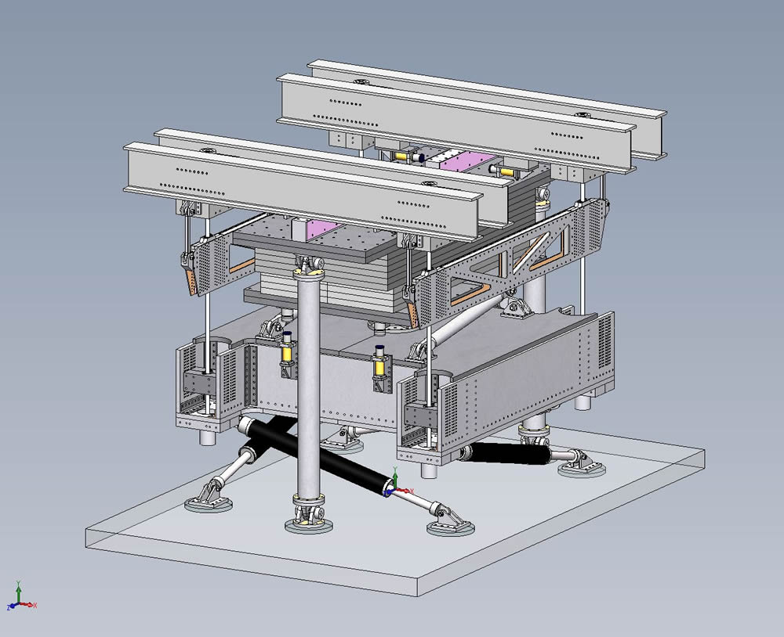
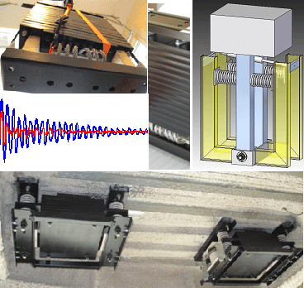

Slide 26
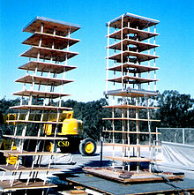

Slide 27
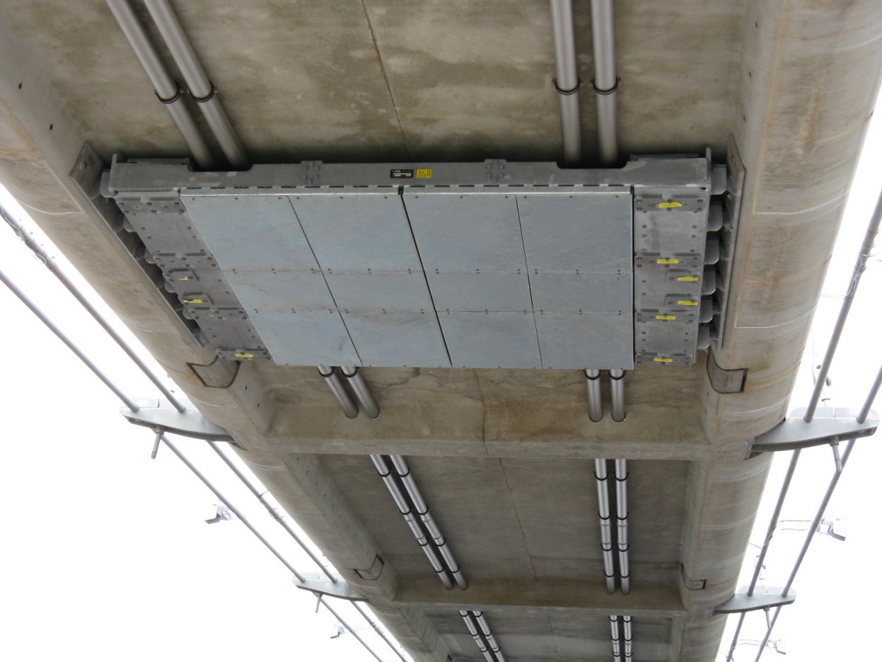
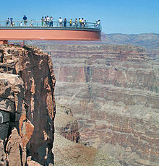

Slide 28
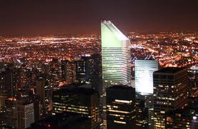
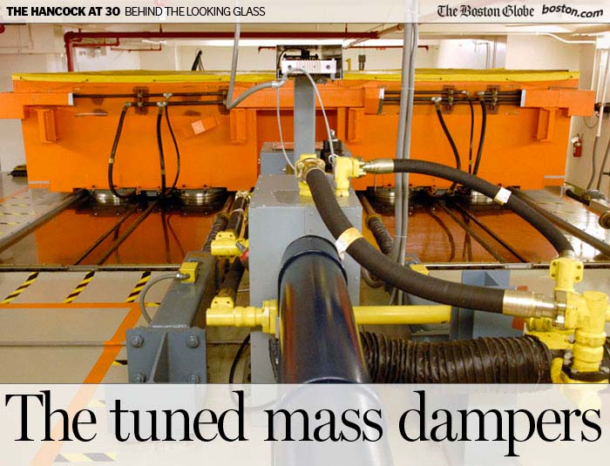

Slide 29
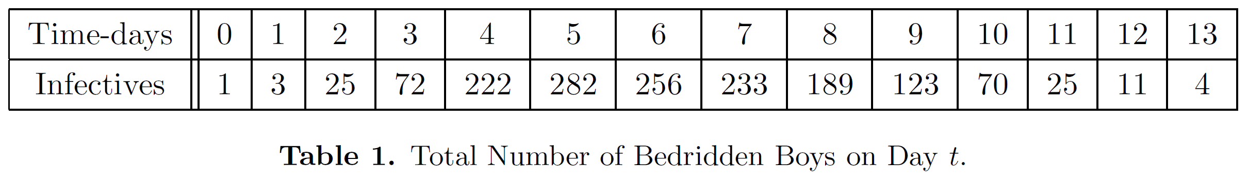
Source: Communicable Disease Surveillance Center. 1978. News and Notes: Influenza in a
Boarding School. British Medical Journal. 1(6112). http://www.pubmedcentral.nih.gov /
picrender.fcgi?artid=1603269&blobtype.pdf. Accessed 5 September 2008.

Slide 30
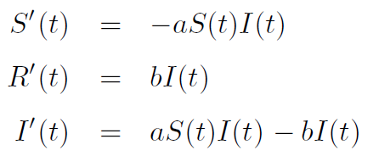
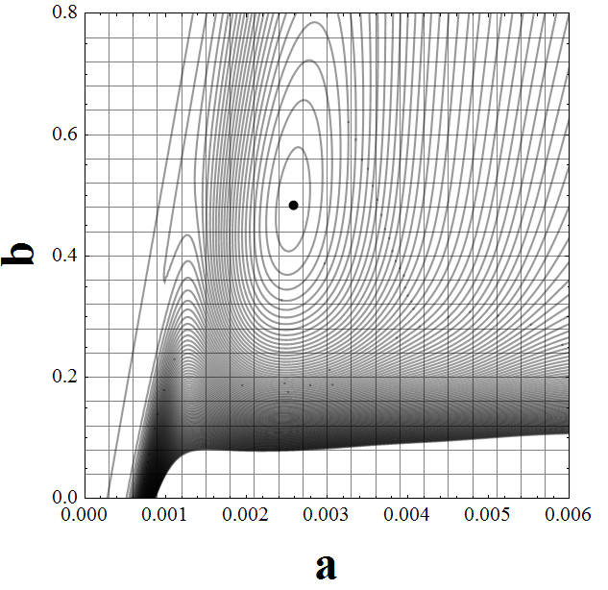
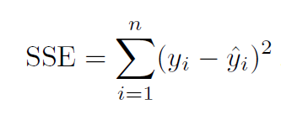
Continuous Model
Using grid in parameter space to minimize
with S(0) = 763-1, I(0) = 1, and
R(0) = 0 we obtain a = 0.00218
and b = 0.441.

Slide 31
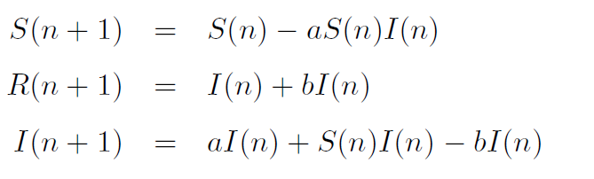
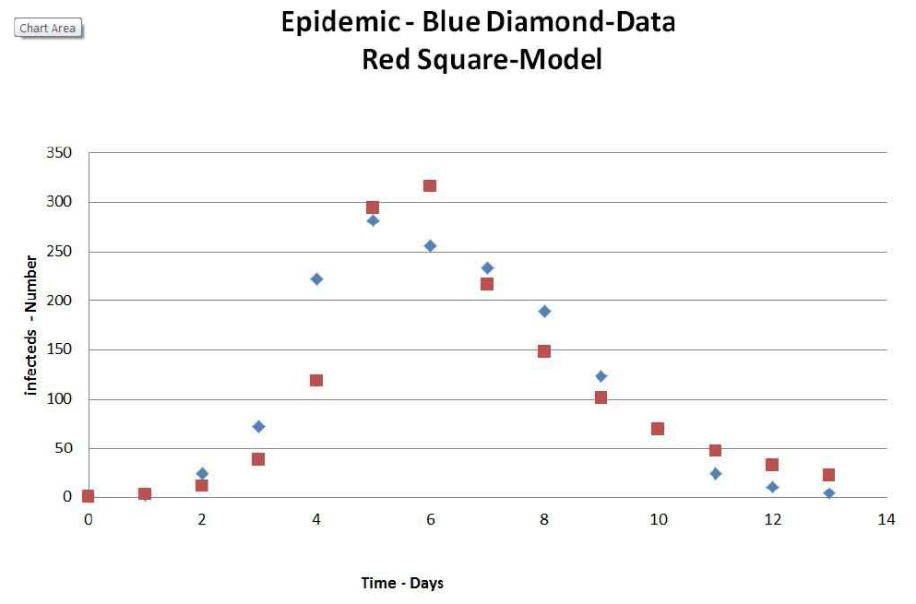
Discrete Model
Using EXCEL’s Solver to minimize
with S(0) = 763-1, I(0) = 1, and
R(0) = 0 we obtain a = 0.00291
and b = 0.72.

Slide 32
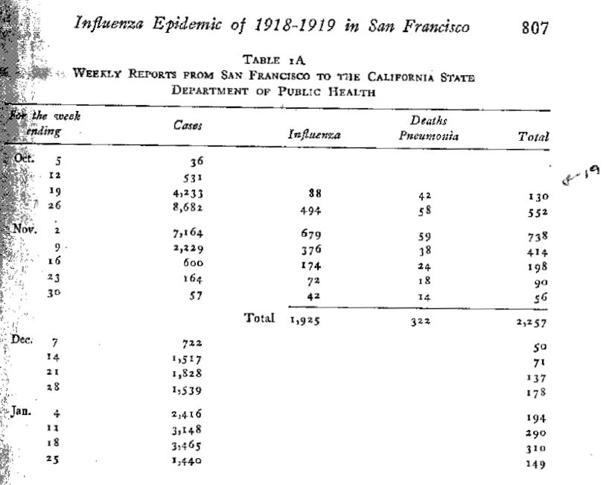
Source: Hrenoff, A. K. 1941. The Influenza Epidemic of 1918-1919 in San Francisco. The Military Surgeon. November: 805-811.
Source: Miller, S, and J. Helms. 2010. The Disease that Infected Half the World: Mathematics, Biology, and History. PRIMUS. 20(3): 245-260.

Slide 33
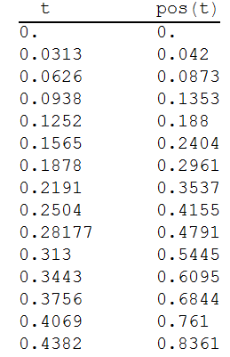
Collected data on falling coffee filters,
(time in s, position in m). Using Vernier
GoMotion detector.
Model built from Newton’s Second Law
m y''(t) = m*g - k y' (t)^{r} , y(0) = 0, y’(0) = v0
Usual cases r = 1 or r = 2. However, from data
k = 6.12 and r = 0.24 with SSE = 0.0000511
Grid in parameter space
(K, r, SSE(K,r)) and result of
gradient search.

Slide 34
The fit is . . . .

Slide 35
Spread of Disease Process
Experiment conducted at Cornwall NY USA by
DR Brian Winkel, PROF Emeritus US Military Academy,
West Point NY
Prepare a grid (print out M&MGridToUseForSimulations pdf file), mark 8 randomly selected cells as infected and write numbers 1 through 8 in each cell, respectively.
Make a corral surrounding the grid so when we toss the M&M’s they stay on the grid.
Source: Winkel, B. J. 2012. Sourcing for Parameter Estimation and Study of Logistic Differential Equation.
International Journal of Mathematical Education in Science and Technology. 43(1): 67-83.

Slide 36
Place 54 M&M’s in a cup and
gently toss them out onto the grid,
if an M&M contacts an infected cell/M&M mark the cell with next number of infected, first 9, then 10, then 11, etc. and remove infected M&M’s from population,
when all M&M’s are marked from this toss or generation collect M&M’s and toss again until all M&M’s are infected.
If you cannot perform this simulation then we have done this for you and enclose 12 generations of our simulation from which you are to gather data on the number of infected at each generation or time.

Slide 37
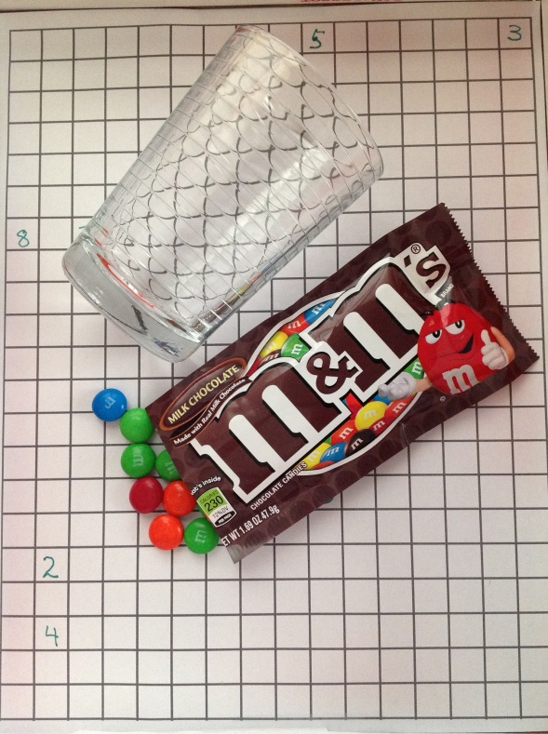
Equipment:
1 small bag regular M&M’s
1 small cup
1 level surface
Early actions:
Prepare grid with 8 randomly selected
infected cells. Number them as seen here.
Open bag and count out 54 M&M’ s.
Place M&M’s in cup.
Gently toss M&M’s onto surface.
If M&M contacts an infected cell/M&M
mark the cell with next number of
infected, first 9, then 10, then 11, etc.
Remove infected M&M’s from population.
When all M&M’s are marked from this toss
Or generation. Collect M&M’s and toss again.
Later action:
Yummy!!!

Slide 38
Collect data for each generation on y(t), the number of
M&M cells which are infected.
Plot the number of infecteds as a function of the generation (time).
Propose a mathematical model, using a differential equation
for the rate of spread of the disease.
Estimate the parameters using a sum of square errors method.
Compare your model to your data, numerically and graphically.
Does your model do a reasonable and reasoned job of modeling
this data and hence this phenomenon?

Slide 39
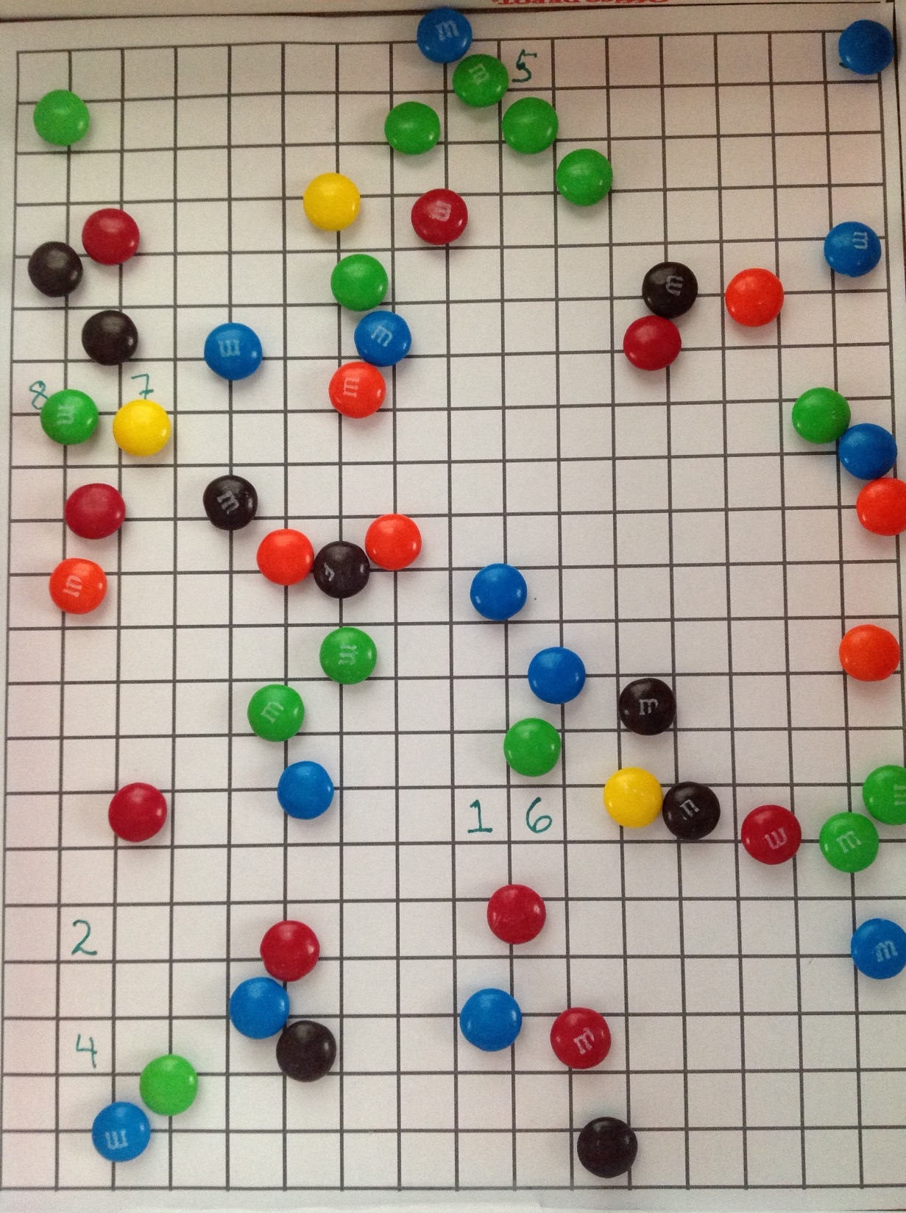
Generation 1

Slide 40
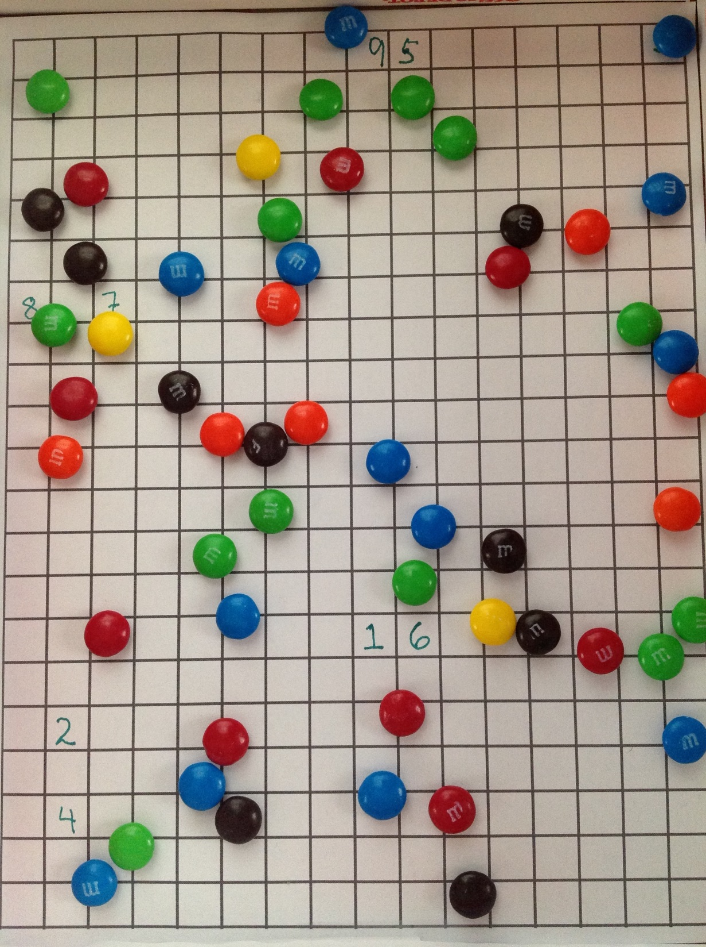
Generation 1

Slide 41
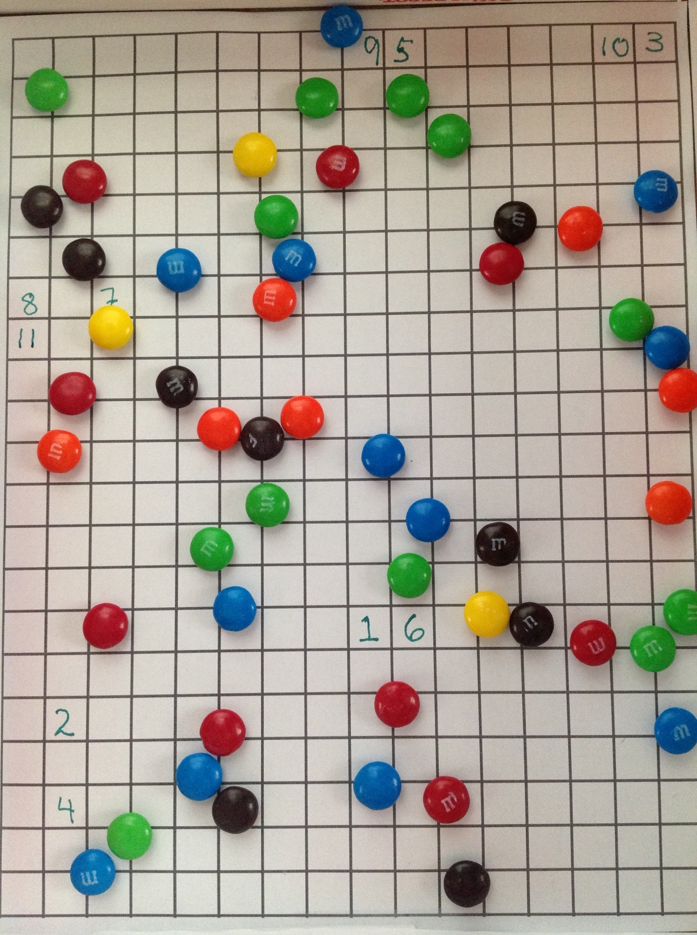
Generation 1

Slide 42
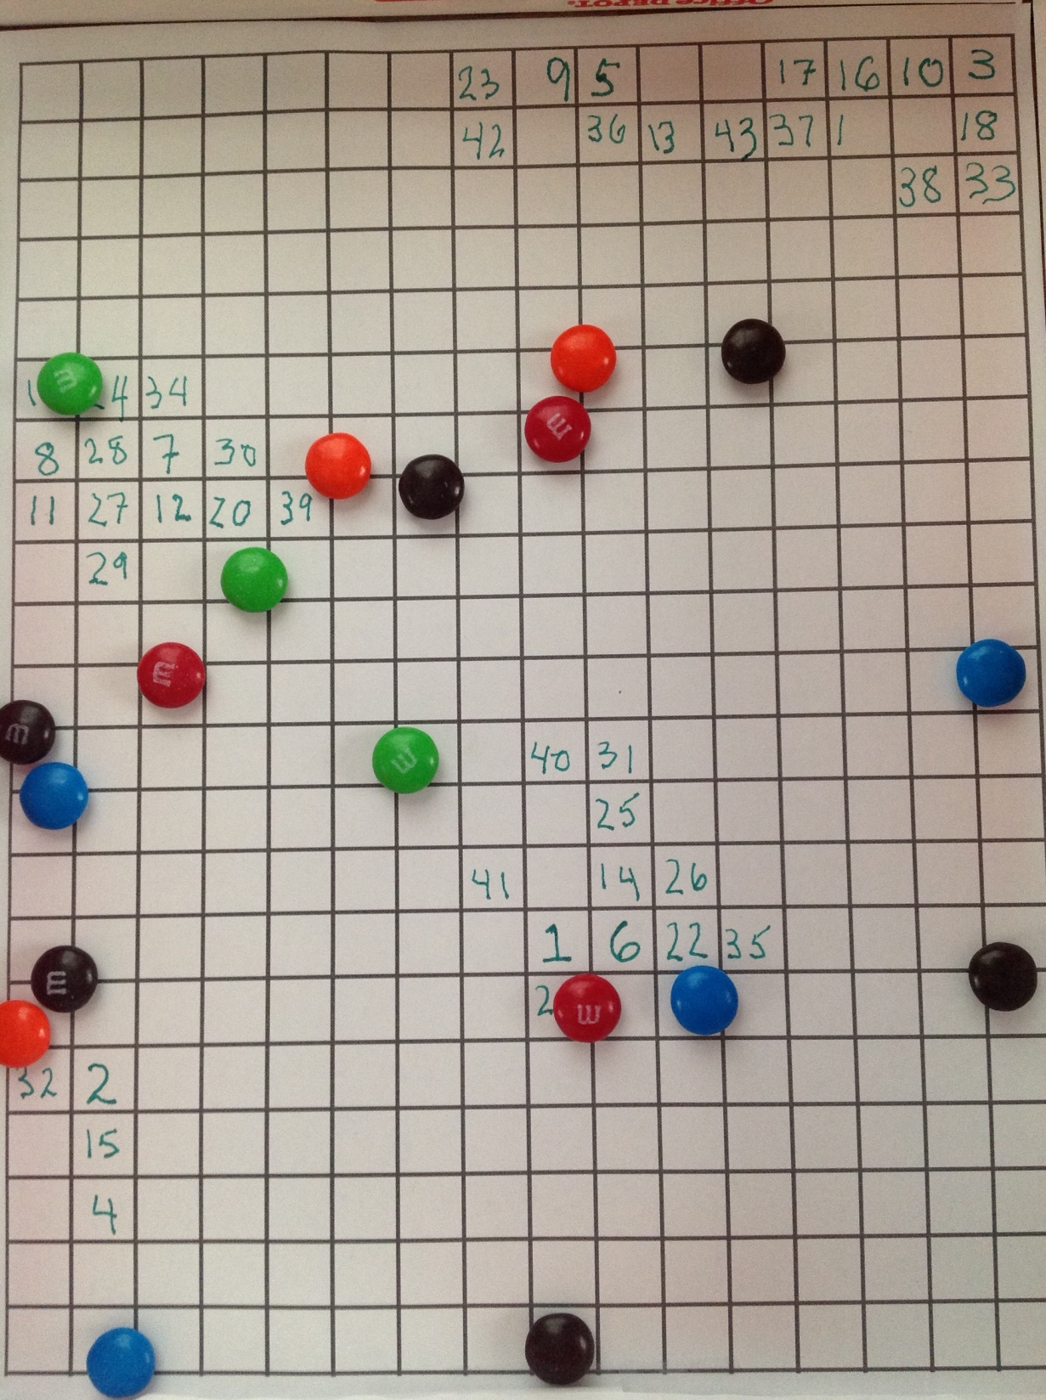
Generation 8

Slide 43
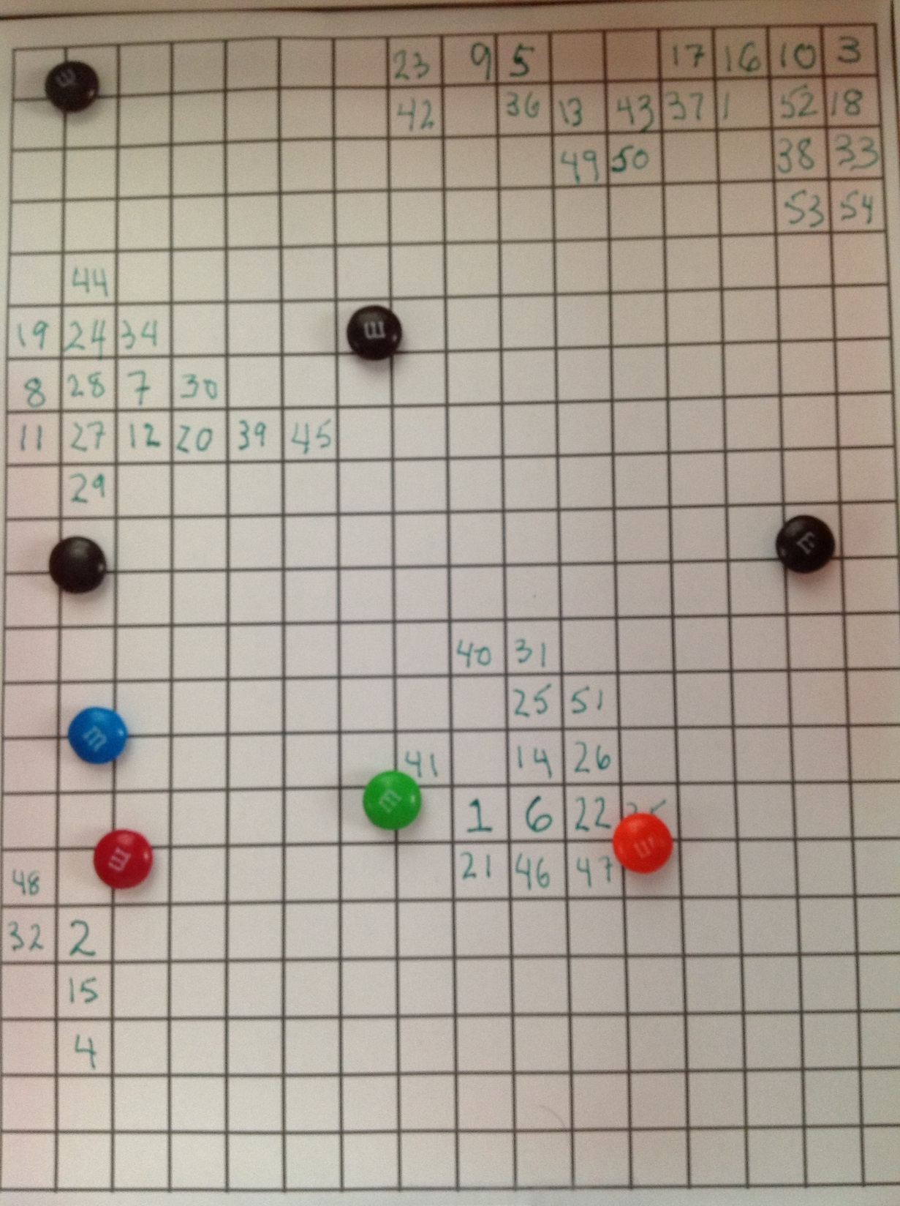
Generation 10

Slide 44
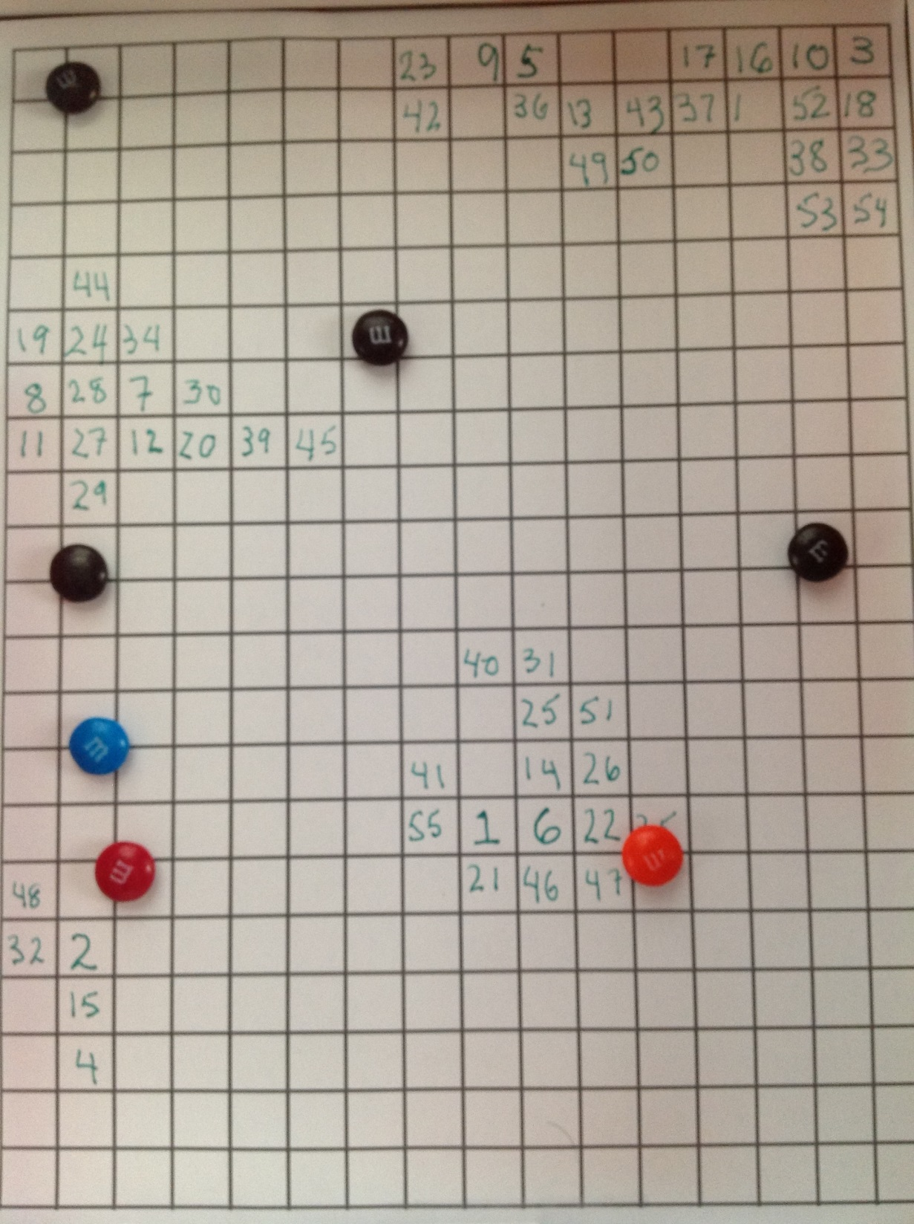
Generation 10

Slide 45
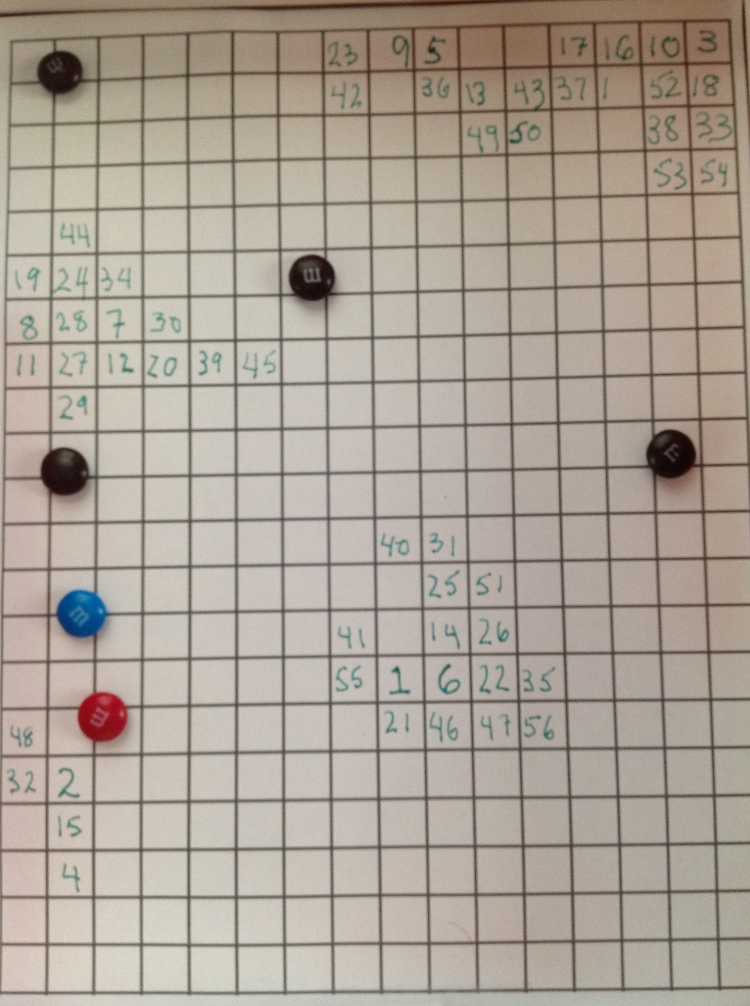
Generation 10

Slide 46

Generation 13

Slide 47

Generation 13

Slide 48

Generation 13

Slide 49

Generation 14

Slide 50

Generation 14

Slide 51

Plot of data from M&M
Generation Efforts.
Logistic mathematical model of spread of disease.

Slide 52



Solve DE and
form SSE between
Data and model.
Plot SSE = SSE(r, K) as contour plot.

Slide 53
The fit is . . . .

Slide 54



Torricelli’s Law Video on SIMIODE YouTube Channel
Build a mathematical model for height at time t,
Say h(t)
$h′(t)$= $\frac{a }{A}\sqrt{2 g h(t)}$ which we got from . . .

Slide 55


Model compared to the data we collect. . .

Slide 56
To see other examples go to www.simiode.org and register. It is FREE.
Then join the Teachers Group. It is FREE.
Resources, modeling scenarios, projects, technique narratives, and more are there.
See our videos at our SIMIODE YouTube Channel ← Type this in Google.
Each instructional unit has a Student Version with just STATEMENT while inside the
Teachers Group there is a version with STATEMENT and extensive COMMENTS
Section as well as other resources, e.g., Excel or Mathematica file with solution
strategies.
We show a sample of the variety of applications or models to motive the study of
differential equations.

Slide 57
Modeling Death and Immigration with M&M 's and Simulation
Saving for Child's College Education
Modeling the Spread of Oil Slick with Incomplete Data
Analysis of incomplete reaction data
Modeling Immigration in a Petri Dish
How long does it take an ant to build a tunnel of length x in soil?
Hang Time Modeling
Modeling the spread of ICU’s in US Hospitals from 1958-1974
Chemical Kinetics Models -Zeroth, First, and Second Order Reactions
Sublimation of Carbon Dioxide
Modeling the Emptying of a Column of Water
Modeling drugs for anesthesiology
Which melts first, a sphere or cube of ice of the same volume?
Modeling dissipation of intraocular gas bubbles used in eye surgery.
Changing temperature of container of water in a changing environment
Modeling sales of consumer products from a classic marketing study
Using data on whiffle ball fall model resistance and predict the fall position
Modeling a falling shuttlecock
Modeling Dialysis Machine
Modeling drug absorption of analgesic pain reliever under two different diets
Insect Colony Optimal Control
Modeling the amount of shampoo in a bottle during a shower
Building a model to help cross a river with current to land at specific spot
Convolution Applications – Machine Replacement Theory

Slide 58
i

Slide 59
Want to teach differential equations using modeling and technology up front and throughout the process?
Then join us at . .
SIMIODE
Systemic Initiative for Modeling Investigations
and Opportunities with Differential Equations
www.simiode.org
Thank you.

