Slide 1
Numerical Simulation of Ebola Outbreak
Capstone Project
Juan Ndong Nguema
Applied Mathematics
University of St. Thomas, Houston, TX
Advisor:
Arati Nanda Pati, PhD

Slide 2
Outline
The Ebola virus
Mathematical models
Numerical simulation

Slide 3
Importance
Preventive Response in case of an early emerging outbreak.
Resource Management
Guidelines

Slide 4
Background
Symptoms
Fever
Sore throat
Severe headache
Muscle pain
Intense Weakness
Vomiting
Diarrhea
Possible routes
infected animals
Contact objects
Touching infected individuals

Slide 5
Actual Data

Slide 6
Actual Data-Plot

Slide 7
Growth

Slide 8
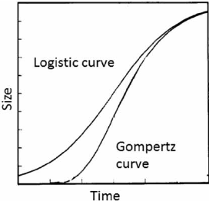
Mathematical Models
A sigmoid function is characteristic "S"-shaped:
Logistic Model
Gompertz Model
https://www.researchgate.net/figure/The-S-shaped-or-sigmoidal-curve-has-frequently-been-used-to-describe-growth-in-size_fig3_230571869.

Slide 9
Logistic Model
r/growth rate
N/size of the population
K/Carrying capacity
$\frac{dN}{dT}$=r * $\left(\frac{k−N}{K}\right)$*N

Slide 10
Gompertz Model
Same variables as Logistic Model

Slide 11
Tools
Wolfram alpha Solver
Finding polynomial roots and solving systems of equations.
Excel solver add-in
Use Solver to find an optimal (maximum or minimum) value.
K/Carrying capacity
r (per capita growth rate)

Slide 12
Logistic Model Total infected
Differential Eq:
$\frac{dy}{dt}$= r*(1 - $\frac{y}{k}$)*y
$y$(0)=49
Solution:
y(t)= $\frac{\text{49}\text{k}}{\text{49+49}\text{k}\text{∗}e^{−rt}}$
k= 27609.05
r= 0.026932
$R^{2}$= 0.994322

Slide 13
Gompertz Model Total Infected
Differential Eq:
$\frac{dy}{dt}$=r * $ln\left(\frac{k}{y}\right)$* y
y(0)=49
Solution:
y(t)= k* $e^{(\ln{((\frac{k}{49}}){∗e}^{−rt}))}$
r= 0.008885
k= 30063.63
$R^{2}$= 0.986652

Slide 14
Compare: T. Infected Models
SQ Error Gompertz | SQ Error Logistic
331184657.9 | 119538139.8

Slide 15
Logistic Model Deaths
Differential Eq:
$\frac{dy}{dt}$= r*(1 - $\frac{y}{k}$)*y
$y$(0)=29
Solution:
y(t)= $\frac{\text{2}\text{9}\text{k}}{\text{2}\text{9+}\text{2}\text{9}\text{k}\text{∗}e^{−rt}}$
k= 11120.2
r= 0.02515
$R^{2}$= 0.99446

Slide 16
Gompertz Model Deaths
Differential Eq:
$\frac{dy}{dt}$=r * $ln\left(\frac{k}{y}\right)$* y
y(0)=29
Solution:
y(t)= k* $e^{(\ln{((\frac{k}{49}}){∗e}^{−rt}))}$
r= 0.00876
k= 12017.1
$R^{2}$= 0.98762

Slide 17
Compare: Death Models
SQ Error Gompertz | SQ Error Logistic
46051092 | 19867933

Slide 18
Numerical Simulation
Euler's Method
Runge Kutta 4th

Slide 19
Euler's Method
Euler's Method, is used to analyze a Differential Equation.

Slide 20
Euler's Method

Slide 21
RK 4th
The Runge-Kutta method finds approximate value of y for a given x. Only first order ordinary differential equations can be solved by using the Runge Kutta 4th order method.

Slide 22
RK4th

Slide 23
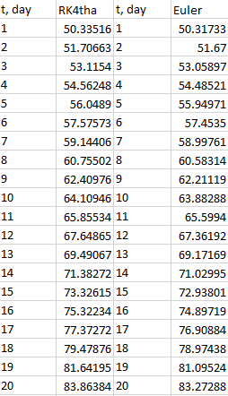
Comparison: RK4TH v Euler's Method h=1
RQ RK4TH = 0.69278
RQ Euler = 0.68964

Slide 24
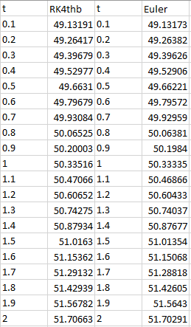
Comparison: RK4TH v Euler's Method h=0.1
RQ RK4TH = 0.9121
RQ Euler = 0.91209

Slide 25
Final Thoughts
Modeling Reality
Work Efficiency
Coronavirus
ACKOWNLEDGEMENT
https://www.simiode.org/

