Slide 1


Activity: Second order
Linear ODEs
with
Constant Coefficients
Award # 1940532

Slide 2
Purpose
This activity provides an overview of 2nd order linear homogeneous ODEs with constant coefficients, to prepare for a
separate modeling activity
Notes:
Version 1 of the materials (posted April 4) has the time as 10-11am

Slide 3
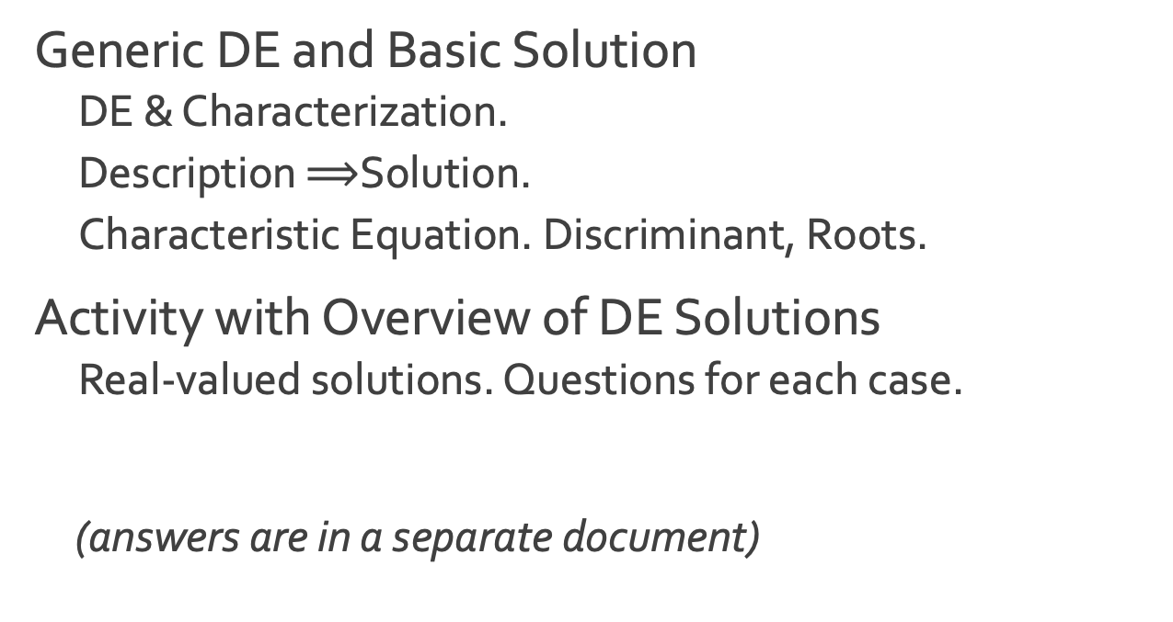
Outline
Generic DE and Basic Solution
  DE & Characterization.
  Description $⟹$Solution.
  Characteristic Equation. Discriminant, Roots.
Activity with Overview of DE Solutions
  Real-valued solutions. Questions for each case.
(answers are in a separate document)

Slide 4
DE and Basic Solution
Notes:
Version 1 of the materials (posted April 4) has the time as 10-11am

Slide 5
DE & Characterization
  (1) a y’’ + b y’ + c y = 0, a ≠ 0
  2nd order - highest order derivative is 2
linear – dependent variable and its derivatives are not inside any functions, nor are they multiplied together; all unknown terms are raised to the 1st power, scaled, and added together
  homogeneous – right hand side is zero; or all added terms in the equation are unknown
  constant coefficient - a, b, and c are not functions of t, as y is.
Notes:
Version 1 of the materials (posted April 4) has the time as 10-11am

Slide 6

Description $⟹$Solution
  (1) a y’’ + b y’ + c y = 0
  description of the equation: the function, its rate of change (velocity), and its second order rate of change (acceleration) are proportional.
  Think: There is an intuitive solution – what is it?
  In other words, for what sort of function are all of the derivatives constant multiples of each other?
Notes:
Version 1 of the materials (posted April 4) has the time as 10-11am

Slide 7
Characteristic Equation
  (1) a y’’ + b y’ + c y = 0, a≠0
  We can try a solution y = e^{r t}
  Substitute into the DE:
  a r² e^{r t} + b r e^{r t} + c e^{r t} = 0
  or, because e^{r t} is never zero,
  (2) a r² + b r + c = 0
  An algebraic equation related to the DE
  is the characteristic equation (2) for the DE.
  Think: what are the different cases roots for the characteristic equation, and of solutions to the DE?
Notes:
Version 1 of the materials (posted April 4) has the time as 10-11am

Slide 8
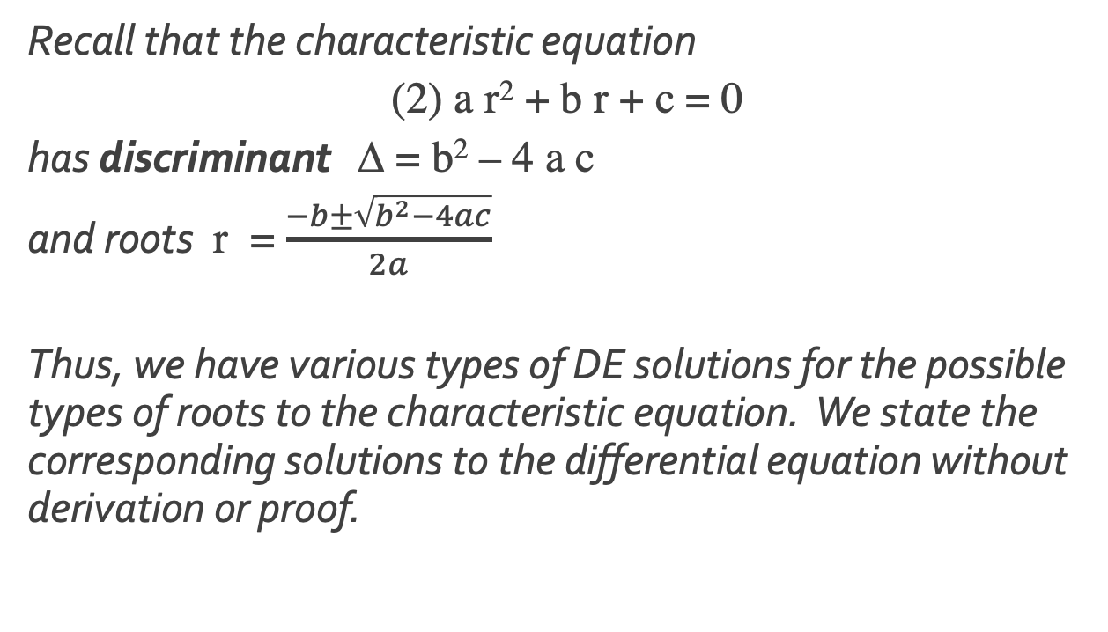
Discriminant, Roots
  Recall that the characteristic equation
  (2) a r² + b r + c = 0
  has discriminant Δ = b² – 4 a c
  and roots r = $\frac{−b±\sqrt{b^{2}−4ac}}{2a}$
  Thus, we have various types of DE solutions for the possible types of roots to the characteristic equation. We state the corresponding solutions to the differential equation without derivation or proof.
Notes:
Version 1 of the materials (posted April 4) has the time as 10-11am

Slide 9
Activity: Overview of DE Solutions
Go through the overview, ponder the questions, and record your answers
Notes:
Version 1 of the materials (posted April 4) has the time as 10-11am

Slide 10
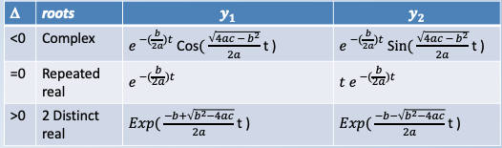
Real-valued solutions to DE
Think: Match each situation above with the appropriate description of solutions:
exponential decay/growth only
oscillatory
exponential times a linear function

Slide 11
Q: Distinct Real Roots
questions about graphs
some POSSIBLE SOLUTIONS
1. which graph shows a solution with a positive root?
2. does either graph show oscillations?
3. what is the limiting behavior of each?
a)
b)

Slide 12
Q: Complex Roots
questions about graphs
some POSSIBLE SOLUTIONS
1. which graph shows a solution with purely imaginary roots?
2. which graph shows a solution corresponding to a root with a positive real part?
3. which graph shows oscillations that decrease in amplitude?
4. which graph shows oscillations with constant amplitude?
5. what is the limiting behavior of each?
b)
c)

Slide 13
Q: Repeated Real Root
questions about graphs
some POSSIBLE SOLUTIONS
1. which is a solution for a positive root?
2. is dashed, or solid, purely exponential? (in both graphs, dashed designates a similar type of solution)
3. does either graph show oscillations?
4. what other solution possibilities exist that are not shown here?
5. what is the limiting behavior of each?
a)
b)

Slide 14
Now Check the Answers
Notes:
Version 1 of the materials (posted April 4) has the time as 10-11am

Slide 15
You completed an overview of 2nd order linear homogeneous ODEs with constant coefficients in general.
Remember: Knowing multiple ways to interpret a differential equation can help you solve/analyze it effectively and skillfully apply it as a model.
Proceed to the answers to this activity, and then onto the modeling activity

